Slide 1


Slide 2
ITEC 275
Computer Networks – Switching, Routing, and WANs
Week 4
Professor Robert D’Andrea
Fall 2017

Slide 3
Agenda
Learning Activities
  Logging into the VMware View Client
  Commands
  Lite review of week three slides
  Traffic flow
  Traffic flow device configurations
  ATM
  QoS
  GoS

Slide 4
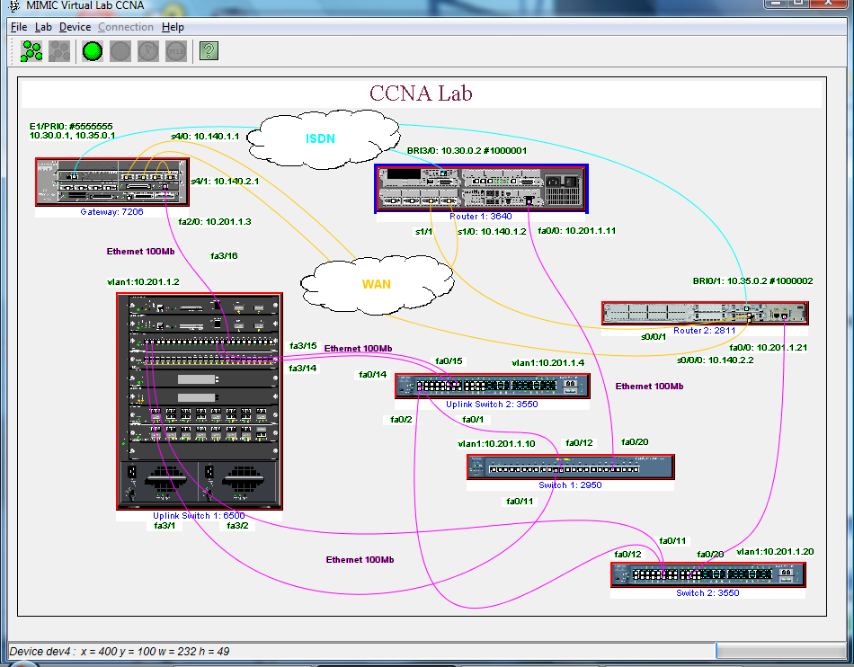
MIMIC Virtual Lab CCNA

Slide 5
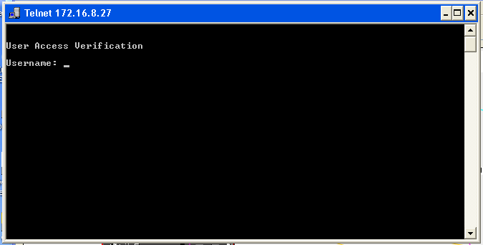
Telnet into device

Slide 6
Command: ?
Exec commands:
clear Reset functions
clock Configure serial interface clock
configure Enter configuration mode
connect Open a terminal connection
copy Copy from one file to another
debug Debugging functions (see also 'undebug')
delete Delete a file
disable Turn off privileged commands
disconnect Disconnect an existing network connection
enable Turn on privileged commands
erase Erase a filesystem
exit Exit from the EXEC
help Description of the interactive help system
logout Exit from the EXEC
no Negate a command or set its defaults
ping Send echo messages
reload Halt and perform a cold restart
show Show running system information
systat Display information about terminal lines

Slide 7
Command: Show ?
access-lists List access lists
aliases Display alias commands
arp ARP table
backup Backup status
buffers Buffer pool statistics
cdp CDP information
clock Display the system clock
compress Show compression statistics
configuration Contents of Non-Volatile memory
controllers Interface controller status
dialer Dialer parameters and statistics
flash: display information about flash: file system
frame-relay Frame-Relay information
history Display the session command history
hosts IP domain-name, lookup style, nameservers, and host table
interfaces Interface status and configuration
ip IP information
ipv6 IPv6 information
isis IS-IS routing information
location Display the system location
logging Show the contents of logging buffers
modemcap Show Modem Capabilities database
privilege Show current privilege level
protocols Active network routing protocols
running-config Current operating configuration
snmp snmp statistics
startup-config Contents of startup configuration
terminal Display terminal configuration parameters
users Display information about terminal lines
version System hardware and software status

Slide 8
Command: Configure
Configure commands:
access-list Add an access list entry
alias Create command alias
banner Define a login banner
cdp Global CDP configuration subcommands
class-map Configure QoS Class Map
dialer-list Create a dialer list entry
enable Modify enable password parameters
end Exit from configure mode
exit Exit from configure mode
frame-relay global frame relay configuration commands
help Description of the interactive help system
hostname Set system's network name
interface Select an interface to configure
ip Global IP configuration subcommands
ipv6 Global IPv6 configuration subcommands
isdn ISDN configuration commands
key Key management
line Configure a terminal line

Slide 9
Command: Configure
Configure commands:
logging Modify message logging facilities
no Negate a command or set its defaults
policy-map Configure QoS Policy Map
router Enable a routing process
snmp-server Modify SNMP parameters
trunk Configure a trunk group
username Establish User Name Authentication

Slide 10
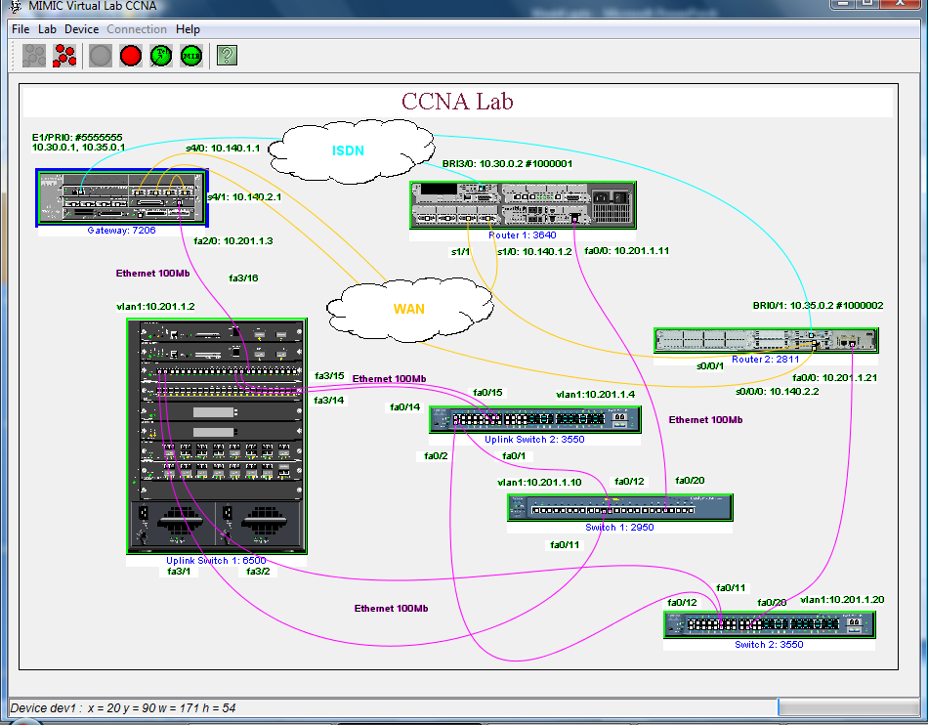
Exercise Demonstration

Slide 11
WARNING!
Every VMware View Client login is a new session
  Any previous work will be lost unless saved to a local drive
  Any files uploaded for a project will have to be reloaded

Slide 12
Review Week Three
Characterize the infrastructure of the existing network
- Develop a set of network maps
- Learning the locations of major internetworking devices
- Identify all network segments
- Identify any standard methods for addressing and naming convention

Slide 13
Review Week Three
Document
-Types and lengths of actual cable and fiber
- Investigate architectural constraints
- Investigate environmental constraints
- Investigate important aspects of characterizing the network infrastructure.

Slide 14
Week Three Review
How to begin characterizing?
Top-down method that shows high-level to low-level information.
Global
WAN
WAN to LAN
Identify each campus network
Buildings, floors, and rooms
Location(s) of servers and main-frames
Location(s) of routers and switches
Location(s) of LANs and VLANs
Create a map that displays network services

Slide 15
Review Week Three
Characterize the logical architecture
- Develop network diagrams of the company
- Develop modular block diagrams
Characterize the network addressing and naming
Characterize wiring and media
- Develop wiring within buildings
- Verify architecture and environmental constraints
- Develop any wireless installations with a wireless site survey

Slide 16
Review Week Three
Baseline the existing network
  Dedicate the right amount of time for the baseline
  Record the existing networks errors
  Record the existing networks packet/cell loss
  Record the existing networks latency issues during normal operating times
  Record the existing networks performance

Slide 17
Review Week Three
Analyze the network availability
Analyze the network utilization
- Bandwidth used by applications
- Bandwidth used by protocols
Analyze the network accuracy
Analyze the network efficiency
Analyze the delays and response times

Slide 18
Week Four
Characterize traffic flow
- Involves identifying the sources and destinations
- Analyzing the direction of traffic
- Analyzing the symmetric of traffic

Slide 19
Week Four
Identify User Communities and Data Stores
A user community is a group of workers who use a particular application. They can exist in a department or group of departments.
A User Communities chart should be utilized to record this type of information in.
A data store is an area in a network where application layer data resides. A data store can be a number of components; server, server farm, a storage-area network (SAN), main-frame, a tape backup unit, a digital video library, or where large quantities of data are stored.

Slide 20
Week Four
Documenting Traffic Flow of the Existing Network
Identify and characterize individual traffic flows between traffic source and stores.
To understand traffic flow better by reading RFC 2722.
Measuring traffic flow behavior
Characterize the behavior of existing networks
Plan for network development and expansion
Quantify network performance
Verify the quality of network services
Assign network usage to users and applications

Slide 21
Week Four
Documenting Traffic Flow of the Existing Network
Flow has attributes:
Direction
Symmetry
Routing path and routing options
Number of packets
Number of bytes
Addresses for each end of the flow
Characterizing the size of a flow by measuring the number of megabytes per second (MBPS) with a protocol analyzer.

Slide 22
Week Four
Traffic Flow
Bidirectional and symmetric is when both ends of the flow send traffic at the same rate.
Bidirectional and asymmetric is when the client sends small queries and servers send large streams of data.
Broadcast flow is unidirectional and asymmetric.

Slide 23
Week Four
Typical flows found in major vendor devices are
Foundry Networks
Cisco
3COM
Juniper
HP
SolarWinds

Slide 24
Week Four
Typical flow formats like
Netflow
sflow
cflow
j-flow
Appflow
Netstream
FNF
IPFIX

Slide 25
Week Four
Netflow Analyzer Capabilities
Bandwidth monitoring and traffic analysis Monitor network bandwidth and traffic patterns at an interface level
Network forensics and security analysis
Detect a broad array of external and internal security threats
Application-centric monitoring and shape application traffic
Recognize and classify non-standard applications that hog your network bandwidth

Slide 26
Week Four
Netflow Analyzer Capabilities
Capacity planning and billing
Make informed decisions on your bandwidth growth using capacity planning reports
Monitor voice, video and data effectively
Analyze IP service levels for network-based applications and services
Multivendor support and flow technology
Collects and reports on different vendor products

Slide 27
Week Four
What is Netflow?
NetFlow is a network protocol developed by Cisco for collecting IP traffic information and monitoring network traffic. By analyzing flow data, a picture of network traffic flow and volume can be built.

Slide 28
Week Four
Cisco NetFlow collects and measures data as it enters a router and switch interface, it’s source, and destination , IP address, source and destination TCP or UDP port numbers, packet and byte counts.
The objective is to document the megabytes per second between pairs of autonomous systems, networks, hosts, and applications.
Use the Network Traffic Flow on the Existing Network form to document this information.

Slide 29
Week Four
Cisco NetFlow
Packets enter the router interface. If the router has never seen the packet it will make an entry in the Flow Cache table. The Flow Cache table contains the following fields:
  Destination IP
  Source IP
  Destination Port
  Source Port
  Source Interface
  Protocol TCP
  Bytes

Slide 30
Week Four

Slide 31
Week Four
Cisco NetFlow
The packet information is recorded in the Flow Cache and routed out to the destination interface. As the succeeding packets that match the existing Flow Cache flow through the router, the byte and packet counts keep incrementing for each packet.
Destination IP: 1.1.1.1
Source IP:2.2.2.2
Destination Port: 80
Source Port:5555
Source Interface: 1
Protocol TCP: TCP
Bytes: 92

Slide 32
Week Four
Cisco NetFlow
Packets that entered the router that have a different flow entry are first determined to be routable. If so, then they are entered into the Flow Cache. A flow cache can contain hundreds of thousands of entries, and into the millions. When the NetFlow expires, then they are sent to the NetFlow Collector, which will analyze and archive the flows for future reference.
Destination IP: 1.1.1.1 3.3.3.3
Source IP:2.2.2.2 3.4.4.4
Destination Port: 80 80
Source Port:5555 8888
Source Interface: 1 2
Protocol TCP: TCP TCP
Bytes: 800 60

Slide 33
Week Four
Cisco NetFlow
These records are later checked for the following:
  Threats detected
  Network topology
  Graphical trends
NetFlow is used to find
Bandwidth Monitoring – finding the hogs on the system
Comprehensive Cyber threats forensics
Isolating application slowness
Billing based on usage.

Slide 34
Week Four
Cisco NetFlow
Many hardware vendors are adopting IPFIX, which is the standard for NetFlow – the official flow for all technologies.
  IPFIX and NetFlow can be found in hardware and software
  Used as real time technologies
  Used for packet and flow sampling

Slide 35
Week Four
Characterize types of Traffic Flow for the New Network Applications
Terminal/host traffic flow (Telnet, asymmetric)
Client/server traffic flow (Thin client, bidirectional and asymmetric)
Peer-to-peer traffic flow (ftp, NFS, and HTTP, bidirectional and symmetric)
Server/server traffic flow ( implement directory services, cache heavily used data, and to mirror data, bidirectional and symmetric)
Distributed computing traffic flow (task manager, applications that require multiple computing nodes)

Slide 36
Week Four
Client/Server Model:
There is a piece of software on the client and a piece of software on the server. The server software sits and waits for the clients to make a request of the server. Envision the server as a robot, go here, get this, and return this. The server performs whatever the client requests and returns it to the client.
The server is no special machine, it can be any machine or your machine. It does have some unique characteristics. It has no monitor, configured with a particular architecture to access and retrieve files quickly. Servers normally have large mounts of memory and data storage capabilities. Generally, servers are connected to the Internet 24/7.

Slide 37
Week Four
Client Server Model:
Client sends a request to the web server.
The server retrieves the file
Sends the file (HTML) to the client.
The client software is a browser (IE, FireFox, Chrome), receives and displays the information.

Slide 38
Week Four
Client Server Model

Slide 39
Week Four
Client Server Model
The servers have ports. These ports act as numbered doorways. Behind each door is a unique software application. The doorway numbers (ports) are as follows:
20 & 21 FTP
22 SSH
23 Telnet
25 SMTP
53 DNS
80 HTTP (used for World Wide Web)
443 HTTPs

Slide 40
Week Four
Client Server Model
All nodes on a network act as clients. When these systems need to access a resource, they each request the resource(s) from a particular location known as a server. A server provides a specific resource for a network, such as, database, email, printer, Internet, …

Slide 41
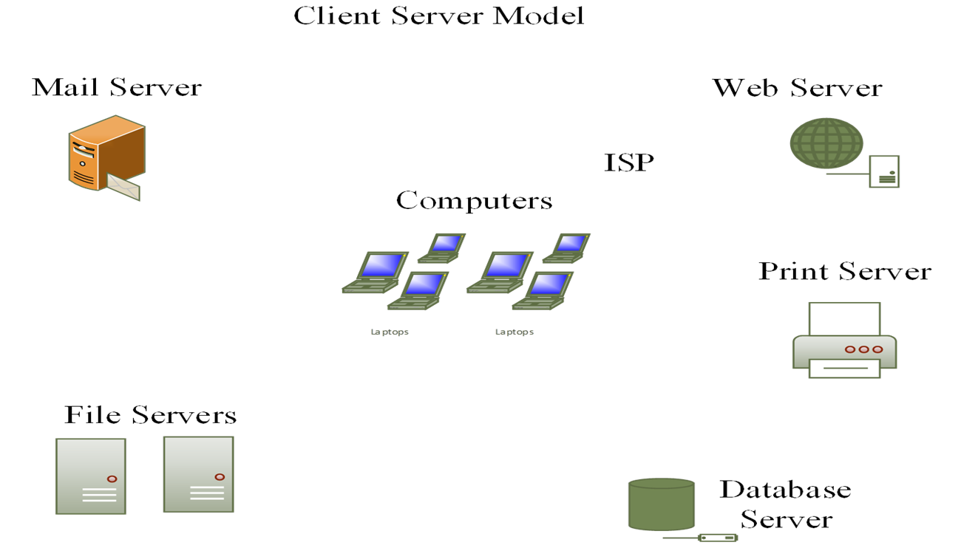
Week Four

Slide 42
Week Four
Peer-To-Peer Model
The computers are equal to each other. One computer can perform the same tasks.

Slide 43
Week Four

Slide 44
Week Four
Traffic Flow in Voice over IP Networks
  Involves two flows
  Audio (peer-to-peer flow, Real-Time Transport Protocol )
  Set up and tear down (client/server flow)

Slide 45
Week Four
Document Traffic Flow for New and Existing Network Applications
Use the Network Application Traffic Characteristics form to identify traffic flow for new and existing network applications.
Characterize Traffic Load
  Traffic load information can help characterize networks with sufficient capacity for local usage and internetwork flows. Estimating traffic loads is difficult. Try to avoid bottlenecks in your network design.

Slide 46
Week Four
Calculate Theoretical Traffic Load
The traffic load is the sum of all the data, all network nodes that are ready to send at a particular time, like horses exiting the starting gates at the same time. The goal is to design the network capacity to be more than adequate to handle the traffic load.
The number of stations
The average time that a station is idle between sending frames.
The time required to transmit a message once medium access is gained.

Slide 47
Week Four
Document Application Usage Patterns
  - Identify user communities
    Identify the applications users use
Refine Estimates of Traffic Load Caused by Applications
- Revisit the size of the data objects sent by applications
- The overhead caused by protocol layers, and any other load caused by application initialization.

Slide 48
Week Four
Traffic Overhead for the Different Protocols
Preamble
Header
Payload
System Level Protocols
Address Resolution Protocol (ARP)
Dynamic Host Configuration Protocol (DHCP)
Internet Control Message Protocol (ICMP)
Domain Name System (DNS)
Multicast DNS (mDNS)
NetBIOS name queries ( runs on the session layer of the OSI model)
Network Time Protocol (NTP)
Simple Service Discovery Protocol (SSDP)
Service Location Protocol (SLP)
Simple Network Management Protocol (SNMP)

Slide 49
Week Four
Broadcast/Multicast Traffic
- A broadcast frame goes to all network stations on a LAN. Routers do not forward broadcasts.
IPv6: FF:FF:FF:FF:FF:FF (128 characters)
- A multicast frame goes to a subset of stations.
IPv6: 01:00:0C:CC:CC:CC
Cisco routers and switches running Cisco Discovery Protocol (CDP) on a LAN.

Slide 50
Week Four
VLAN
Allow users to be subdivided into subnets by associating switch ports with one or more VLANs. A VLAN can span many switches, broadcast traffic within a VLAN is not transmitted outside the VLAN.
Broadcast radiation is a term used to describe the affect of broadcasts spreading from the sender to all other devices in a broadcast domain. Broadcast radiation can impact your endpoints network performance.

Slide 51
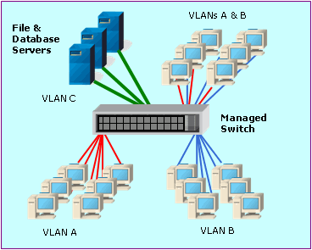
Week Four
VLAN

Slide 52
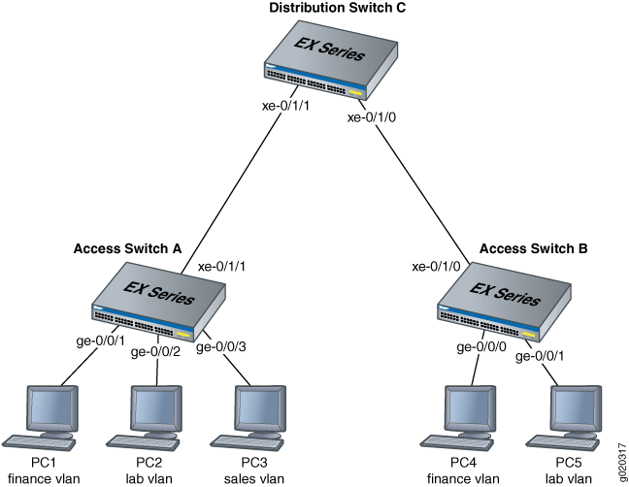
Week Four
VLAN

Slide 53
Week Four
Network Efficiency
Efficiency refers to whether applications and protocols use bandwidth effectively. Efficiency is affected by
- Frame size (maximum transmission unit MTU))
- Interaction of protocols used by an application
- Windowing and flow control (recipient states in TCP packet how much data it is ready to receive (receive window).
- Error-recovery methods

Slide 54
Week Four
Characterize the IP-based applications running on top of UDP and TCP.
File Transfer Protocol (FTP, TCP)
Telnet (TCP)
Simple Mail Transfer Protocol (SMTP, TCP)
Hypertext Transfer Protocol (HTTP, TCP)
Simple Network Management Protocol (SNMP, UDP)
Domain Name System (DNS, UDP)
Trivial File Transfer Protocol (TFTP, UDP)
DHCP server (UDP)
DHCP client (UDP)
remote Procedure Call (RPC, UDP)

Slide 55
Week Four
Characterize Quality of Service Requirements
Are the requirements flexible or inflexible
- Voice and video are inflexible applications regarding bandwidth. - Data transmissions a flexible when dealing with insufficient bandwidths.

Slide 56
Week Four
ATM (Asynchronous Transfer Mode) QoS Specs
- Constant bit rate (CBR)
- Real-time variable bit rate (rt-VBR)
- Non-real time bit rate (nrt-VBR)
- Unspecified bit rate (UBR)
- Available bit rate (ABR)
- Guaranteed frame rate (GFR)

Slide 57
Week Four
Constant Bit rate Service CRB)
Source end system reserves network resources in advance and requests a guarantee that the negotiated QoS be assured to all cells.
CBR service is intended to support real-time applications.
Real-time Variable Bit Rate Service (rt-VBR)
Connections are characterized in terms of a peak cell rate (PCR), sustained cell rate (SCR), and maximum burst size (MBS).

Slide 58
Week Four
Non-real-time Bit Rate Service (nrt-VBR)
Intended for non-real-time applications.
Data flow is bursty
Unspecified Bit Rate Service (UBR)
Does not specify any traffic related guarantees.
Available Bit Rate Service (ABR)
Use resource management (RM) cells to communicate back to the source any traffic flow changes.

Slide 59
Week Four
Guaranteed Frame Rate Service (GFR)
GFR is designed for applications that require a minimum rate guarantee and can benefit from dynamically accessing additional bandwidth available in the network.

Slide 60
Week Four
IETF Integrated Services Working Group QoS
Resource Reservation Protocol (RSVP) is considered a set up protocol used by a host to request specific qualities of service from the network for particular application flow. RSVP is used by routers to deliver QoS requests to other routers along the paths of a flow. RSVP requests resources being reserved in each node along the path.

Slide 61
Week Four
Controlled-Load Service
Provides a client with a data flow and Quality of Service (QoS) closely approximated to the QoS a flow would receive on an unloaded network.
The controlled-load service is intended for applications that are highly sensitive to over-loaded conditions, such as real-time applications.

Slide 62
Week Four
Guaranteed Service
RFC 2212 describes the guaranteed bandwidth and delay characteristics.
Guaranteed service provides a firm limit on end-to-end packet-queuing delays.

Slide 63
Week Four
Grade of Service Requirements for Voice Applications
Voice traffic need a high grade of service (GoS).
GoS refers to the fraction of calls that are successfully completed in a timely manner. A network must have high availability to meet the GoS requirement.

Slide 64
Week Four
Document QoS Requirements
- Document applications with inflexible requirements for constant bandwidth, delay, delay variation, accuracy, and throughput.
- Document applications that just expect a best effort network transmission.

Slide 65




This Week’s Outcomes
Logging into the VMware View Client
Accessing the MIMIC Virtual Lab CCNA
Introduce Cisco IOS
Review week three
Characterize traffic flows, user communities,
Data stores
Traffic flows
QoS
GoS

Slide 66
Due this week
3-1 – Concept questions 3

Slide 67
Next week
Read chapters 4 and 5 in
Top-Down Network Design
4-2-1 – Simulator Tutorial and Basic IOS Command Exploration
Midterm exam (week 8) outline June 19 through 24, 2017.

Slide 68
Q & A
Questions, comments, concerns?

