Slide 1
ITEC275 WinterWeek Fourteen Professor Robert D’Andrea

Slide 2
Week Fourteen Agenda
Are there any assignments that have not been graded?
Administration of the final exam will also be at the Student Learning Center.
Final exam review link for this class has been requested.
If you experience problems taking the final exam, call me immediately at 614.519.5853.
Your final exam status will be posted on the course web page in the folder named, Final Exam Status.

Slide 3
Week Fourteen Agenda
Current Week Discussions
Wireless NIC’s
Access Point
Coverage Area
LAN Security
Designing WLANs

Slide 4
Wireless NICs
The device that makes a client station capable of sending and receiving RF signals is the wireless NIC.
Like an Ethernet NIC, the wireless NIC, uses the modulation technique it is configured to use, encodes a data stream onto an RF signal.
Wireless NICs are most often associated with mobile devices, such as laptop computers.
In the 1990s , wireless NICs for laptops were cards that slipped into the PCMCIA slot.
PCMCIA wireless NICs are still available, but manufacturers build the wireless NIC right into the laptop.

Slide 5
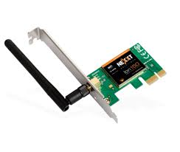
Wireless NICs

Slide 6
Wireless NICs
Unlike IEEE 802.3 standard Ethernet interfaces built into PCs, the wireless NIC is not visible, because there is no requirement to connect a cable to it.

Slide 7
What is a Wireless Access Point (AP)
An access point connects wireless clients (or stations) to the wired LAN.
An access point is a Layer 2 device that functions like an IEEE 802.3 Ethernet hub.
Client devices do not typically communicate directly with each other; they communicate with the AP.
In essence, an access point converts the TCP/IP data packets from their IEEE 802.11 frame encapsulation format in the air to the IEEE 802.3 Ethernet frame format on the wired Ethernet network.

Slide 8
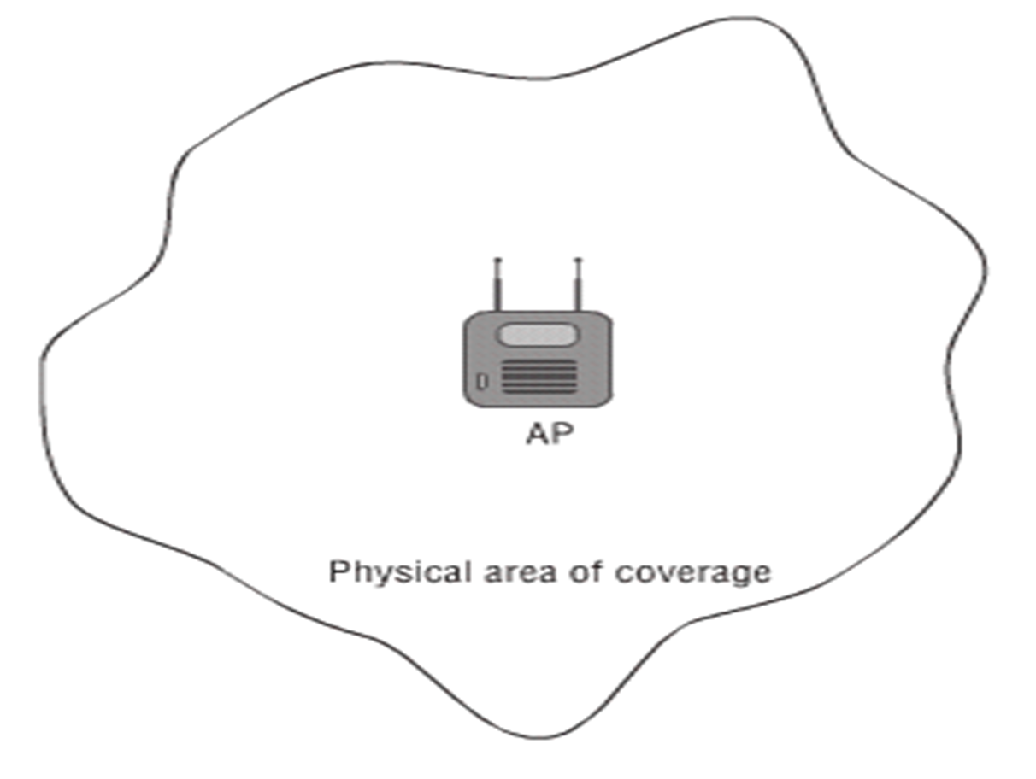
Access Point’s Area of Coverage

Slide 9
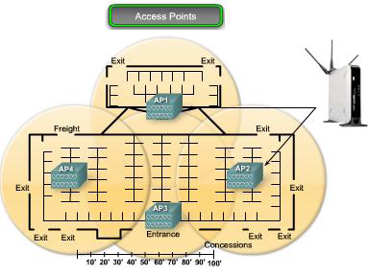
Wireless Access Point (AP)

Slide 10
WLAN Operation
The coverage area of an AP is called the Basic Service Set (BSS). Otherwise known as a cell.
A Service Set Identifier (SSID) is a wireless network name transmitted by the WLAN.
Roaming occurs when a wireless client moves from one AP area to another. Basically, moving from one cell to another cell within the same SSID.

Slide 11
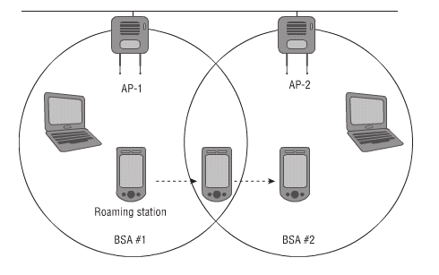
Mobility in a LAN

Slide 12
Communication Security
Authentication: Only legitimate clients are allowed to access the network via trusted APs.
Encryption: Securing the confidentiality of transmitted data. Encryption is a piece of technology that works by scrambling data so it is unreadable by unintended parties.
Triple DES - Replaced Data Encryption Standard. Triple DES uses three individual keys with 56 bits each. The total key length adds up to 168 bits.
RSA - RSA is a public-key encryption algorithm and the standard for encrypting data sent over the internet.

Slide 13
WLAN Security
Blowfish - This symmetric cipher splits messages into blocks of 64 bits and encrypts them individually.
Twofish - Keys used in this algorithm may be up to 256 bits in length and as a symmetric technique, only one key is needed.
AES - Although it is extremely efficient in 128-bit form, AES also uses keys of 192 and 256 bits for heavy duty encryption purposes. AES is largely considered impervious to all attacks, with the exception of brute force, which attempts to decipher messages using all possible combinations in the 128, 192, or 256-bit cipher. Still, security experts believe that AES will eventually be hailed the de facto standard for encrypting data in the private sector.
Intrusion detection and intrusion protection: Monitors, detects, and reduces unauthorized access and attacks against the network.

Slide 14
WLAN Security
Intrusion detection and intrusion protection:
Cisco security researchers recently found that malicious traffic was visible on 100% of the networks sampled for the Cisco Midyear Security Report. Worse, the breaches were entirely undetected. The moral of the story? Traditional security measures no longer work. It’s next-gen time.

Slide 15
Wireless Network Technologies
Personal-area network (PAN): A persons personal workspace.
Local-area network (WLAN): A network design to be enterprise-based network that allows the use of complete suites of enterprise applications, without wires.
Metropolitan-area network (MAN): Deployed inside a metropolitan area, allowing wireless connectivity throughout an urban area.
Wide-area network (WAN): A wider but slower area of coverage, such as rural areas.

Slide 16
Autonomous Access Point
Originally, WLANs were all the same configuration and management at each access point. This type of access point was considered a stand-alone device.
The term referring to the stand-alone device was a fat AP, or most commonly called today, an autonomous AP.
All encryption and decryption mechanisms and MAC layer mechanisms also operate within the autonomous AP.

Slide 17
Autonomous Access Point
Autonomous AP require power in usually non-traditional places.
Two solutions:
1. Power of Ethernet (PoE) and power injectors. This power is inline with the
Ethernet port, over the Category 5 cable.
2. Mid-span power injectors is a stand-alone
unit, positioned into the LAN between the
Ethernet switch and the device requiring
power.

Slide 18
Autonomous Access Point
IEEE 802.1X Standard is used for wireless client authentication, dynamic encryption keys can be distributed to each user each time that user authenticates on the network. Wi-Fi Alliance also introduced Wi-Fi Protection Access (WPA) to enhance encryption and protect against all known Wired Equivalent Privacy (WEP) key vulnerabilities. The Wi-Fi Alliance interoperable implementation of IEEE 802.11i with AES is called WPA2.

Slide 19
Autonomous Access Point
The autonomous AP acts as an IEEE 802.1Q translational bridge and is responsible for putting the wireless client RF traffic into the appropriate local VLAN on the wired network.

Slide 20
Designing a Wireless Network
An RF Site Survey is used for many reasons in a wireless network design, and the process to conduct such a survey.
It is the first step in the design and deployment of a wireless network and the one to insure desired operation.

Slide 21
Designing a Wireless Network
The RF Site Survey is used to study the following facility areas:
To understand the RF characteristics in the environment.
Plans and reviews RF coverage areas.
Check for RF interference.
Determine the appropriate placement of wireless infrastructure devices.

Slide 22
Designing a Wireless Network
In a wireless network, issues could prevent the RF signal from reaching many parts of the facility. To address these issues, weak signal strength regions must be addressed and identified.

Slide 23
Designing a Wireless Network
RF Site Survey Process
Define customer requirements number and types to support devices.
Identify coverage areas and user density facility diagram, and do a visual inspection.
Determine preliminary AP locations existing power, cabling, cell coverage and overlap.
Perform the actual survey of the actual AP locations after installation.
Document the findings record device locations and signal readings (baseline).

Slide 24
Designing a Wireless Network
Use of a Graphical heat map helps identify and visualize anticipated WLAN behavior for planning and fast rollout. A heat map diagrammatically represents signal strength. The warmer the color, the stronger the signal.

Slide 25
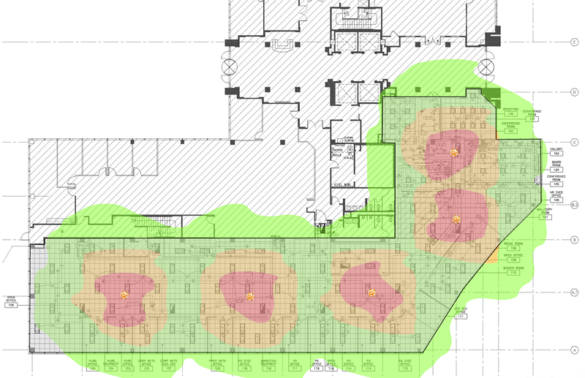
Designing a Wireless Network
Graphical Heat map

Slide 26
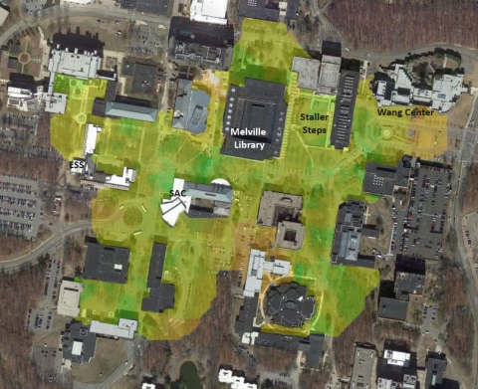
Designing a Wireless Network
Stony Brook’s outdoor wireless network map

Slide 27
Security Issues
Early networks were not designed for security as all users were trusted and the network was not international.
Modern network security requirements include the following:
Prevent external hackers from getting access to the network.
Allow only authorized users into the network.
Prevent those inside the network from executing deliberate or inadvertent attacks.
Provide different levels of access for different types of users.
Protect data from misuse and corruption.
Comply with security legislation, industry standards, and company policies.

Slide 28
Legislation and Security
The U.S. Gramm-Leach-Bliley Act of 1999 (GLBA)
provides limited privacy protections against the sale of private financial information and codifies protections against pretexting (concealing).
The U.S. Health Insurance Portability and Accountability Act (HIPAA)
to enable better access to health insurance, reduce fraud and abuse, and lower the overall cost of health care in the United States.
European Union data protection Directive 95/46/EC
requires that European Union member states protect people's privacy rights when processing personal data, and that the flow of personal data between member states must not be restricted or prohibited because of these privacy rights.

Slide 29
Legislation and Security
The U.S. Sarbanes-Oxley Act of 2002 (SOX)
establishes new or enhanced auditing and financial standards for all U.S. public company boards, management, and public accounting firms.
Payment Card Industry (PCI) Data Security Standard (DSS)
developed to ensure safe handling of sensitive payment information.
The Canadian Personal Information Protection and Electronic Documents Act (PIPEDA):
establishes rules for managing personal information by organizations involved in commercial activities.

Slide 30
Security Terminology
Virus
A program that triggers a damaging outcome to a computer and/or network.
Trojan horse
Pretends to be an inoffensive application when in fact it might contain a destructive payload.
SPAM
Unsolicited or unwanted email that may contain viruses or links to compromised web sites.
Spyware
A program that gathers information without the user's knowledge or consent and sends it back to the hacker.

Slide 31
Security Terminology
Phishing
Emails that try to convince the victim to release personal information.
Email appears to come from a legitimate source
directs the victim to website that looks legitimate.
Spear phishing
Very targeted phishing attack may seem to come from a bank or IRS or from a creditable source to gain access to accounts.

Slide 32
Security Terminology
Social engineering
The practice of obtaining confidential information by manipulating legitimate users. Examples include the following:
Getting physical access: A hacker might get confidential information and passwords by having physical access to the organization. For example, the hacker might visit an organization and see passwords that are insecurely posted in an office or cubicle.
Using a psychological approach: A hacker might exploit human nature to obtain access to confidential information. For example, a hacker might send an email or call and ask for passwords, pretending that the information is required to maintain the victim's account.

Slide 33
Threats
Reconnaissance:
The active gathering of information about an enemy or target
to learn as much as possible about the target and the involved systems.
Usually the prelude to an attack against a particular target.
Gaining unauthorized system access:
The next step after reconnaissance
gaining access to the system by exploiting the system or using social engineering techniques.
Denial of service (DoS):
Does not require direct access to a system
is used to make systems unusable by overloading their resources such as CPU or network bandwidth.
Multiple sources conduct DoS attacks, which are called a Distributed DoS (DDoS) attack.

Slide 34
Targets of Reconnaissance Attacks
Active targets (hosts/devices currently communicating on the network).
Network services that are running continuously.
Operating system platforms that are not secured.
Trust relationships rather than objective software or hardware defenses.
File and directory permissions not set properly.
User account information not secured properly.

Slide 35
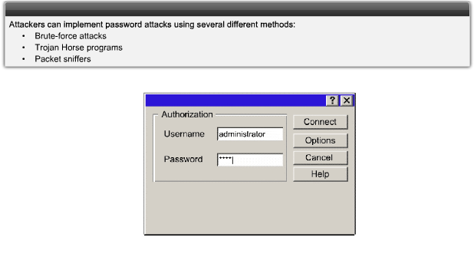
Threat: Gaining Unauthorized Access to Systems
Use of usernames and passwords by unauthorized persons

Slide 36
DoS Threat
DoS attacks are aggressive attacks on an individual computer or groups of computers with the intent to deny services to intended users.
DoS attacks can target end user systems, servers, routers, and network links.
Video on DoS and DDOS:
https://www.youtube.com/watch?v=0VutW15kEZM
https://www.youtube.com/watch?v=1YiYBoeci7k

Slide 37
Mitigate DoS Attack
What is Cisco DHCP Snooping?
DHCP snooping is a security feature that acts like a firewall between untrusted hosts and trusted DHCP servers. The DHCP snooping feature performs the following activities:
Validates DHCP messages received from untrusted sources and filters out invalid messages.
Rate-limits DHCP traffic from trusted and untrusted sources.
Builds and maintains the DHCP snooping binding database, which contains information about untrusted hosts with leased IP addresses.
Utilizes the DHCP snooping binding database to validate subsequent requests from untrusted hosts.

Slide 38
Mitigate DoS Attack
Use Cisco DHCP Snooping to verify DHCP transactions and protect against rogue DHCP servers. DHCP Snooping filters DHCP packets.
Use Dynamic Address Resolution Protocol (ARP) Inspection (DAI) to intercept all ARP requests and replies on untrusted interfaces (ports).
Implement unicast reverse path forwarding checks to verify if the source IP address is reachable so that packets from malformed or forged source IP addresses are prevented from entering the network.
Implement access control lists (ACL) to filter traffic.
Rate-limit traffic such as incoming ARP and DHCP requests.

Slide 39
Port Scanners
Network Mapper (Nmap): Nmap is a free open-source utility for network exploration or security auditing. It was designed to rapidly scan large networks; it also maps single hosts.
NetStumbler: Net Stumbler is a tool for Microsoft Windows that facilitates detection of WLANs using the IEEE 802.11b, 802.11a, and 802.11g WLAN standards. A trimmed-down version of the tool called MiniStumbler is available for Windows.
SuperScan: Super Scan is a popular Windows port-scanning tool with high scanning speed, host detection, extensive banner grabbing, and Windows host enumeration capability.

Slide 40
Port Scanners (con’t)
Kismet: Kismet is an IEEE 802.11 Layer 2 wireless network detector, sniffer, and IDS that can sniff IEEE 802.11b, 802.11a, and 802.11g traffic. It identifies networks by passively collecting packets and detecting standard named networks, detecting hidden networks, and inferring the presence of non-beaconing networks (networks that do not advertise themselves) via data traffic.

Slide 41
Vulnerability Scanners
Nessus: Nessus is an open-source product designed to automate the testing and discovery of known security problems. A Windows graphical front end is available, although the core Nessus product requires Linux or UNIX to run.
Microsoft Baseline Security Analyzer (MBSA): Although it’s not a true vulnerability scanner, companies that rely primarily on Microsoft Windows products can use the freely available MBSA. MBSA scans the system and identifies whether any patches are missing for products such as the Windows operating systems, Internet Information Server, SQL Server, Exchange Server, Internet Explorer, Windows Media Player, and Microsoft Office products. MBSA also identifies missing or weak passwords and other common security issues.

Slide 42
Vulnerability Scanners
Security Administrator’s Integrated Network Tool (SAINT): SAINT is a commercial vulnerability assessment tool that runs exclusively on UNIX.

Slide 43
Risks
Confidentiality of data:
Ensures that only authorized users can view sensitive information.
Prevents theft, legal liabilities, and damage to the organization.
Integrity of data:
Ensures that only authorized users can change sensitive information.
Guarantees the authenticity of data.
System and data availability:
Ensures uninterrupted access to important computing resources.
Prevents business disruption and loss of productivity.

Slide 44
Risks of Integrity Violations and Confidentiality Breaches
Integrity violations can occur when an attacker attempts to change sensitive data without proper authorization.
Confidentiality breaches can occur when an attacker attempts to read sensitive data without proper authorization.
Confidentiality attacks can be extremely difficult to detect because the attacker can copy sensitive data without the owner’s knowledge and without leaving a trace.

Slide 45
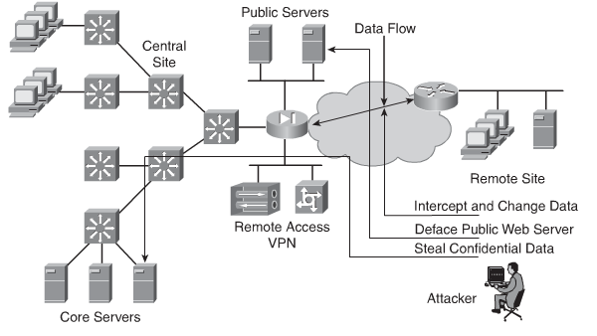
Risks of Integrity Violations and Confidentiality Breaches

Slide 46
Mitigation
Limit access to network resources using network access control, such as physical separation of networks, restrictive firewalls, and VLANs.
Limit access to files and objects using operating system-based access controls, such as UNIX host security and Windows domain security and SNMP Firewall and SNMP.
Limit user access to data by using application-level controls, such as different user profiles for different roles.

Slide 47
Mitigation
Use cryptography to protect data outside the application. Examples include encryption to provide confidentiality, and secure fingerprints or digital signatures to provide data authenticity and integrity.

Slide 48
Considerations
Business needs: What the organization wants to do with the network.
Risk analysis: The risk-versus-cost balance.
Security policy: The policies, standards, and guidelines that address business needs and risk.
Industry-recommended practices: The reliable, well-understood, and recommended security practices in the industry.
Security operations: The process for incident response, monitoring, maintenance, and compliance auditing of the system.

Slide 49
Network Security Policy
What is a Network Security Policy?
It is a broad, end-to-end document designed to be clearly applicable to an organization's operations.
The policy is used to aid in network design, convey security principles, and facilitate network deployments.
It is a complex document meant to govern items such as data access, web browsing, password usage, encryption, and email attachments.

Slide 50
Network Security Policy
What is in the Network Security Policy?
The network security policy outlines rules for network access, determines how policies are enforced, and describes the basic architecture of the organization's network security environment.
The network security policy outlines what assets need to be protected and gives guidance on how it should be protected.
Because of its breadth of coverage and impact, it is usually compiled by a committee.

Slide 51
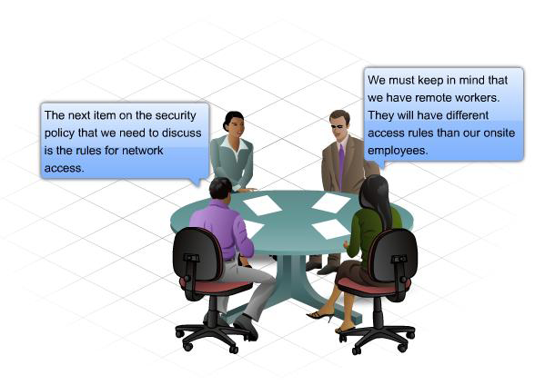
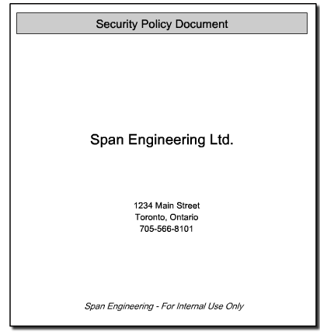
Formulating A Network Security Policy

Slide 52
Risk Assessment and Management
As part of developing a security policy, you should perform a risk assessment and cost-benefit analysis, including considering the latest attack techniques.
Risk assessment defines threats, their probability, and their severity.
Network security employs risk management to reduce risk to acceptable levels.
It is important to note that risks are not eliminated by network security; they are reduced to levels acceptable to the organization.
The cost of security should not exceed the cost of potential security incidents.

Slide 53
Know the Risks
What assets are to be secured?
The monetary value of these assets.
The actual loss that would result from an attack.
The severity and the probability that an attack against the assets will occur.
How to use security policy to control or minimize the risks.

Slide 54
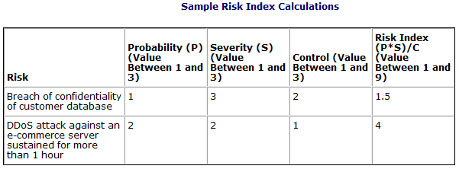
Risk Index
The probability of risk (in other words, the likelihood that compromise will occur).
The severity of loss in the event of compromise of an asset.
The ability to control or manage the risk.

Slide 55
The Concept of Trust
Trust is the relationship between two or more network entities that are permitted to communicate with each other.
Security policy decisions are largely based on the premise of trust.
If you are trusted, you are allowed to communicate as needed.
However, at times security controls need to apply restraint to trust relationships by limiting access to the designated privilege level.

Slide 56
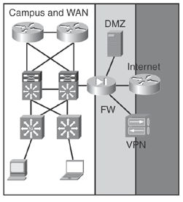
Domains of Trust
Domains of Trust are a way to group network systems that share a common policy or function.
Network segments have different trust levels, depending on the resources they are securing. When applying security controls within network segments.

Slide 57
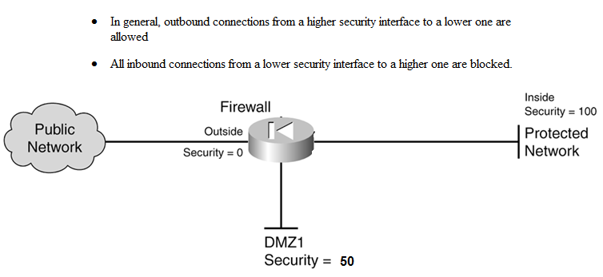
Trust in Operation on a Cisco ASA Appliance

Slide 58
Identity
The identity is the whoof of a trust relationship.
The identity of a network entity is verified by credentials:
Passwords, tokens, and certificates

Slide 59
Authentication (Proof of Identity)
Based on one (or more) of the following:
Something the subject knows: This usually involves knowledge of a unique secret, which the authenticating parties usually share. To a user, this secret appears as a classic password, a personal identification number, or a private cryptographic key.
Something the subject has: This usually involves physical possession of an item that is unique to the subject. Examples include password token cards, Smartcards, and hardware keys.

Slide 60
Authentication (Proof of Identity)
Something the subject is: This involves verifying a subject’s unique physical characteristic, such as a fingerprint, retina pattern, voice, or face.

Slide 61
Access Control
Access control is the ability to enforce a policy that states which entities (such as users, servers, and applications) can access which network resources.

Slide 62
Access Control Through AAA
Which entities (such as users, servers, and applications) can access which network resources.
Authentication
Establish the subject's identity
Authorization
Define what a subject can do in a network limit access to a network
Accounting
Audit trail provides evidence and accounting of the subject's actions
Real-time monitoring provides security services such as intrusion detection.

Slide 63
Trust and Identity Management Technologies
ACLs: Lists maintained by network devices such as routers, switches, and firewalls to control access through the device. An example is an ACL on a router that specifies which clients, based on their IP addresses, can connect to a critical server in the data center.
Firewall: A device designed to permit or deny network traffic based on certain characteristics, such as source address, destination address, protocol, port number, and application. The firewall enforces the access and authorization policy in the network by specifying which connections are permitted or denied between security perimeters.

Slide 64
Trust and Identity Management Technologies
Network Admission Control (NAC): A set of technologies and solutions that uses the network infrastructure to enforce security policy compliance on all devices trying to access network computing resources, thereby limiting damage from emerging security threats.
IEEE 802.1X: An IEEE standard for media-level access control, providing the ability to permit or deny network connectivity, control VLAN access, and apply traffic policy based on user or device identity.
Cisco Identity-Based Networking Services (IBNS): An integrated solution combining several Cisco products that offer authentication, access control, and user policies to secure network connectivity and resources.

Slide 65
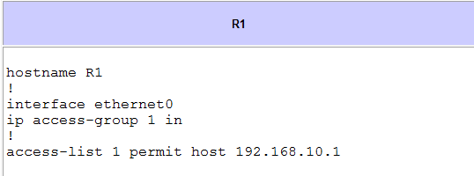
ACL (Access Control List)

Slide 66
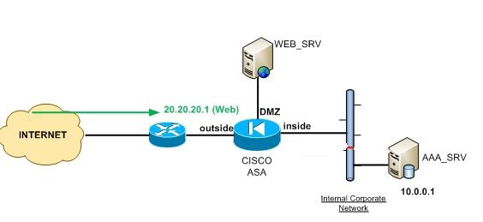
Firewall
A device designed to permit or deny network traffic based on certain characteristics.
The firewall enforces the access and authorization policy in the network by specifying which connections are permitted or denied between security perimeters.

Slide 67
Cisco NAC
Network Admission Control
http://www.cisco.com/assets/cdc_content_elements/flash/nac/demo.htm

Slide 68
Confidentiality Through Encryption
Cryptography provides confidentiality through encryption, which is the process of disguising a message to hide its original content

Slide 69
Encryption Keys
For encryption and decryption to work, devices need keys.
The sender needs a key to lock (encrypt) the message, and the receiver needs a key to unlock (decrypt) the message.
Two types of keys:
Shared secrets (symmetric)
The keys to encode and decode the message are the same.
Asymmetric keys -the Public Key Infrastructure (PKI).
The keys to encode and decode the message are different, but related; they come as a pair (the public/private keys).

Slide 70
Integrity Through Secure Fingerprints and Digital Signatures
Integrity means that the data has not been altered.
Proof the data has not changed is provided through a combination of encryption and a hash function.
Digital signatures use PKI (Asymmetric keys).
Secure Fingerprints use a shared secret key.

Slide 71
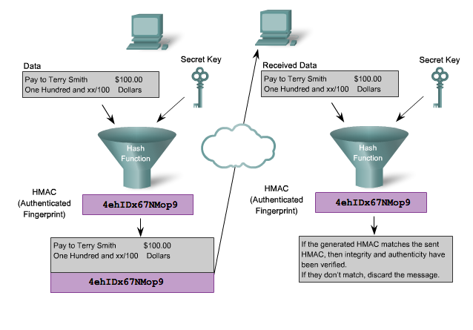
Integrity Through Secure Fingerprints and Digital Signatures (con’t)
HMAC is an algorithm used for secure fingerprints.

Slide 72
Encryption
What is a hash?
A hash is the result of a one-way mathematical function and is a fixed length string produced by a hashing function:
Both the message and hash are sent
The message recipient uses the same hash
function on the message.
Their hash result should be the same as
the hash that was sent; otherwise, the
message has changed.

Slide 73
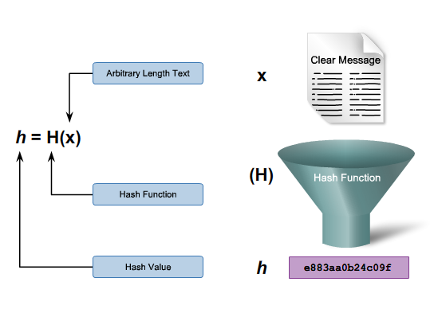
Concept of a Hash

Slide 74
VPNs
IPsec VPNs use the IKE protocol to exchange keys; IKE normally uses PKI certificates. IPsec requires both communicating endpoints to run software that understands IPsec. Most routers and security appliances currently support high-speed IPsec.
SSL VPNs are built on top of the TCP layer using port 443, the HTTPS port. SSL VPNs are used extensively to provide confidentiality for web traffic and are supported by all major browsers.

Slide 75
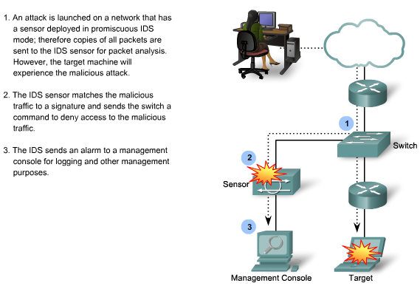
Intrusion Detection System

Slide 76
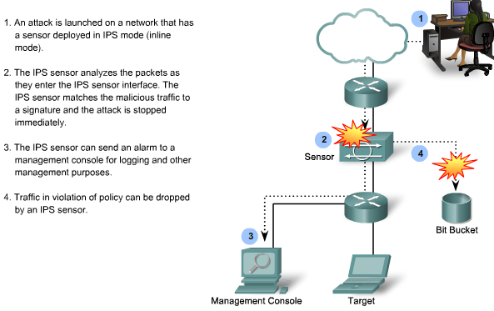
Intrusion Detection System

Slide 77
Network Security Solutions
Cisco IOS Routers
Cisco IOS Firewall
Cisco IOS IPS (Intrusion Protection System)
IPsec
VPN Modules
VPN Concentrators
ASA/PIX
IPS

Slide 78
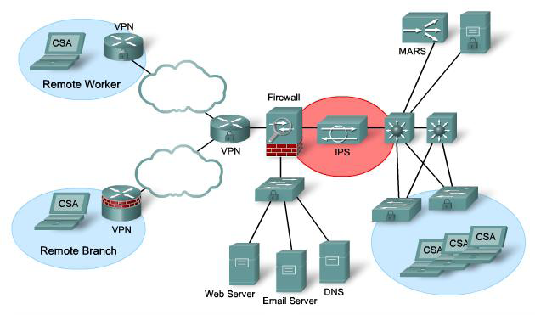
Implementing Security Throughout the Enterprise

Slide 79
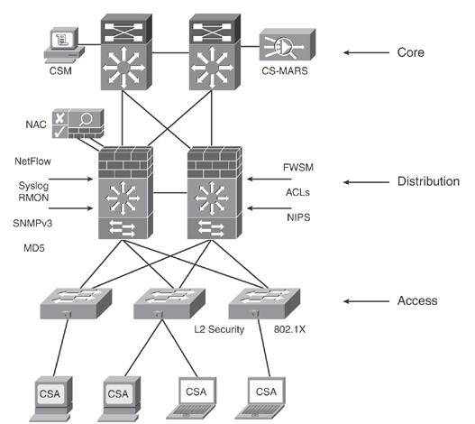
Enterprise Campus

Slide 80
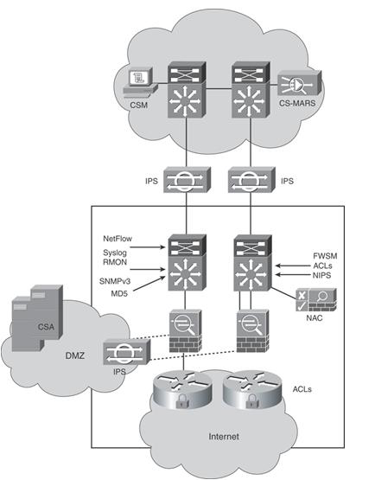
Enterprise Edge and WAN Security

Slide 81
Upcoming Deadlines
Administration of the final exam will start April 10 (Monday) through April 15 (Saturday).

Slide 82
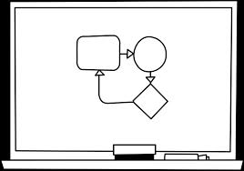
Where do we go from here?

Slide 83
Calculation
Multiply:
111.111.111
* 111.111.111
Answer
12345678987654321

