Slide 2
Week Three Agenda
Attendance
Announcements
Review week one information
Current week information
Discuss lab assignment

Slide 3
Review Week Two
Switch Behavior
Flood (Broadcast and multicast frames).
Learning
What component is driving network architecture today?
New network designs often are driven by the introduction of new network applications. The implementation time frame for new applications are often tightly connected and influence the availability time for network design.

Slide 4
Review Week Two
SONA Framework
Within the SONA framework, the network is the key component that connects and enables all components in the IT infrastructure.

Slide 5
Review Week Two
SONA Framework (cont)
SONA is defined by the following three layered framework:
Network Infrastructure layer -This layer identifies all IT resources that are interconnected across a converged network structure. This includes network devices, links to servers, storage, voice, wireless, computer and remote access.

Slide 6
Review Week Two
SONA Framework (cont)
Interactive Service layer - This layer identifies application networking services and infrastructure services. Application services are voice, wireless, security, collaboration services.

Slide 7
Review Week Two
SONA Framework (cont)
Application layer – This layer includes business applications and collaboration applications. The objective is to meet the business requirements and achieve efficiencies through the interactive services layer. This includes IP telephony, video delivery, and Instant messaging

Slide 8
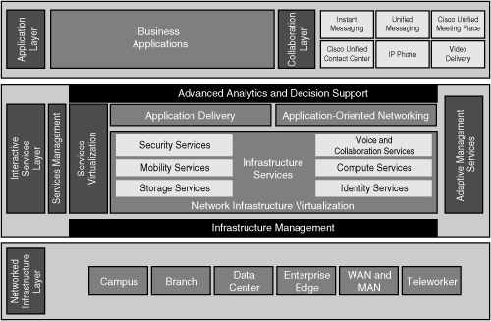
Review Week Two
SONA Framework (cont)
Application layer – This layer includes business applications and collaboration applications. The objective is to meet the business requirements and achieve efficiencies through the interactive services layer. This includes IP telephony, video delivery, and Instant messaging

Slide 9
Review Week Two
SONA Framework
What are the benefits?
Functionality: Supports the organizational requirements.
Scalability: Supports growth and expansion of organizational tasks by separating functions and products into layers.
Availability: Provides the necessary services, reliability, anywhere, anytime.

Slide 10
Review Week Two
SONA Framework (cont)
What are the benefits?
Performance: Provides the desired responsiveness, throughput, and utilization on a per application basis through the network infrastructure and services.
Manageability: Provides control, performance monitoring, fault detection.

Slide 11
Review Week Two
SONA Framework (cont)
What are the benefits?
Efficiency: Provides the required network services and infrastructure with reasonable operational costs and appropriate capital investment on a migration path to a more intelligent network, through step-by-step network services growth.

Slide 12
Review Week Two
SONA Framework (cont)
What are the benefits?
Security: Provides for an effective balance between usability and security while protecting information assets and infrastructure from inside and outside users.

Slide 13
Review Week Two
PPDIOO Network Lifecycle
The PPDIOO network lifecycle represents the phases of a standard network lifecycle.
Prepare phase: Abstract level of understanding.
At this phase, there will be customer requirements, and high-level conceptual architecture.
Plan phase: The designer has the initial requirements based on the goals for the network, and tentative timeline. A network design specification is produced.

Slide 14
Review Week Two
PPDIOO Network Lifecycle (cont)
Design phase: The initial design requirements in the Plan phase are followed by the design specialists’ activities. If necessary, data obtained from the network analysis and network audit and discussions with managers and network users. Fault detection and correction and performance monitoring are implemented at this phase.

Slide 15
Review Week Two
PPDIOO Network Lifecycle (cont)
Implement phase: The network and additional components are built according to the design requirements, with the goal of integrating devices without disrupting the existing network or accidentally create shortcomings to the network.

Slide 16
Review Week Two
PPDIOO Network Lifecycle (cont)
Operate phase: This is the final test of the designs logic. The Operate phase involves maintaining the network health through daily use.
Optimize phase: The Optimize phase is based on proactive management of the network. The goal is to identify and resolve problems before they happen and involve bigger problems that affect more of the network.

Slide 17
Review Week Two
Design Methodology
Step 1: Identify your customer requirements.
Step 2: Characterize the existing network and sites.
Step 3: Design the network topology and solutions, which includes the following:
Possibly building a pilot or prototype network.
Creating a detailed design document.

Slide 18
Review Week Two
Typical Organizational Goals
Increase revenue
Shorter development cycles
Improved customer support
Open the organization’s information infrastructure

Slide 19
Review Week Two
New network designs often are driven by the introduction of new network applications.
Design Methodology
Use a design document to list and identify the network. Categories are as follows:
Introduction
Design requirements
Existing network infrastructure
Design
Proof of Concept
Implementation plan
Appendixes

Slide 20
Review Week Two
Network Design Tools
A pilot network: Tests and verifies the design before the network is implemented to the real world. Could be a subset of the existing network.
A prototype network: Tests and verifies a redesign in an isolated network before it is applied to the existing network.

Slide 21
Review Week Two
Top-Down Approach can be used to design a network solution, after the organizational requirements and documenting the existing network. This approach allows the designer to view the picture before worrying about the details.
Botton-up Approach has a limited usage. If the network is small or if the network is faced with a critical situation, should this approach be used.

Slide 22
Review Week Two
Convergence this is the process for all routers in an internetwork to update their routing tables and create a consistent view of the network, using the best possible path. No user data is passed during a convergence time.
Latency is the time it takes a data packet to get from one location to another.
Internet Control Message Protocol (ICMP) is used by IP for many different services. ICMP is a management protocol and messaging service provider for IP. Its messages are carried as IP datagram's.

Slide 23
Structuring and Modularizing the Network
Cisco Enterprise Architecture:
Enterprise Campus
Enterprise Edge
Service Provider
Remote Enterprise

Slide 24
Structuring and Modularizing the Network
Services
Security
High Availability
Voice Services
Network Management
SNMP
MIB
RMON

Slide 25
Hierarchy Model Benefits
Provides an opportunity for flexibility
Sub divides a system into smaller parts
Modules can be created independently
Modules can be utilized in different systems to drive multiple functions
Easier to implement
Provides an efficient method of solving and
scaling complex tasks

Slide 26
Enterprise Campus
Access Layer
Concentration point at which clients access the network
Provides local and remote workgroup or user access
Distribution Layer
Represents a separation and a connection point between the Access and Core layers
Provides policy-based connectivity
Core Layer
Provides high-speed transport to satisfy the connectivity and transport needs of the distribution layer

Slide 27
Network Design Using the Hierarchical Model

Slide 28
Functional Areas or Modules
Enterprise Campus – a large core site
Corporate headquarters
Major office
Enterprise Edge – aggregates connectivity from elements outside the campus
E – Commerce
Remote access
WAN/MAN and site-to-site VPN

Slide 29
Functional Areas or Modules
Service Provider – usually not implemented by service provider
Internet service provider
PSTN
Frame Relay or ATM
IANA is responsible for global coordination of the Internet Protocol addressing systems, and the Autonomous System Numbers (ASN) used for routing Internet traffic. Currently, there two types of Internet Protocol addressing, IPv4 and IPv6.
IANA allocates IP addresses to Local Internet Registry (LIR) or National Internet Registry (NIR), or Regional Internet Registry (RIR).

Slide 30
Functional Areas or Modules
Remoter Enterprise Modules
Enterprise Branch – extends the enterprise by connecting remote locations
Enterprise Data Center – similar to campus Server Farm
Enterprise Teleworker – secure access for traveling or home workers

Slide 31
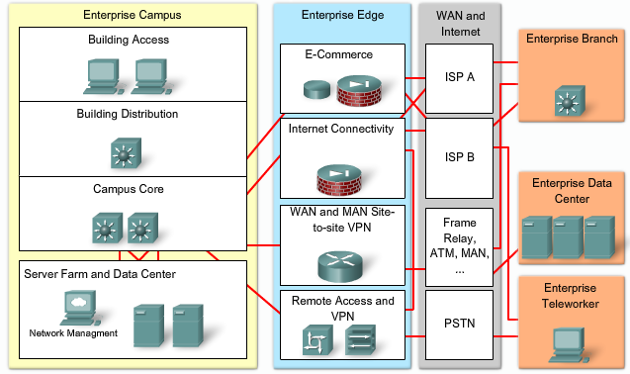
Cisco Enterprise Architecture

Slide 32
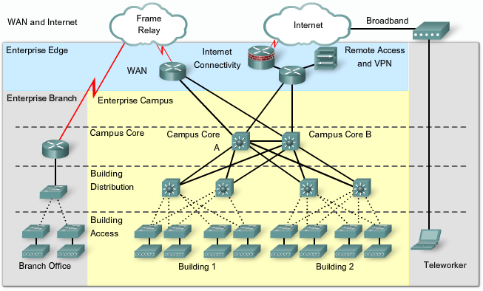
WAN and Internet

Slide 33
Divide Network into Specific Modules
Enterprise Campus includes all devices and connections within the main Campus location
Enterprise Edge includes all communications with remote locations and the Internet from perspective of Enterprise Campus
Remote modules:
Branches
Teleworkers
Remote data center

Slide 34
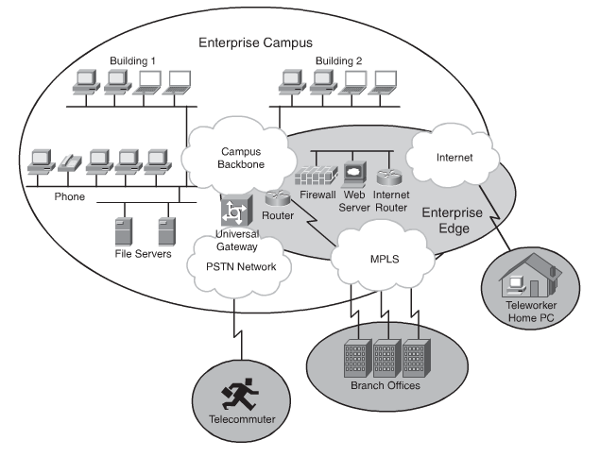
Divide Network into Specific Modules

Slide 35
Enterprise Campus
Since this area is so large, it is broken down further
Building Access Layer
Building Distribution Layer
Campus Core
Server Farm

Slide 36
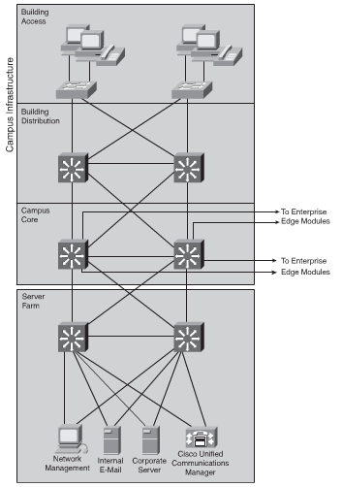
Enterprise Campus

Slide 37
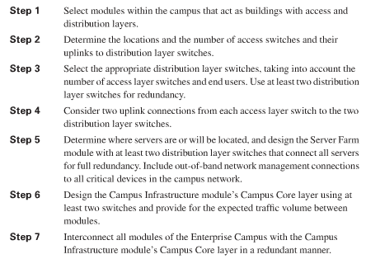
Enterprise Campus Guidelines

Slide 38
Enterprise Edge
E-Commerce
Internet Connectivity
Remote Access and VPN
WAN, MAN, Site-to-Site VPN

Slide 39
Enterprise Edge
E-Commerce buying and selling of goods use fax machines, Internet, and electronic funds transfer
Internet Connectivity basic Internet infrastructure.
VPN is a virtual private network. A method of encrypting point-to-point logical connections across a public network, such as the Internet. This allows secure communications across a public network.
WAN, and MAN. MAN is metropolitan area network. Any network that encompasses a metropolitan area; that is, and area larger than a LAN and smaller than a WAN.

Slide 40
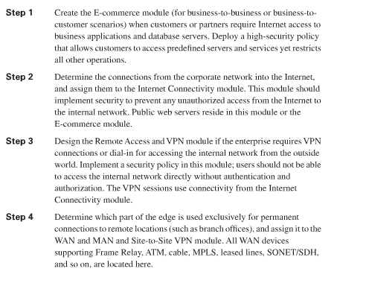
Enterprise Edge Guidelines

Slide 41
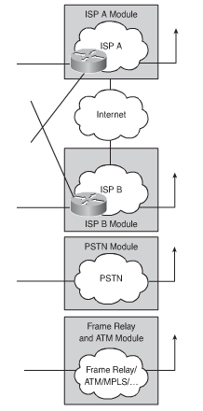
Service Provider Modules
Frame Relay/ATM (permanent WAN)
For connections to remote locations
Frame Relay
ATM
Leased Lines (T1)
SONET/SDH
Cable modem
DSL
Wireless
MPLS
Internet Service Provider
PSTN
(non-permanent WAN)

Slide 42
Services within Network Services
A network service is a supporting and necessary service, but not an ultimate solution.
Security Services – Ensure all aspects of the network are secure
Mobility services – Allow users to access network resources regardless of location
Storage services – Provides distributed and virtual storage across the enterprise

Slide 43
Services within Network Services
What are collaborative services?
They are features, such as email, document management, calendaring, on-line learning, and Web conferencing. These features are administered and maintained through policies. This allows an administrator to provide secure, controlled access to users.
Voice and collaboration services – Foundation for voice across the network
Security
High availability

Slide 44
Services within Network Services
Computer services – Connects and virtualizes resources based on application
Identity services – Maps resources and policies to the user and device

Slide 45
Network Services Examples
Network management
High availability
Quality of Service (QoS)
IP multicasting

Slide 46
Security Services
Internal
IPS and IDS
AAA (Authentication, Authorization, Accounting)
External Threats
Attacks

Slide 47
High Availability
Ensures end-to-end availability for services, clients, and sessions.
Implementation includes:
Reliable, fault-tolerant network devices to automatically identify and overcome failures
resilient to network technologies.

Slide 48
High Availability Services
Redundancy
Duplicate network links
Eliminate single points of failure
Device redundancy (card and port)
Redundant physical connections
Route redundancy
Power Redundancy
Redundancy costs $$$$$$

Slide 49
High Availability
Redundant transceiver
Redundant NICs
EtherChannel bundling
Discovering an alternative router
Virtual routers with HSRP, GLBP, VRRP
Load Balancing with multiple links
Redundant links at Layer 2 must consider STP
Backup WAN links – are they really a backup?

Slide 50
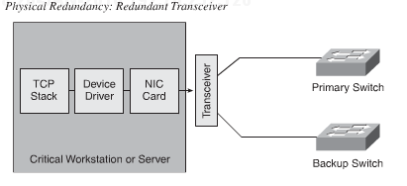
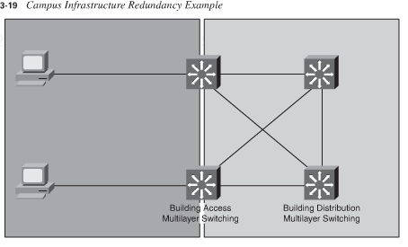
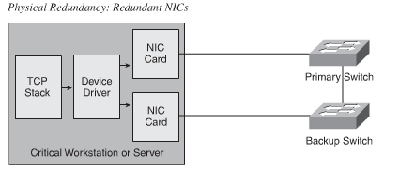
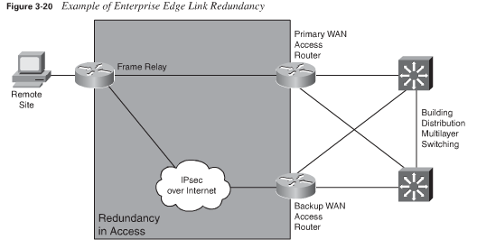

Slide 51
Voice Services
VoIP - Voice-enabled routers convert analog voice to IP packets and route to destinations.
Users may use traditional analog phones which connect to PBX
PBX connects to VoIP router rather than PSTN
IP Telephony - Uses IP phones and a server for call control and signaling.

Slide 52
IP Telephony Components
IP phones:
used to place calls in an IP telephony network.
performs voice-to-IP (and vice versa) coding and compression using special hardware. IP phones offer services such as user directory lookups and Internet access
are active network devices that require power to operate; power is supplied through the LAN connection using PoE or with an external power supply
Switches with inline power:
switches with inline power (PoE) enable the modular wiring closet infrastructure to provide centralized power for Cisco IP telephony networks
similar to traditional switches, with an added option to provide power to the LAN ports where IP phones are connected.
also perform some basic QoS tasks, such as packet classification, which is required for prioritizing voice through the network.
Call-processing manager:
provides central call control and configuration management for IP phones
provides the core functionality to initialize IP telephony devices and to perform call setup and call routing throughout the network
Voice gateway:
also called voice-enabled routers or voice-enabled switches
provide voice services such as voice-to-IP coding and compression, PSTN access, IP packet routing, backup call processing, and voice services

Slide 53
Network Management
Includes:
LAN management for advanced management of multilayer switches routed. WAN management for monitoring, traffic management, and access control to administer the routed infrastructure of multiservice networks. Service management for managing and monitoring service level agreements (SLAs). VPN security management for optimizing VPN performance and security administration.

Slide 54
Quality of Service QoS
Manages the delay, delay variation (jitter), bandwidth availability, and packet loss parameters of a network to meet the diverse needs of voice, video, and data applications.
Features provide value-added functionality:
network-based application recognition for classifying traffic on an application basis
Cisco IOS IP SLAs (previously called the service assurance agent) for end-to-end QoS measurements
Resource Reservation Protocol signaling for admission control and reservation of resources a variety of configurable queue insertion and servicing functions.

Slide 55
Quality of Service QoS
Resource Reservation Protocol (RSVP) can be used by either hosts or routers to request or deliver specific levels of quality of service (QoS) for application data streams or flows. RSVP defines how applications place reservations and how they can relinquish the reserved resources once the need for them has ended. RSVP operation will generally result in resources being reserved in each node along a path.

Slide 56
IP Multicasting
Provides bandwidth-conserving technology that reduces network traffic by delivering a single stream of information intended for many recipients through the transport network.
It enables distribution of videoconferencing, corporate communications, distance learning, software, and other applications.
Multicast packets are replicated only as necessary by Cisco routers enabled with Protocol Independent Multicast and other supporting multicast protocols that result in the most efficient delivery of data to multiple receivers.

Slide 57
IP Multicasting

Slide 58
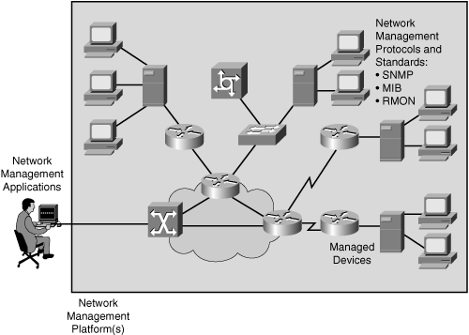
Management Architecture
Network management system (NMS)
Executes applications that monitor and control devices
Network management protocol
Facilitates the exchange of management information
Managed devices
Devices managed by NMS
Management agents
Software on devices that collects and stores data
Management information
Data of interest to a device’s management

Slide 59
Network Management Protocols and Standards
SNMP
v1, v2, v3
MIB – A database of info about the device being monitored
RMON
A MIB that allows for active monitoring of packets and traffic on a LAN
A RMON agent collects and stores information about a device

Slide 60
Quiz #1
The hierarchical network model provides a framework that network designers can use to design an intelligent network. List the three layers and define their role.
What are the benefits associated with using Cisco’s SONA Framework?
What components are found in the Enterprise Campus?
What components are found in the Service Provider.

Slide 61
Upcoming Assignments
Concept Question 3, Assignment 3-1 is due May 16, 2011.
Simulator Tutorial and Basic IOS Command Exploration, Assignment 4-1-1 is due May 23, 2011.
Concept Question 4, Assignment 5-1 is due May 30, 2011.

Slide 62
Notes
An Intrusion Prevention System (IPS) is a network security device that monitors network and/or system activities for malicious or unwanted behavior and can react, in real-time.
An Intrusion Detection System (IDS) is a device (or application) that monitors network and/or system activities for malicious activities or policy violations and produces reports to a Management Station.
There isn’t always three distinct layers to the hierarchical model . If a business is small, the core and distribution layers are combined.

