Slide 1
ISEC 400 – Application Security Week 1
Copyright © 2013 Todd Whittaker (todd.whittaker@franklin.edu)

Slide 2
Agenda
Introductions
Review policies, procedures, and expected outcomes
Learning Activities
Introduce homework problems

Slide 3
Introductions
Prof. Todd Whittaker
Full time faculty @ Franklin
ITEC and ISEC Program Chair
Developer on most ITEC & ISEC classes, some COMP classes
Industry experience in software development, systems administration, networking

Slide 4
Administrivia
ISEC 400 – Application Security
Prerequisite(s): Web Information Systems Programming (WEBD 236) or Application Server Programming (COMP 321) and Principles of Information Security (ISEC 300).
Software vulnerabilities, especially those that compromise personal or financial data, are appallingly common. Nearly every major software company has needed to deal with the fallout of a major incident due to vulnerabilities in their products. Writing correct – let alone secure – software is very difficult. Yet users and executives expect it. In this course, you will learn about the typical development mistakes that lead to…

Slide 5
Administrivia
ISEC 400 – Application Security
Prerequisite(s): Web Information Systems Programming (WEBD 236) or Application Server Programming (COMP 321) and Principles of Information Security (ISEC 300).
…application-level security issues as well as how to defend against them. Students will explore the Open Web Application Security Project (OWASP) top 10 security vulnerabilities. Topics include unchecked user input, injection, fuzzing, CSRF, XSS, cryptography, CAPTCHA, configuration errors, authentication, and authorization.

Slide 6
Administrivia
Course Outcomes
Describe basic terminology and concepts related to application security.
Assess threats and impacts on application infrastructure.
Perform black- and white-box testing on application software.
Understand the browser security structure and how it is circumvented.

Slide 7
Administrivia
Course Outcomes (continued)
Modify software to prevent common web application attacks.
Explore the OWASP security vulnerabilities.
Employ common tools for application security assessments.

Slide 8
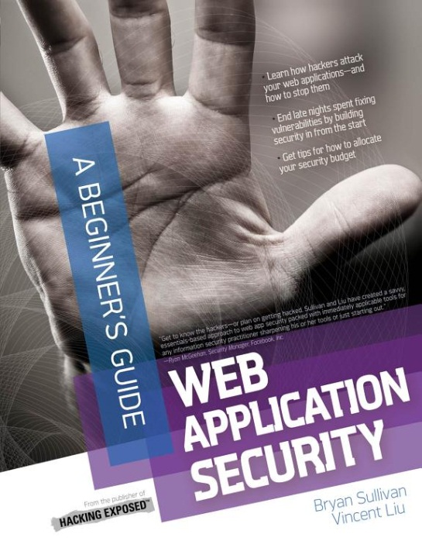
Administrivia
Texts
Sullivan, B., Liu, V., & Howard, M. (2012). Web Application Security: A Beginner's Guide. McGraw-Hill. ISBN: 9780071776165

Slide 9
Administrivia
Texts
Sullivan, B., Liu, V., & Howard, M. (2012). Web Application Security: A Beginner's Guide. McGraw-Hill. ISBN: 9780071776165
This will be our “main” text. It’s available for free on Safari*
*Only 80 concurrent Ohio-link users at a time.

Slide 10
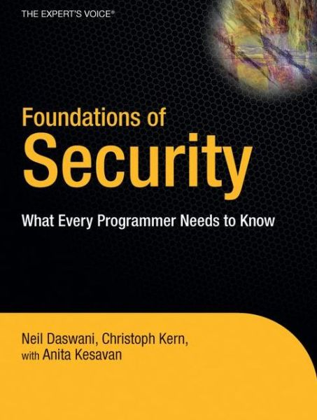
Administrivia
Texts
Daswani, N., Kern, C., & Kesavan, A. (2007). Foundations of Security: What Every Programmer Needs To Know. New York, NY: Springer-Verlag. ISBN: 9781590597842

Slide 11
Administrivia
Academic integrity
Items on the Web can serve as “inspiration” for your solutions if:
You understand the solution as if you had written it yourself.
You cite your source of inspiration
Not citing your source can get you charged with cheating/plagiarism.

Slide 12
Administrivia
Academic integrity
Items on the Web can serve as “inspiration” for your solutions if:
You understand the solution as if you had written it yourself.
You cite your source of inspiration
Not citing your source can get you charged with cheating/plagiarism.
Note: if a homework problem says “research X,” or “investigate Y,” then I’m expecting a citation! Technically, you should cite your textbooks on almost every HW assignment.

Slide 13
Administrivia
Academic integrity
Other students cannot serve as a source for your “inspiration!"
The closer you move toward sharing answers with or soliciting answers from another person (student or not), the more likely it is that you are cheating.

Slide 14
Administrivia
Academic integrity
If you have a vague feeling that you wouldn’t want your instructor to know about what you’re doing… don’t do it.
When in doubt, ask your instructor.

Slide 15
Administrivia
Points Breakdown
Type | Count | Each | Total
Homework | 12 | 20 | 240
Labs | 4 | 70 | 280
Exams | 2 | 150 | 300
Participation | 13 | 10 | 130
Reflection paper | 1 | 50 | 50
 |  |  | 1000

Slide 16
Administrivia
Points Breakdown
Type | Count | Each | Total
Homework | 12 | 20 | 240
Labs | 4 | 70 | 280
Exams | 2 | 150 | 300
Participation | 13 | 10 | 130
Reflection paper | 1 | 50 | 50
 |  |  | 1000
The labs may be a little flexible. I really haven’t decided on what we’re to do here, so I made a best guess. Some might be a paper. I may divide others in half. Due dates may change.

Slide 17
Daily/weekly Activities
Daily: Check announcements and e-mail lists
Before class
Read the associated sections from the text
Read and consider the weekly homework problems
After class
Complete the homework assignment
Work on any scheduled lab assignments
Note significant learning

Slide 18
This Week’s Outcomes
Distinguish between authentication and authorization models
Describe the Bell-LaPadula, Biba, and Clark-Wilson security models
Describe the goals of security regarding the CIA triad

Slide 19
Holistic security
What does “holistic security” mean?
Synonymous with defense in depth?

Slide 20
Holistic security
What does “holistic security” mean?
Synonymous with defense in depth?
Three elements (book answer)
Technological security
Physical security
Policy and process
McCumber cube is probably more comprehensive, but doesn’t include physical.

Slide 21
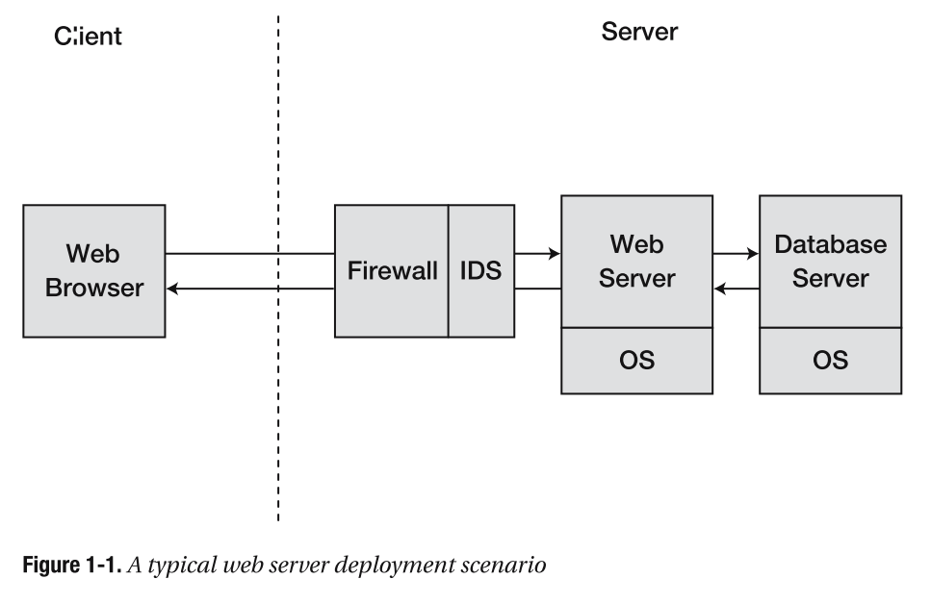
Holistic security
Where are security measures?

Slide 22
Holistic security
Where are security measures?
Same origin policy, blocked ports, local vs. remote resources, third party cookies, certificate checking, SSL/TLS negotiation, popup-blocking,

Slide 23
Holistic security
Where are security measures?
See ISEC 325: packet filtering, intrusion detection, stateful packet inspection, application proxies

Slide 24
Holistic security
Where are security measures?
Web server configuration: directory traversal, resource types, SSL/TLS.

Slide 25
Holistic security
Where are security measures?
Database configuration: restricted user access, permitted host connections

Slide 26
Holistic security
Where are security measures?
OS configuration: file security, process limits, restricted services, permitted hosts, patch management

Slide 27
Holistic security
Where are security measures?
Not seen: application level security built in to what’s running on the web server. Authentication, authorization, encoding, input sanitizing, and many more.

Slide 28
Application security
Key aspects
Authentication
Authorization
Confidentiality
Integrity
Accountability
Availability
Non-repudiation
Look at each in some additional detail.

Slide 29
Authentication
Verification of identity
Single factor: something you know
Multi-factor: something you know one or more of
Something you have (tokens)
Something you are (biometric)

Slide 30
Authorization
Verification of permission for an action
Many-to-many mapping of subject to object with associated permissions

Slide 31
Authorization
Verification of permission for an action
Many-to-many mapping of subject to object with associated permissions
Access control matrix – subjects (users, processes) as rows, objects (resources) as columns.
Access control lists – a view of the matrix as columns; list of permitted subjects and rights kept on the object.
Capability lists – a view of the matrix as rows; list of accessible objects and permissions kept with subject.

Slide 32
Authorization
Tradeoffs of ACLs vs CLs
Example: bank safe deposit box (object) and shared users (subjects)
ACL-based: bank maintains a list of people who can access the box
CL-based: bank issues keys to the original owner of the box
Source: http://www.cis.syr.edu/~wedu/Teaching/cis643/LectureNotes_New/Capability.pdf

Slide 33
Authorization
Tradeoffs of ACLs vs CLs
 | ACL-based | CL-based
Authentication | Bank | None
Bank’s involvement | Store list, verify users | None
Forging rights | Bank must safeguard the list | Key cannot be forged
Add a new person | Owner visits bank to update list | Owner gives the key to friend
Delegation | Non-owner can’t delegate | Friend can give the key to another
Revocation | Owner removes a name from the list | Owner requests key back, but it may have been copied.
Source: http://www.cis.syr.edu/~wedu/Teaching/cis643/LectureNotes_New/Capability.pdf

Slide 34
Authorization
Tradeoffs of ACLs vs CLs
 | ACL-based | CL-based
Authentication | Bank | None
Bank’s involvement | Store list, verify users | None
Forging rights | Bank must safeguard the list | Key cannot be forged
Add a new person | Owner visits bank to update list | Owner gives the key to friend
Delegation | Non-owner can’t delegate | Friend can give the key to another
Revocation | Owner removes a name from the list | Owner requests key back, but it may have been copied.
This is such a big concern that most systems are ACL-based.
Source: http://www.cis.syr.edu/~wedu/Teaching/cis643/LectureNotes_New/Capability.pdf

Slide 35
Authorization
Access control policy models
Mandatory access control (MAC): system policy determines access to an object, not alterable by owner, enforced by the system.
Discretionary access control (DAC): individual user determines access to an object, enforced by the system. Flexible.

Slide 36
Authorization
Access control policy models
Role-based access control (RBAC). Based on MAC, uses the role in the organization to determine access.

Slide 37
Authorization
Access control enforcement models
Bell-LaPadula model
Primarily concerned about confidentiality (DOD)
Subjects and objects are assigned labels (top secret, secret, confidential, unclassified)
Simple property: subjects cannot read objects of higher classification levels (“no read up”).
Star property: subjects cannot write objects of lower classification levels (“no write down”).

Slide 38
Authorization
Access control enforcement models
Bell-LaPadula model
Primarily concerned about confidentiality (DOD)
Subjects and objects are assigned labels (top secret, secret, confidential, unclassified)
Simple property: subjects cannot read objects of higher classification levels (“no read up”).
Star property: subjects cannot write objects of lower classification levels (“no write down”).
Pronounced “la pa du la” according to the man himself.

Slide 39
Authorization
Access control enforcement models
Bell-LaPadula model
Primarily concerned about confidentiality (DOD)
Subjects and objects are assigned labels (top secret, secret, confidential, unclassified)
Simple property: subjects cannot read objects of higher classification levels (“no read up”).
Star property: subjects cannot write objects of lower classification levels (“no write down”).
This is understandable. It keeps people out of things they’re not cleared to read.

Slide 40
Authorization
This is harder. It prevents a TS cleared analyst with lots of TS stuff in her head from writing an unclassified document and accidentally leaking TS information. So, she writes a TS document that can later be vetted to lower its classification to unclassified.
Access control enforcement models
Bell-LaPadula model
Primarily concerned about confidentiality (DOD)
Subjects and objects are assigned labels (top secret, secret, confidential, unclassified)
Simple property: subjects cannot read objects of higher classification levels (“no read up”).
Star property: subjects cannot write objects of lower classification levels (“no write down”).

Slide 41
Authorization
Access control enforcement models
Bell-LaPadula model
Primarily concerned about confidentiality (DOD)
Subjects and objects are assigned labels (top secret, secret, confidential, unclassified)
Simple property: subjects cannot read objects of higher classification levels (“no read up”).
Star property: subjects cannot write objects of lower classification levels (“no write down”).
Tranquility property: no object can be reclassified while it is being written. Prevents TOCTTOU (time of check to time of use) errors.

Slide 42
Authorization
Access control enforcement models
Biba model
Primarily concerned about integrity (business)
Subjects and objects are assigned integrity labels (master, expert, journeyman, novice)
Simple property: subjects cannot read objects of lower integrity levels (“no read down”).
Star property: subjects cannot alter objects of higher integrity levels (“no write up”).

Slide 43
Authorization
Access control enforcement models
Biba model
Primarily concerned about integrity (business)
Subjects and objects are assigned integrity labels (master, expert, journeyman, novice)
Simple property: subjects cannot read objects of lower integrity levels (“no read down”).
Star property: subjects cannot alter objects of higher integrity levels (“no write up”).
The higher skilled people shouldn’t be reading the ramblings/data of lower skilled people.

Slide 44
Authorization
Access control enforcement models
Biba model
Primarily concerned about integrity (business)
Subjects and objects are assigned integrity labels (master, expert, journeyman, novice)
Simple property: subjects cannot read objects of lower integrity levels (“no read down”).
Star property: subjects cannot alter objects of higher integrity levels (“no write up”).
Lower skilled people have no business altering the work of higher skilled people.

Slide 45
Authorization
Access control enforcement models
Biba model
Primarily concerned about integrity (business)
Subjects and objects are assigned integrity labels (master, expert, journeyman, novice)
Simple property: subjects cannot read objects of lower integrity levels (“no read down”).
Star property: subjects cannot alter objects of higher integrity levels (“no write up”).
Typical implementation is in rings. Ring 0 is highest trust, ring n is lowest. OS kernel is ring 0, device drivers are ring 1, user applications are ring 3, etc. Very specific gates allow data flow between them.

Slide 46
Authorization
Access control enforcement models
Biba model
Primarily concerned about integrity (business)
Subjects and objects are assigned integrity labels (master, expert, journeyman, novice)
Simple property: subjects cannot read objects of lower integrity levels (“no read down”).
Star property: subjects cannot alter objects of higher integrity levels (“no write up”).
Typical implementation is in rings. Ring 0 is highest trust, ring n is lowest. OS kernel is ring 0, device drivers are ring 1, user applications are ring 3, etc. Very specific gates allow data flow between them.

Slide 47
Authorization
Access control enforcement models
Clark-Wilson model
Primarily concerned about integrity (business)
Four concerns for all businesses:
Authentication – identity confirmation
Audit – logging
Well formed transactions – data manipulation is constrained.
Separation of duty – users can run only certain processes.
Source: http://www.cs.utexas.edu/~byoung/cs361/lecture24.pdf

Slide 48
Authorization
Access control enforcement models
Clark-Wilson model
Four policy features
Constrained data items (CDI) – integrity preserved objects
Unconstrained data items (UDI) – not covered by policy
Transformation Procedures (TP) – modify CDIs or convert UDIs to CDIs in a way that keeps the system in a valid state
Integrity Verification Procedures (IVP) – verify integrity of CDIs
Source: http://www.cs.utexas.edu/~byoung/cs361/lecture24.pdf

Slide 49
Authorization
Access control enforcement models
Clark-Wilson model
Rules for certification and enforcement
C1: All IVPs ensure that CDIs are in a valid state initially
C2: All TP must be certified as preserving the integrity of CDIs
C3: Assignment of TPs to users must enforce duty separation
C4: All TPs must be logged
C5: TPs on UDIs must produce valid CDIs
E1: Only certified TPs can work with CDIs.
E2: Users only access CDIs via TPs they’re authorized to run
E3: The identity of users running TPs is authenticated
Source: http://www.cs.utexas.edu/~byoung/cs361/lecture24.pdf

Slide 50
Authorization
Access control enforcement models
Clark-Wilson model
Rules for certification and enforcement
C1: All IVPs ensure that CDIs are in a valid state initially
C2: All TP must be certified as preserving the integrity of CDIs
C3: Assignment of TPs to users must enforce duty separation
C4: All TPs must be logged
C5: TPs on UDIs must produce valid CDIs
E1: Only certified TPs can work with CDIs.
E2: Users only access CDIs via TPs they’re authorized to run
E3: The identity of users running TPs is authenticated
Main idea: the system starts in a valid state, the rules keep it in a valid state and so it ends in a valid state.
Source: http://www.cs.utexas.edu/~byoung/cs361/lecture24.pdf

Slide 51
Authorization
Access control enforcement models
Other models you may see
Brewer-Nash (Chinese wall)
Goguen-Meseguer (non-interference)
Lipner (hybrid of BLP & Biba)

Slide 52
Confidentiality
Keeping communications or data secret
Prevent man-in-the middle attacks (transmitted)
Eavesdropping – listens and records
Manipulation – listens, alters, forwards
Prevent illegal access (stored)
Disclosure – unauthorized reads
Tampering – unauthorized writes
Controls: authentication, encryption

Slide 53
Message Integrity
Verification that data has not been altered
Control over manipulation, tampering, or errors. Based on hashing.
Simple mechanisms – speed
Checksum, CRC checks
MD5, SHA-X hashing
Advanced mechanisms
MACs (message authentication code) – shared secret key (no non-repudiation)

Slide 54
Accountability
Goal: determine who and when an attack or error occurred
Prove and prosecute
Implementation mechanisms
Logging
Audit trails
Separation of duties

Slide 55
Availability
Goal: provide a service within a time window
Implementation mechanisms
Redundancy (avoid SPOFs)
Resource limits (memory, CPU time, disk space, network bandwidth)

Slide 56
Non-repudiation
Goal: transactions cannot later be denied
Data integrity is a prerequisite
Relies heavily on public key infrastructure (PKI)
Digital signing:
Produce a message
Hash the message
Encrypt the hash with your private key
Append your certificate and the encrypted hash to the message

Slide 57
This Week’s Outcomes
Distinguish between authentication and authorization models
Describe the Bell-LaPadula, Biba, and Clark-Wilson security models
Describe the goals of security regarding the CIA triad

Slide 58
Due this week
Homework 1
Session 1 participation (or alternate)
Arrange for a proctor

Slide 59
Next week
Secure systems design
Design principles

Slide 60
Q & A
Questions, comments, concerns?

