Slide 1
ISEC 400 Application Security Week 2
Copyright © 2013 Todd Whittaker
(todd.whittaker@franklin.edu)

Slide 2
Agenda
This week’s expected outcomes
This week’s topics
This week’s homework
Upcoming deadlines
Question & answer

Slide 3
Outcomes
Explain the importance of a secure development cycle
Follow a process for security requirements elicitation.
Describe the principles of secure software design.

Slide 4
Secure Systems Design
Standard Software Development Lifecycle
5 phases
Requirements
Analysis & design
Coding
Testing
Maintenance
Linearly – waterfall
Circularly – spiral
Require-ments
Analysis and Design
Coding
Testing
Maint-enance

Slide 5
Secure Systems Design
Standard Software Development Lifecycle
5 phases
Requirements
Analysis & design
Coding
Testing
Maintenance
Linearly – waterfall
Circularly – spiral
Require-ments
Analysis and Design
Coding
Testing
Maint-enance
Where and what types of vulnerabilities can be introduced in each phase?

Slide 6
Secure Systems Design
Threats
Defacement
Infiltration
Phishing
Pharming
Insider
Click Fraud
Denial-of-Service
Data theft and loss

Slide 7
Secure Systems Design
Threats
Defacement
Infiltration
Phishing
Pharming
Insider
Click Fraud
Denial-of-Service
Data theft and loss
Vandalism of a web site. Opportunistic or maliciously motivated.

Slide 8
Secure Systems Design
Threats
Defacement
Infiltration
Phishing
Pharming
Insider
Click Fraud
Denial-of-Service
Data theft and loss
Breaking in. Full access to the computer system.

Slide 9
Secure Systems Design
Threats
Defacement
Infiltration
Phishing
Pharming
Insider
Click Fraud
Denial-of-Service
Data theft and loss
Similar looking web site, stealing credentials. Email targets real users.

Slide 10
Secure Systems Design
Threats
Defacement
Infiltration
Phishing
Pharming
Insider
Click Fraud
Denial-of-Service
Data theft and loss
DNS cache poisoning to redirect to malicious look-alike site.

Slide 11
Secure Systems Design
Threats
Defacement
Infiltration
Phishing
Pharming
Insider
Click Fraud
Denial-of-Service
Data theft and loss
Employees steal or sell data to others. Least privilege, separation of duties.

Slide 12
Secure Systems Design
Threats
Defacement
Infiltration
Phishing
Pharming
Insider
Click Fraud
Denial-of-Service
Data theft and loss
Max out the your ad budget through automated clicks on ad sites.

Slide 13
Secure Systems Design
Threats
Defacement
Infiltration
Phishing
Pharming
Insider
Click Fraud
Denial-of-Service
Data theft and loss
Intentional (DDoS), or unintentional (bad input checking crashes system).

Slide 14
Secure Systems Design
Threats
Defacement
Infiltration
Phishing
Pharming
Insider
Click Fraud
Denial-of-Service
Data theft and loss
Lost backup tapes, laptops, or intentional theft via infiltration.

Slide 15
Secure Systems Design
Designing in security
Architectural
Network security ≠ all security
Turtle shell architectures (one system built to protect another vulnerable system) is highly problematic

Slide 16
Secure Systems Design
Designing in security
Architectural
Network security ≠ all security
Turtle shell architectures (one system built to protect another vulnerable system) is highly problematic
Defense-in-depth involves designing security measures as the information system is built. All levels (network, system, policy, software, etc.)

Slide 17
Security Requirements
Security Quality Requirements Engineering (SQUARE)
Developed by the Software Engineering Institute (SEI) at Carnegie Mellon University
9 steps for defining goals, artifacts, risks, and prioritization for security in information systems
Require-ments
Analysis and Design
Coding
Testing
Maint-enance

Slide 18
Security Requirements
Security Quality Requirements Engineering (SQUARE)
Developed by the Software Engineering Institute (SEI) at Carnegie Mellon University
9 steps for defining goals, artifacts, risks, and prioritization for security in information systems
Require-ments
Analysis and Design
Coding
Testing
Maint-enance
“Requirements engineering, a vital component in successful project development, often does not include sufficient attention to security concerns. Studies show that up-front attention to security can save the economy billions of dollars, yet security concerns are often treated as an afterthought to functional requirements.” (Meade, Hough, & Stehney, 2005)
Source: http://www.sei.cmu.edu/reports/05tr009.pdf

Slide 19
Security Requirements
SQUARE
Agree on definitions
Identify security goals
Develop artifacts
Perform risk assessment
Select elicitation technique
Elicit security requirements
Categorize requirements
Prioritize requirements
Requirements inspection
Source: http://www.sei.cmu.edu/reports/05tr009.pdf

Slide 20
Security Requirements
SQUARE – Agree on definitions
Stakeholders may define “access control” or “confidentiality” very differently depending on their knowledge base and experience.
Define all terms using existing sources
Source: http://www.sei.cmu.edu/reports/05tr009.pdf

Slide 21
Security Requirements
SQUARE – Identify security goals
Eliminate conflicting goals of stakeholders
Support overall business goal
Comply with existing policy
Source: http://www.sei.cmu.edu/reports/05tr009.pdf

Slide 22
Security Requirements
SQUARE – Develop artifacts
System architecture diagrams
Attack trees
Use cases/abuse cases
Source: http://www.sei.cmu.edu/reports/05tr009.pdf

Slide 23
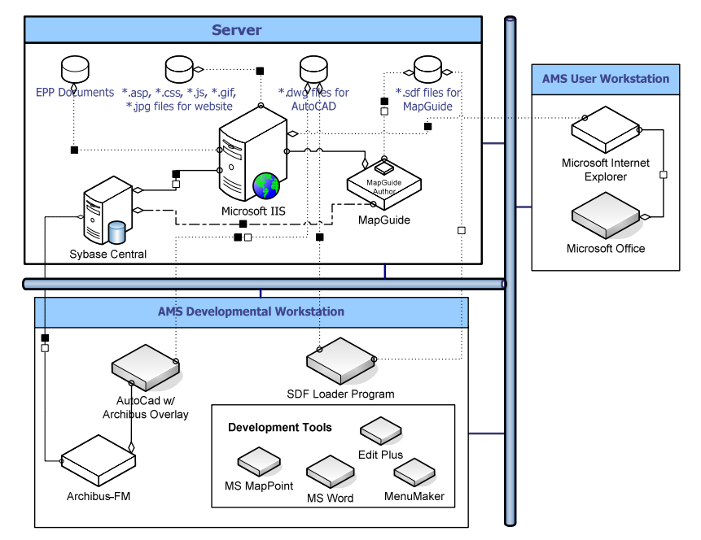
Security Requirements
SQUARE – Develop artifacts
System architecture diagrams
Attack trees
Use cases/abuse cases
Source: http://www.sei.cmu.edu/reports/05tr009.pdf

Slide 24
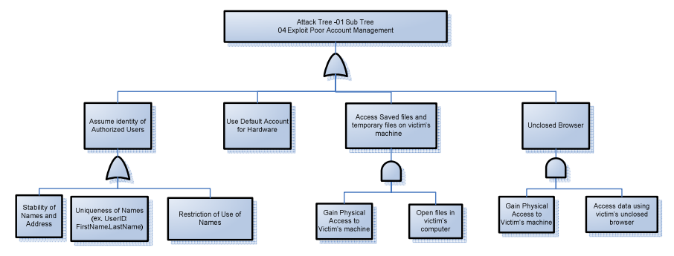
Security Requirements
SQUARE – Develop artifacts
System architecture diagrams
Attack trees
Use cases/abuse cases
Source: http://www.sei.cmu.edu/reports/05tr009.pdf

Slide 25
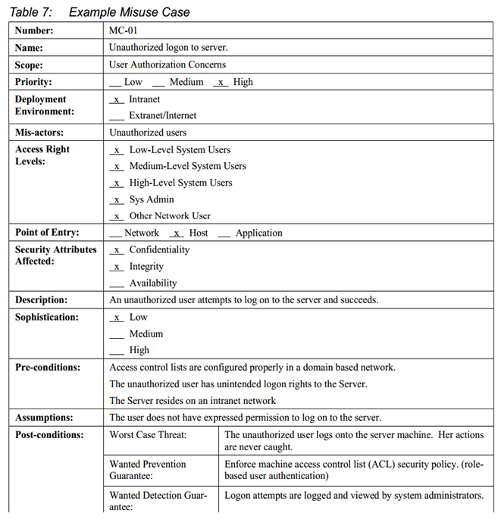
Security Requirements
SQUARE – Develop artifacts
System architecture diagrams
Attack trees
Use cases/abuse cases
Source: http://www.sei.cmu.edu/reports/05tr009.pdf

Slide 26
Security Requirements
SQUARE – Develop artifacts
System architecture diagrams
Attack trees
Use cases/abuse cases
Map these misuse cases to attack trees and security policies and goals.
Source: http://www.sei.cmu.edu/reports/05tr009.pdf

Slide 27
Security Requirements
SQUARE – Perform risk assessment
Risk is the probability that a threat will exploit a vulnerability resulting in a loss.
Many risk assessment techniques to choose from
Identify threats
Identify vulnerabilities
Determine likelihood and impact
Identify and implement controls
Source: http://www.sei.cmu.edu/reports/05tr009.pdf

Slide 28
Security Requirements
SQUARE – Select elicitation technique
Requirements elicitation come in many flavors
Structured/unstructured interviews
Joint Application Development (JAD)
Use case analysis, etc...
Each has advantages and disadvantages
Stakeholder interaction is key!
Source: http://www.sei.cmu.edu/reports/05tr009.pdf

Slide 29
Security Requirements
SQUARE – Select elicitation technique
Requirements elicitation come in many flavors
Structured/unstructured interviews
Joint Application Development (JAD)
Use case analysis, etc...
Each has advantages and disadvantages
Stakeholder interaction is key!
See MIS 400 for a whole course on how this kind of thing is done.
Source: http://www.sei.cmu.edu/reports/05tr009.pdf

Slide 30
Security Requirements
SQUARE – Elicit security requirements
Use objective, measureable requirements
Bad: “the system shall improve the availability of the existing customer service center”
Good: “the system shall handle at least 300 simultaneous connections to the customer service center”
Focus on what the system should do, not how it gets it done.
Source: http://www.sei.cmu.edu/reports/05tr009.pdf

Slide 31
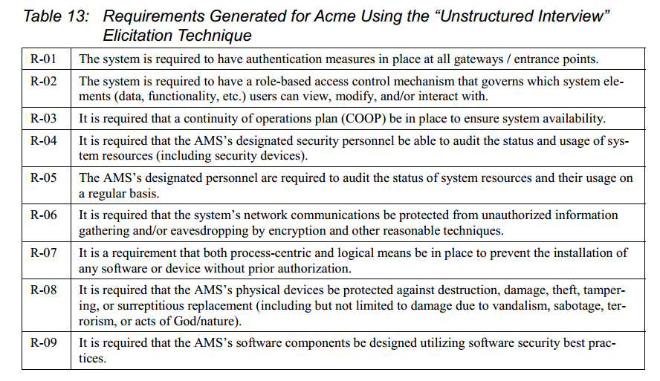
Security Requirements
SQUARE – Elicit security requirements
Use objective, measureable requirements
Bad: “the system shall improve the availability of the existing customer service center”
Good: “the system shall handle at least 300 simultaneous connections to the customer service center”
Focus on what the system should do, not how it gets it done.
Source: http://www.sei.cmu.edu/reports/05tr009.pdf

Slide 32
Security Requirements
SQUARE – Categorize requirements
Use stakeholder-defined categories
E.g. system level, software level, architectural level vs essential, non-essential.
E.g. Confidentiality, access control, integrity, manageability, usability, authentication, etc.
Source: http://www.sei.cmu.edu/reports/05tr009.pdf

Slide 33
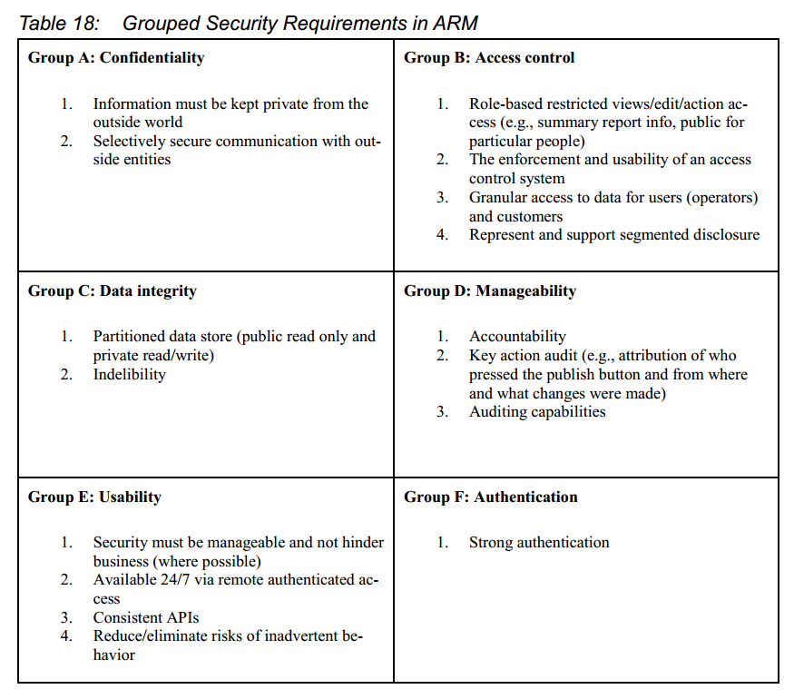
Security Requirements
SQUARE – Categorize requirements
Use stakeholder-defined categories
E.g. system level, software level, architectural level vs essential, non-essential.
E.g. Confidentiality, access control, integrity, manageability, usability, authentication, etc.
Source: http://www.sei.cmu.edu/reports/05tr009.pdf

Slide 34
Security Requirements
SQUARE – Prioritize requirements
Not all requirements can be implemented due to technical feasibility or economics.
Use the risk analysis from previous steps to produce the prioritized list.
E.g. cost vs. value diagram of requirements
Source: http://www.sei.cmu.edu/reports/05tr009.pdf

Slide 35
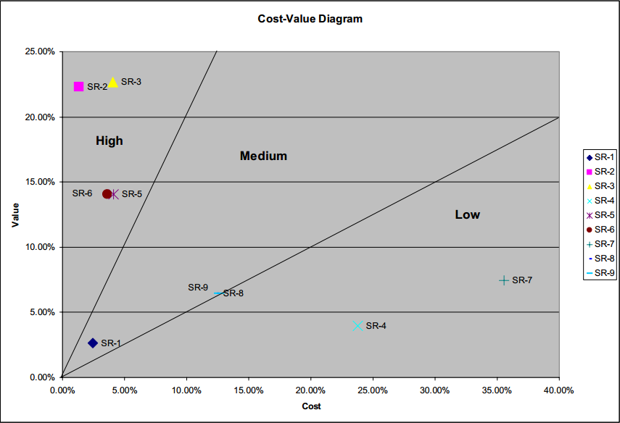
Security Requirements
SQUARE – Prioritize requirements
Not all requirements can be implemented due to technical feasibility or economics.
Use the risk analysis from previous steps to produce the prioritized list.
E.g. cost vs. value diagram of requirements
Source: http://www.sei.cmu.edu/reports/05tr009.pdf

Slide 36
Security Requirements
SQUARE – Requirements inspection
Find defects (if any) in the requirements
Formal (Fagan inspection) to informal (peer review)
Source: http://www.sei.cmu.edu/reports/05tr009.pdf

Slide 37
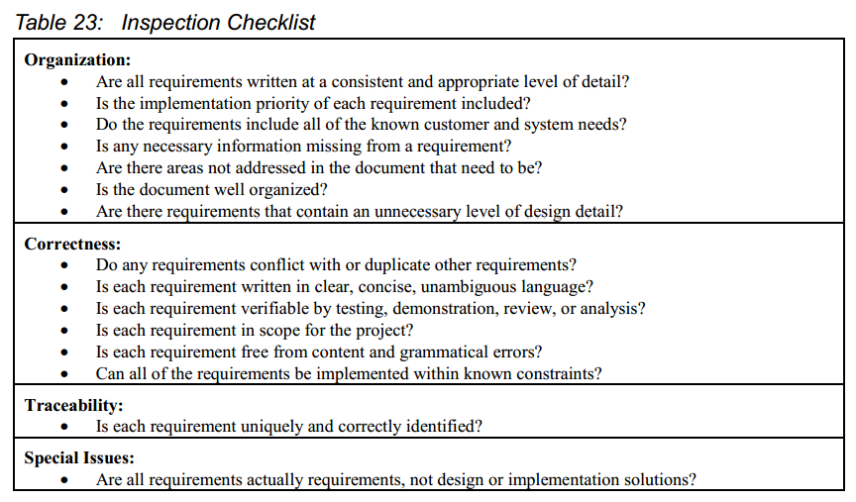
Security Requirements
SQUARE – Requirements inspection
Find defects (if any) in the requirements
Formal (Fagan inspection) to informal (peer review)
Source: http://www.sei.cmu.edu/reports/05tr009.pdf

Slide 38
Secure Design Principles
Require-ments
Analysis and Design
Coding
Testing
Maint-enance
What kinds of design?
System architecture
Major software components
Frameworks
APIs and user interfaces
Etc.

Slide 39
Secure Design Principles
Require-ments
Analysis and Design
Coding
Testing
Maint-enance
8 principles of secure design
Least privilege
Defense in depth
Fail securely
Securing the weakest link
Separation of privilege
Simplicity
Usability
No security by obscurity

Slide 40
Secure Design Principles
Least privilege
“Only the minimum necessary rights should be assigned to a subject that requests access to a resource and should be in effect for the shortest duration necessary (remember to relinquish privileges). Granting permissions to a user beyond the scope of the necessary rights of an action can allow that user to obtain or change information in unwanted ways. Therefore, careful delegation of access rights can limit attackers from damaging a system.”
Source: https://buildsecurityin.us-cert.gov/articles/knowledge/principles/least-privilege

Slide 41
Secure Design Principles
Defense in depth
“Layering security defenses in an application can reduce the chance of a successful attack. Incorporating redundant security mechanisms requires an attacker to circumvent each mechanism to gain access to a digital asset. For example, a software system with authentication checks may prevent an attacker that has subverted a firewall. Defending an application with multiple layers can prevent a single point of failure that compromises the security of the application.”
Source: https://buildsecurityin.us-cert.gov/articles/knowledge/principles/defense-in-depth

Slide 42
Secure Design Principles
Failing securely
“When a system fails, it should do so securely. This typically involves several things: secure defaults (default is to deny access); on failure undo changes and restore to a secure state; always check return values for failure; and in conditional code/filters make sure that there is a default case that does the right thing. …. Upon failing, a system that reveals sensitive information about the failure to potential attackers could supply additional knowledge for creating an attack. Determine what may occur when a system fails and be sure it does not threaten the system.”
Source: https://buildsecurityin.us-cert.gov/articles/knowledge/principles/failing-securely

Slide 43
Secure Design Principles
Securing the weakest link
“Attackers are more likely to attack a weak spot in a software system than to penetrate a heavily fortified component. For example, some cryptographic algorithms can take many years to break, so attackers are not likely to attack encrypted information communicated in a network. Instead, the endpoints of communication (e.g., servers) may be much easier to attack. Knowing when the weak spots of a software application have been fortified can indicate to a software vendor whether the application is secure enough to be released.”
Source: https://buildsecurityin.us-cert.gov/articles/knowledge/principles/securing-the-weakest-link

Slide 44
Secure Design Principles
Separation of privilege
“A system should ensure that multiple conditions are met before granting permissions to an object. Checking access on only one condition may not be adequate for strong security. If an attacker is able to obtain one privilege but not a second, he or she may not be able to launch a successful attack. If a software system largely consists of one component, the idea of having multiple checks to access different components cannot be implemented. Compartmentalizing software into separate components that require multiple checks for access can inhibit an attack or potentially prevent an attacker from taking over an entire system.”
Source: https://buildsecurityin.us-cert.gov/articles/knowledge/principles/separation-of-privilege

Slide 45
Secure Design Principles
Simplicity
“One factor in evaluating a system's security is its complexity. If the design, implementation, or security mechanisms are highly complex, then the likelihood of security vulnerabilities increases. Subtle problems in complex systems may be difficult to find, especially in copious amounts of code. … One strategy for simplifying code is the use of choke points, where shared functionality reduces the amount of source code required for an operation. Simplifying design or code is not always easy, but developers should strive for implementing simpler systems when possible.”
Source: https://buildsecurityin.us-cert.gov/articles/knowledge/principles/economy-of-mechanism

Slide 46
Secure Design Principles
Usability
“Accessibility to resources should not be inhibited by security mechanisms. If security mechanisms hinder the usability or accessibility of resources, then users may opt to turn off those mechanisms. Where possible, security mechanisms should be transparent to the users of the system or at most introduce minimal obstruction. Security mechanisms should be user friendly to facilitate their use and understanding in a software application.”
Source: https://buildsecurityin.us-cert.gov/articles/knowledge/principles/psychological-acceptability

Slide 47
Secure Design Principles
No security by obscurity
“Relying on an obscure design or implementation does not guarantee that a system is secured. You should always assume that an attacker can obtain enough information about your system to launch an attack. Tools such as decompilers and disassemblers allow attackers to obtain sensitive information that may be stored in binary files. Also, inside attacks, which may be accidental or malicious, can lead to security exploits. Using real protection mechanisms to secure sensitive information should be the ultimate means of protecting your secrets.”
Source: https://buildsecurityin.us-cert.gov/articles/knowledge/principles/never-assuming-that-your-secrets-are-safe

Slide 48
Topic #2
Continue your material here, etc.
protected static class Node<E> {
/** The data held in the node. */
protected E data;
/** The left subtree. */
protected Node<E> leftChild;
/** the right subtree. */
protected Node<E> rightChild;
/** the parent of this node. */
protected Node<E> parent;
// snip...
}
Textbox for source code emphasis.

Slide 49
Upcoming deadlines
Homework 1 due Sunday
Homework 2 due a week from Sunday
Lab 1 due a week from Sunday.
Proctor selection?

Slide 50
Question & answer
Questions?
Comments?
Concerns?

