Slide 1
ISEC 400 Application Security Week 5
Copyright © 2013 Todd Whittaker
(todd.whittaker@franklin.edu)

Slide 2
Agenda
This week’s expected outcomes
This week’s topics
This week’s homework
Upcoming deadlines
Question & answer

Slide 3
Outcomes
Specify best practices in authentication
Contrast standard and multi-factor authentication
Describe common password attacks and mitigation strategies.

Slide 4
Authentication
What is authentication
Authentic: /ôˑˈTHenˑtik/ (adjective) of undisputed origin; genuine.
Therefore authentication is the act of demonstrating that a subject is genuine. How is that accomplished?

Slide 5
Authentication
What is authentication
Authentic: /ôˑˈTHenˑtik/ (adjective) of undisputed origin; genuine.
Therefore authentication is the act of demonstrating that a subject is genuine. How is that accomplished?
Identity + Confirmation = Authentication
The subject provides their identity (name, email address, ID number, UUID, etc)

Slide 6
Authentication
What is authentication
Authentic: /ôˑˈTHenˑtik/ (adjective) of undisputed origin; genuine.
Therefore authentication is the act of demonstrating that a subject is genuine. How is that accomplished?
Identity + Confirmation = Authentication
The subject provides something uniquely tied to the subject’s identity and known to the system.

Slide 7
Authentication
What is authentication
Authentic: /ôˑˈTHenˑtik/ (adjective) of undisputed origin; genuine.
Therefore authentication is the act of demonstrating that a subject is genuine. How is that accomplished?
Identity + Confirmation = Authentication
Something known, possessed, or embodied only by the subject.
The subject provides something uniquely tied to the subject’s identity and known to the system.

Slide 8
Authentication
What is authentication
Authentic: /ôˑˈTHenˑtik/ (adjective) of undisputed origin; genuine.
Therefore authentication is the act of demonstrating that a subject is genuine. How is that accomplished?
Remember: not all subjects are people, and not all confirmations are passwords!
Identity + Confirmation = Authentication

Slide 9
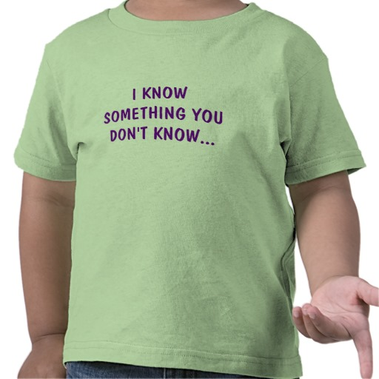
Authentication
Confirmation
Something you know
Passwords, passphrases, PINs, answers to security questions, etc. This is the most common because of the low bar to entry.

Slide 10
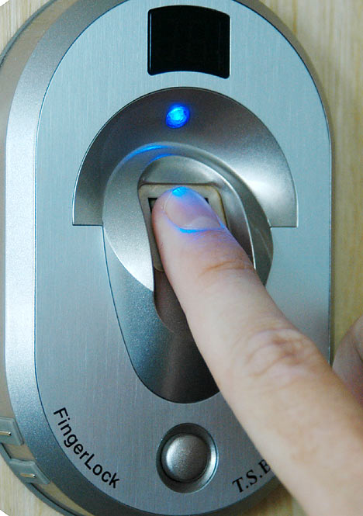
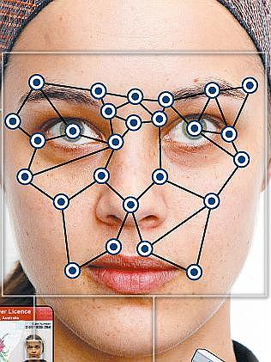
Authentication
Confirmation
Something you know
Something you are
Retinal or iris scanners, fingerprint scanners, voice recognition, facial recognition, etc. High bar due generally to specialized hardware.

Slide 11
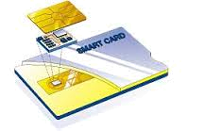
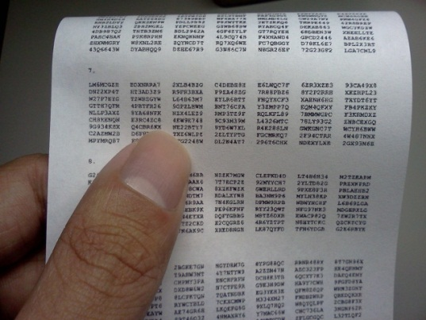
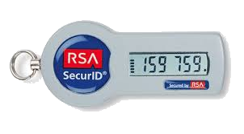
Authentication
Confirmation
Something you know
Something you are
Something you have
Security tokens, smart cards, mobile device apps (“soft tokens”), one time pads, SMS one time passwords, etc. Medium bar to entry. Becoming more popular, esp. soft tokens.

Slide 12
Authentication
HTTP authentication
Basic authentication
User attempts to access a protected resource
Server responds with 401 code (Authorization required)
Browser pops up dialogue requesting username and password

Slide 13
Authentication
HTTP authentication
Basic authentication
User attempts to access a protected resource
Server responds with 401 code (Authorization required)
Browser pops up dialogue requesting username and password
username:password plaintext (i.e. “todd:p@55w0rd!” is base 64 encoded to be “dG9kZDpwQDU1dzByZCE=” Telltale “=” at the end for base64.

Slide 14
Authentication
HTTP authentication
Basic authentication
User attempts to access a protected resource
Server responds with 401 code (Authorization required)
Browser pops up dialogue requesting username and password
Base64 encoded credentials are appended to each subsequent request header
Credentials accepted or rejected at server

Slide 15
Authentication
HTTP authentication
Basic authentication – big problems
Not forced over SSL, so easily decoded credentials are moving unencrypted
Credentials resent with every subsequent request
Browser is caching the credentials

Slide 16
Authentication
HTTP authentication
Digest authentication
Similar process, but now credentials are MD5 hashed.
Server sends a nonce value that is used in computing the hash (like a salt), but because it is unique per the “session,” it prevents replay attacks.
Still horribly weak in the same ways as basic authentication. Also susceptible to MITM attacks that downgrade the auth to basic.

Slide 17
Authentication
Single sign-on
Common in corporate settings using LDAP/AD
Getting more common in websites with Google+ and Facebook Connect.
Essentially outsourcing authentication to a “trusted” provider

Slide 18
Authentication
Custom (form-based) authentication
Most common
Typical workflow

Slide 19
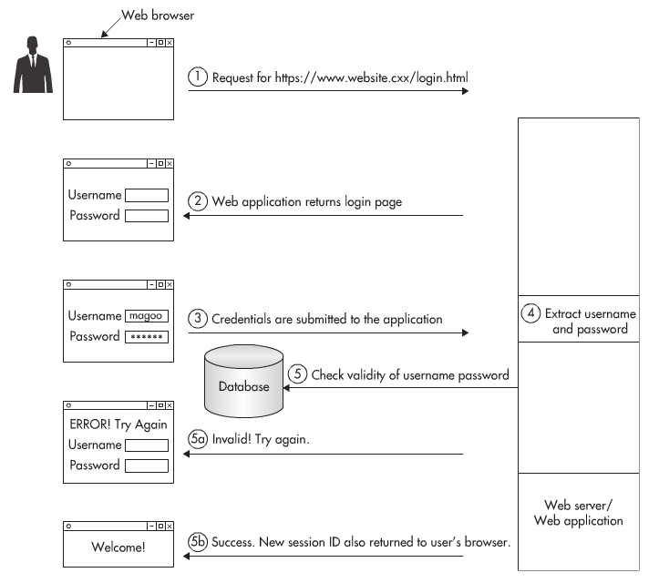
Authentication
Custom (form-based) authentication
Most common
Typical workflow

Slide 20
Authentication
Custom (form-based) authentication
Most common
Typical workflow
Where can the weaknesses be exploited? How do we harden the app against them?

Slide 21
Authentication
Attacks against passwords
Dictionary
Brute-force
Pre-computed dictionary (rainbow)
All can be online against live app or offline against stolen DB of username/passwords

Slide 22
Authentication
Attacks against passwords
Dictionary: run “typical” passwords through the application or against the hashed database. Can use multiple words, common letter substitutions, Markov chains, etc. Very effective.
Brute force: try every combination from ‘AAAAAA’ to ‘zzzzzz’ including numbers & symbols. Fairly fast, fairly effective.
Pre-computed: formerly very effective, now much less so due to salts and multiple hash rounds.

Slide 23
Authentication
Attacks against passwords
Dictionary: run “typical” passwords through the application or against the hashed database. Can use multiple words, common letter substitutions, Markov chains, etc. Very effective.
Brute force: try every combination from ‘AAAAAA’ to ‘zzzzzz’ including numbers & symbols. Fairly fast, fairly effective.
Pre-computed: formerly very effective, now much less so due to salts and multiple hash rounds.
Excellent article on real world password cracking using GPUs: http://arstechnica.com/security/2013/05/how-crackers-make-minced-meat-out-of-your-passwords/

Slide 24
Authentication
Password length and complexity
Very important.
Anything less than 6 characters is cracked nearly instantly. All lowercase less than 9 characters is cracked nearly instantly. 12 character minimum, 16 characters is better.
Larger set of symbols means more time to crack. Upper & lower case, numbers, symbols minimum. Easy to enforce in the application.

Slide 25
Authentication
Password expiration
Somewhat important.
Risk-based approach depending on how long is the expected crack time.
Must be combined with password history (to prevent recycling of old passwords) and change window limits (to prevent rotating through 12 old passwords in 10 minutes).

Slide 26
Authentication
Password storage
Don’t encrypt. Hash.
Hash with good algorithms (e.g. SHA-512).
Use many rounds of hashing (5000+).
Use a salt
Random per-user junk injected into the hashing process and stored with the hash in the database (why?)
Use a pepper
High entropy, system wide secret also injected into the hashing process.

Slide 27
Authentication
Authentication best practices
Authenticate
When users access or rights change
With every request to protected resources
When accessing a third party resource
Can involve re-authentication.

Slide 28
Authentication
Authentication best practices
Encrypt all transmissions between browser and client via SSL/TLS.
Limit the number of attempts for login
CAPTCHA (Completely Automated Public Turing test to tell Computers and Humans Apart) after a number of bad attempts
Lockout periods (how many attempts, within what period, how long should lockout be).
Disabling accounts in high security applications (requiring call to help desk)

Slide 29
Authentication
Authentication best practices
Turn off autocomplete so browsers won’t remember passwords (not guaranteed)
Don’t have default accounts enabled when installing your app
Don’t try to hard-code credentials in source code for third party services

Slide 30
Upcoming deadlines

Slide 31
Question & answer
Questions?
Comments?
Concerns?

