Slide 1
ISEC 400 Application Security Week 14
Copyright © 2013 Todd Whittaker
(todd.whittaker@franklin.edu)

Slide 2
Agenda
This week’s expected outcomes
This week’s topics
This week’s homework
Upcoming deadlines
Question & answer

Slide 3
Outcomes
Create and deploy certificates
Describe secure communication principles
Describe key exchange mechanisms

Slide 4
Keeping Secrets – Cryptography

Slide 5
Keeping Secrets – Cryptography
Confidentiality: one third of the CIA-triad
Often handled by encryption
Integrity: another third of the triad
Often handled by authentication codes
Encryption and hashing are the topics for this week.

Slide 6
Cipher Methods
Bit stream method
Each bit in plaintext transformed, one bit at a time
Commonly uses exclusive OR operation (XOR)
Block cipher method
Message divided into blocks
Each block transformed into an encrypted block
Commonly uses substitution, transposition, XOR or combination of these

Slide 7
Common Crypto Building Blocks
Three primary operations
Substitution: exchanging one pattern of bits for another (different) pattern of bits.
Transposition (permutation): rearranging the ordering of the bits.
Exclusive Or (XOR): transforming bits by using XOR against a second set of bits.

Slide 8
Substitution Cipher
One value substituted for another
Monoalphabetic substitution
Uses one alphabet
Polyalphabetic substitution
Uses two or more alphabets
Caesar cipher
Three position shift to the right
Vigenère cipher

Slide 9
THE QUICK BROWN FOX
SECRETSECRETSECRETS
LLG UNAGM FKGAP JHP
Use the plaintext to select the row and the key text to select the column. Read the character at the intersection.

Slide 10
Transposition Cipher
Simple to understand
Can product difficult to decipher ciphertext if properly used
Rearranges values within a block to create ciphertext
Bit level or byte level
Transposition and substitution ciphers can be combined
Highly secure encryption process

Slide 11
Transposition Cipher
Simple example
Plaintext: “The quick brown fox jumped over the lazy dog.”
Construct an n x m grid (for 2 dimensions)
Fill by rows, read out by columns

Slide 12
Transposition Cipher
Simple example
Plaintext: “The quick brown fox jumped over the lazy dog.”
Construct an n x m grid (for 2 dimensions)
Fill by rows, read out by columns
T | h | e
q | u | i | c
k |  | b | r
o | w | n
f | o | x
j | u | m | p
e | d |  | o
v | e | r
Cryptext: “Tqkofjevhu woudeeibrnxm r cr po” Decrypt by creating m × n grid using the same algorithm.

Slide 13
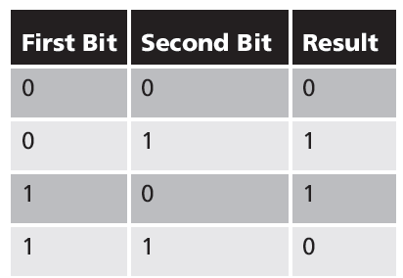
Exclusive OR Operation
Exclusive OR (XOR)
Function of a binary operation

Slide 14
Exclusive OR Operation
Simple example
Plaintext: “The quick brown fox…”
Convert to ASCII binary

Slide 15
Exclusive OR Operation
Simple example
Plaintext: “The quick brown fox…”
Convert to ASCII binary
01010100 01101000 01100101 00100000 01110001 01110101 01101001 01100011 01101011 00100000 01100010 01110010 01101111 01110111 01101110 00100000 01100110 01101111 01111000 00100000 01101010 01110101 01101101 01110000 01100101 01100100 00100000 01101111 01110110 01100101 01110010 00100000 01110100 01101000 01100101 00100000 01101100 01100001 01111010 01111001 00100000 01100100 01101111 01100111 00101110

Slide 16
Exclusive OR Operation
Simple example
Generate random bits as the key.
10011101 11100001 10011011 11010000 11111000 10000011 11001011 11111010 01111100 11111000 10100001 10001010 10111110 11010001 11000011 10010111 11101010 00101110 11111001 10111001 01111000 11010000 01101001 01000111 11110111 00000111 00011011 01100001 00110110 10110010 01110101 01011101 10000011 10110100 01011110 11010101 01111011 11000101 00011110 10011011 11001101 10001000 11011001 01101111 10100101

Slide 17
Exclusive OR Operation
Simple example
Perform bitwise XOR to produce cryptext.
01010100 01101000 01100101 00100000 01110001 01110101 01101001 01100011…
XOR
10011101 11100001 10011011 11010000 11111000 10000011 11001011 11111010…
11001001 10001001 11111110 11110000 10001001 11110110 10100010 10011001…

Slide 18
Exclusive OR Operation
Simple example
Perform bitwise XOR to produce cryptext.
Plaintext
01010100 01101000 01100101 00100000 01110001 01110101 01101001 01100011…
XOR
10011101 11100001 10011011 11010000 11111000 10000011 11001011 11111010…
Key
11001001 10001001 11111110 11110000 10001001 11110110 10100010 10011001…
Cryptext

Slide 19
Exclusive OR Operation
Simple example
Perform bitwise XOR to produce cryptext.
XOR is reversible. If you XOR the cryptext with the same key, you get back the plaintext.
01010100 01101000 01100101 00100000 01110001 01110101 01101001 01100011…
XOR
10011101 11100001 10011011 11010000 11111000 10000011 11001011 11111010…
11001001 10001001 11111110 11110000 10001001 11110110 10100010 10011001…

Slide 20
Vernam Cipher
Also called one-time pad
Uses set of characters only one time for each encryption process
Pad values are added to numeric values that represent plaintext
Each character of plaintext turned into a number
A pad value for that position is added to it
Sum is converted back to a ciphertext character
All numbers must be in the range 1-26

Slide 21
Vernam Cipher
Also called one-time pad
Uses set of characters only one time for each encryption process
Pad values are added to numeric values that represent plaintext
Each character of plaintext turned into a number
A pad value for that position is added to it
Sum is converted back to a ciphertext character
All numbers must be in the range 1-26
Key length must be at least as large as the message length!

Slide 22
Book or Running Key Cipher
Text in a book used as key to decrypt a message
Recipient must know which book is used
Page and line number
Dictionaries and thesauruses commonly used
Grille cipher
Uses a stencil or template with holes cut out
Apply template to particular book or document
Message is revealed in the holes (apertures)

Slide 23
Cryptographic Algorithms
Two broad categories
Symmetric
Asymmetric
Today’s popular cryptosystems:
Combine symmetric and asymmetric algorithms

Slide 24
Cryptographic Notation
Notation varies depending on the source
M represents original message
C represents ciphertext
E represents the encryption process
D represents the decryption process
K represents the key
Example of use: E(M) = C

Slide 25
Symmetric Encryption
Same secret key used to encipher and decipher the message
Also called private key encryption
Mathematical algorithms used
Processes executed quickly by computers
Primary challenge: getting the key to the receiver
Must be done “out of band”
Using a different channel other than one carrying the ciphertext

Slide 26
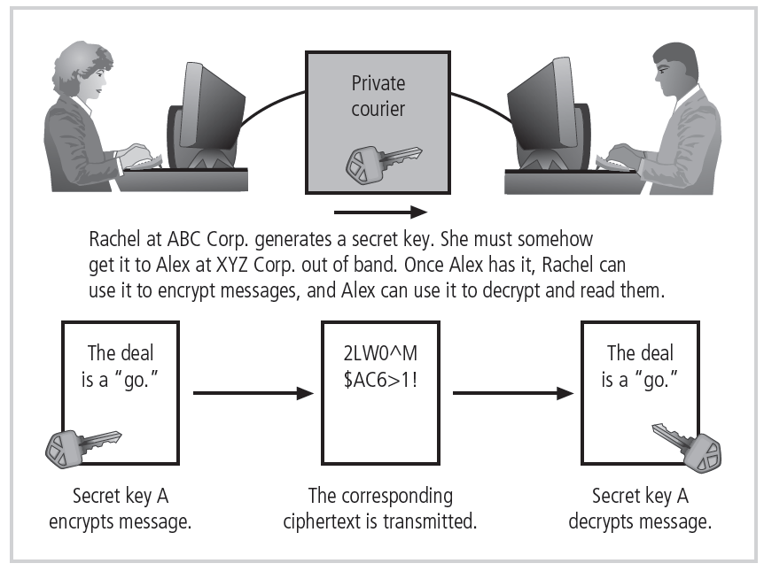

Slide 27
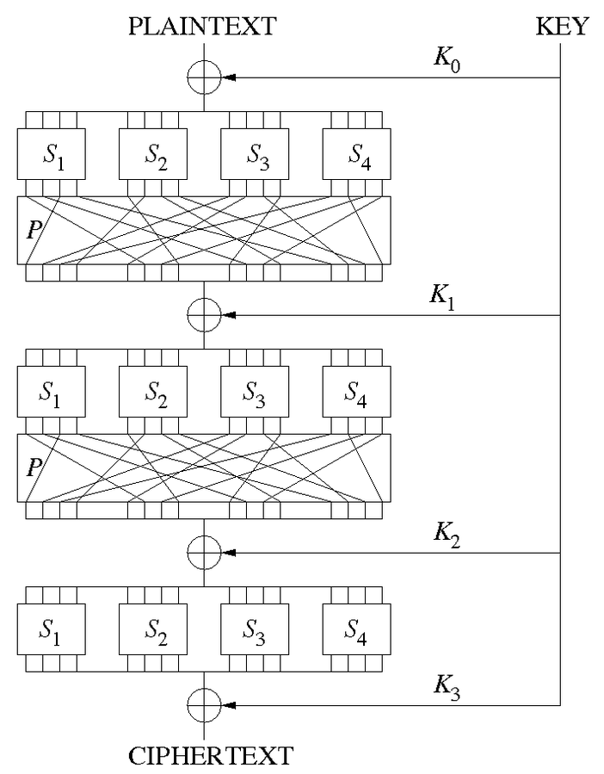
Symmetric Encryption
Substitution-permutation network
S-box: substitution
P-box: permutation
XOR: exclusive or
Substitution-permutation network, 16-bit plain text block, 16-bit “round keys” derived from original key. Operations are invertible.
Source: http://en.wikipedia.org/wiki/Substitution-permutation_network

Slide 28
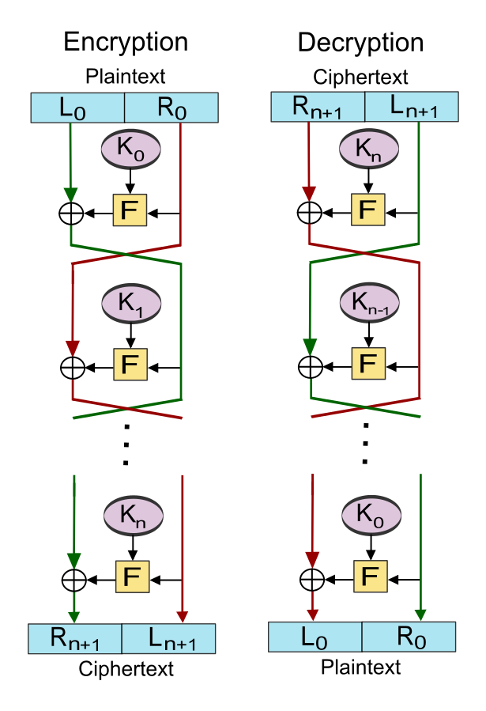
Symmetric Encryption
Feistel ciphers
Divide plaintext in halves
Feed round keys and each half (with round-key) into Feistel function (non-invertible)
Perform n rounds.
The better the function, the better the encryption.

Slide 29
Symmetric Encryption
Data Encryption Standard (DES)
Developed by IBM
Key length: 56 bits
Block size: 64 bits
Adopted as a federal standard in 1976
Key length is insufficient to provide acceptable security
Electronic Frontier Foundation broke a DES key in 56 hours in 1998

Slide 30
Symmetric Encryption
Triple DES (3DES)
Provides level of security far beyond DES
Uses same encryption
Repeats encryption three times
Uses three 64-bit keys
Common implementations use two or three different keys

Slide 31
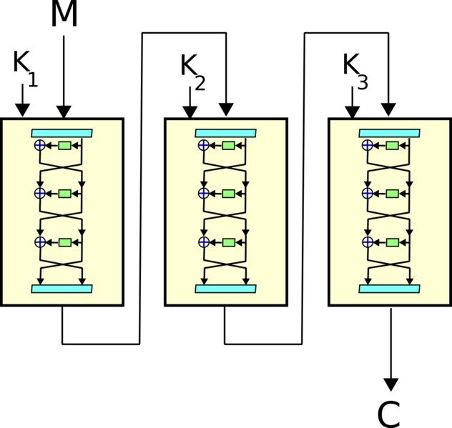
Symmetric Encryption
Feistel-based encryption function.
Encrypt
Decrypt
Encrypt
Source: http://simple.wikipedia.org/wiki/Triple_DES

Slide 32
Symmetric Encryption
If K₁=K₂=K₃ then this is backwards compatible with DES.
Encrypt
Decrypt
Encrypt
Source: http://simple.wikipedia.org/wiki/Triple_DES

Slide 33
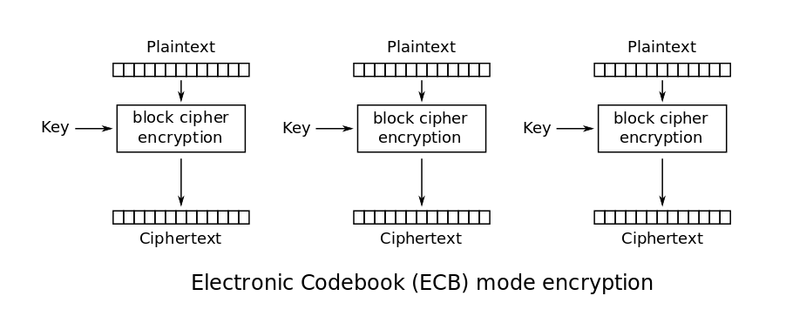
Symmetric Encryption
DES modes of operation
Electronic codebook
Message is divided into blocks and encrypted separately
Source: http://en.wikipedia.org/wiki/Block_cipher_mode_of_operation

Slide 34
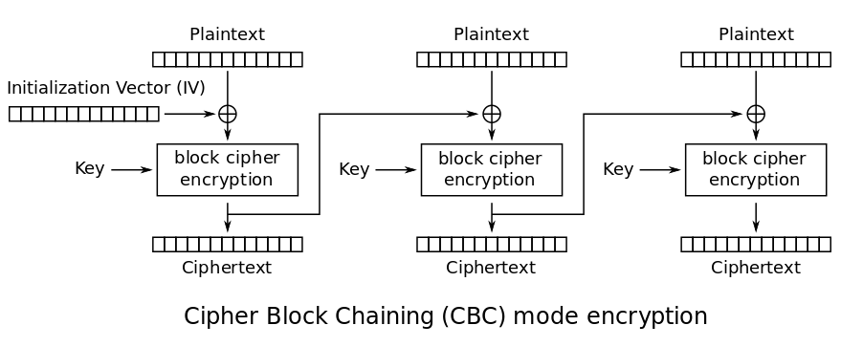
Symmetric Encryption
DES modes of operation
Cipher block chaining
Message is divided into blocks and encrypted depending on previous encrypted blocks.
Source: http://en.wikipedia.org/wiki/Block_cipher_mode_of_operation

Slide 35
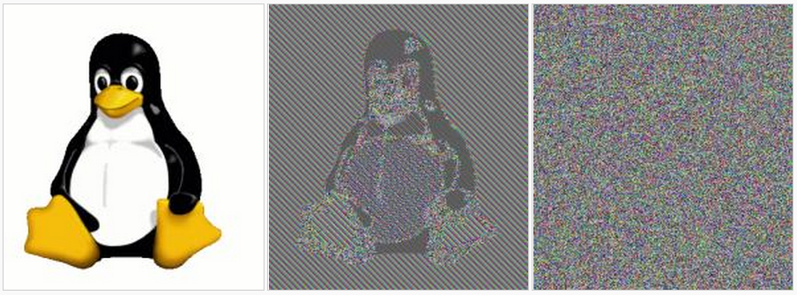
Symmetric Encryption
DES modes of operation
Original
ECB-mode
CBC-mode
Source: http://en.wikipedia.org/wiki/Block_cipher_mode_of_operation

Slide 36
Symmetric Encryption
DES modes of operation
Two other modes: Propagating cipher-block chaining (PCBC) and Cipher feedback (CFB). Similar outcomes to CBC.
Source: http://en.wikipedia.org/wiki/Block_cipher_mode_of_operation

Slide 37
Symmetric Encryption
Advanced Encryption Standard (AES)
Federal Information Processing Standard (FIPS)
Specifies a cryptographic algorithm used within the US government
Not used for National Defense
Replaces both DES and 3DES
Uses the Rijndael Block Cipher
Variable block length
Key lengths of 128, 192, or 256 bits
Number of rounds varies between 9 and 13

Slide 38
Asymmetric Encryption
Uses two different keys
Either key can be used to encrypt or decrypt
Commonly used with one public key and one private key
Public keys shared in reliable directories
Private keys kept secret
RSA
Popular asymmetric key cryptosystem
Developed in 1977 by Rivest, Shamir, and Adleman

Slide 39
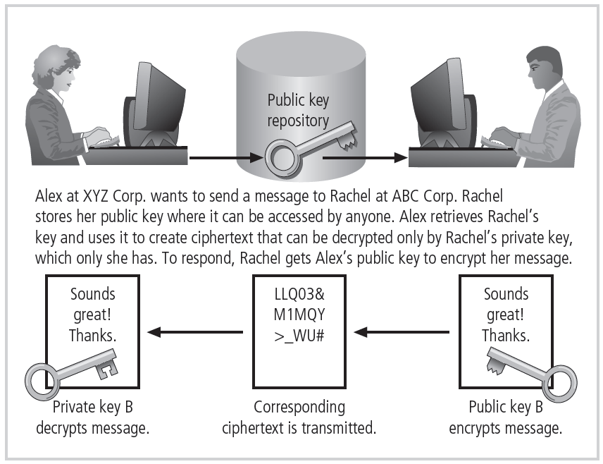
Figure 3-6 Example of asymmetric encryption
© Cengage Learning 2013

Slide 40
Asymmetric Encryption
RSA algorithm
Choose random primes $p$ and $q$ of same bit length
Compute $n = pq$
Compute $φ\left(n\right)=\left(p−1\right)\left(q−1\right)$
Choose $e$ such that $1 < e <φ\left(n\right)$ and $e$ and $n$ share no factors (i.e. are relatively prime)
Compute $d$ such that $d×e \text{mod} φ\left(n\right)=1$
Public key is $(e, n)$and private key is $(d, n)$

Slide 41
Asymmetric Encryption
RSA algorithm
Choose random primes $p$ and $q$ of same bit length
Compute $n = pq$
Compute $φ\left(n\right)=\left(p−1\right)\left(q−1\right)$
Choose $e$ such that $1 < e <φ\left(n\right)$ and $e$ and $n$ share no factors (i.e. are relatively prime)
Compute $d$ such that $d×e \text{mod} φ\left(n\right)=1$
Public key is $(e, n)$and private key is $(d, n)$
p=19, q=31
n=19*31=589
phi=18*30=540
e=17
d=953
Public key is (17,589)
Private key is (953, 589)

Slide 42
Asymmetric Encryption
RSA algorithm
Choose random primes $p$ and $q$ of same bit length
Compute $n = pq$
Compute $φ\left(n\right)=\left(p−1\right)\left(q−1\right)$
Choose $e$ such that $1 < e <φ\left(n\right)$ and $e$ and $n$ share no factors (i.e. are relatively prime)
Compute $d$ such that $d×e \text{mod} φ\left(n\right)=1$
Public key is $(e, n)$and private key is $(d, n)$
p=19, q=31
n=19*31=589
phi=18*30=540
e=17
d=953
Public key is (17,589)
Private key is (953, 589)
Encrypt: E(p) = p^{e} mod n
E(333) = 333¹⁷ mod 589 = 401
Decrypt: D(c) = c^{d} mod n
D(401) = 401⁹⁵³ mod 589 = 333

Slide 43
Asymmetric Encryption
RSA algorithm
Choose random primes $p$ and $q$ of same bit length
Compute $n = pq$
Compute $φ\left(n\right)=\left(p−1\right)\left(q−1\right)$
Choose $e$ such that $1 < e <φ\left(n\right)$ and $e$ and $n$ share no factors (i.e. are relatively prime)
Compute $d$ such that $d×e \text{mod} φ\left(n\right)=1$
Public key is $(e, n)$and private key is $(d, n)$
p=19, q=31
n=19*31=589
phi=18*30=540
e=17
d=953
Public key is (17,589)
Private key is (953, 589)
Now, imagine that p and q are enormous (1024-bit) primes…
Encrypt: E(p) = p^{e} mod n
E(333) = 333¹⁷ mod 589 = 401
Decrypt: D(c) = c^{d} mod n
D(401) = 401⁹⁵³ mod 589 = 333

Slide 44
Asymmetric Encryption
RSA algorithm
Choose random primes $p$ and $q$ of same bit length
Compute $n = pq$
Compute $φ\left(n\right)=\left(p−1\right)\left(q−1\right)$
Choose $e$ such that $1 < e <φ\left(n\right)$ and $e$ and $n$ share no factors (i.e. are relatively prime)
Compute $d$ such that $d×e \text{mod} φ\left(n\right)=1$
Public key is $(e, n)$and private key is $(d, n)$
p=19, q=31
n=19*31=589
phi=18*30=540
e=17
d=953
Public key is (17,589)
Private key is (953, 589)
Now, imagine that p and q are enormous (1024-bit) primes…
See: https://www.cs.drexel.edu/~jpopyack/IntroCS/HW/RSAWorksheet.html
Encrypt: E(p) = p^{e} mod n
E(333) = 333¹⁷ mod 589 = 401
Decrypt: D(c) = c^{d} mod n
D(401) = 401⁹⁵³ mod 589 = 333

Slide 45
Symmetric vs. Asymmetric
Symmetric
Advantages | Disadvantages
Fast, simple algorithms | Needs out-of-band key exchange
Same key encrypts and decrypts | Need one key for every pair of communication endpoints (n² keys for n nodes)
Uses fewer resources | Doesn’t guarantee authenticity
Source: http://voices.yahoo.com/comparing-symmetric-asymmetric-key-encryption-6329400.html?cat=15

Slide 46
Symmetric vs. Asymmetric
Asymmetric
Advantages | Disadvantages
Solves key distribution problems | Must verify identity out-of-band
Can authenticate messages, detect tampering | Slow, resource intensive algorithms, longer key lengths
Provides non-repudiation | Lost, stolen keys cause spectacular damage
Source: http://voices.yahoo.com/comparing-symmetric-asymmetric-key-encryption-6329400.html?cat=15

Slide 47
Hybrid Cryptography Systems
Problem with asymmetric encryption
Holding a two-party conversation requires four keys
Diffie-Hellman key exchange
Exchanging private keys using public-key encryption

Slide 48
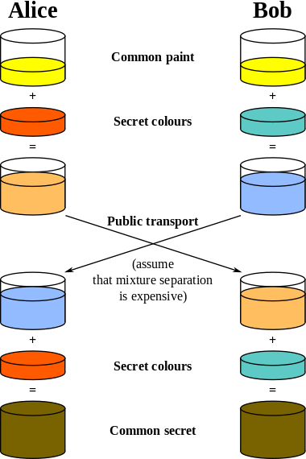
http://en.wikipedia.org/wiki/Diffie%E2%80%93Hellman_key_exchange

Slide 49
Encryption Key Size
Strength of the encryption algorithm corresponds to key size
Length increases number of random guesses required to break code
Details of encrypting algorithms typically published
Allows research to uncover weaknesses

Slide 50
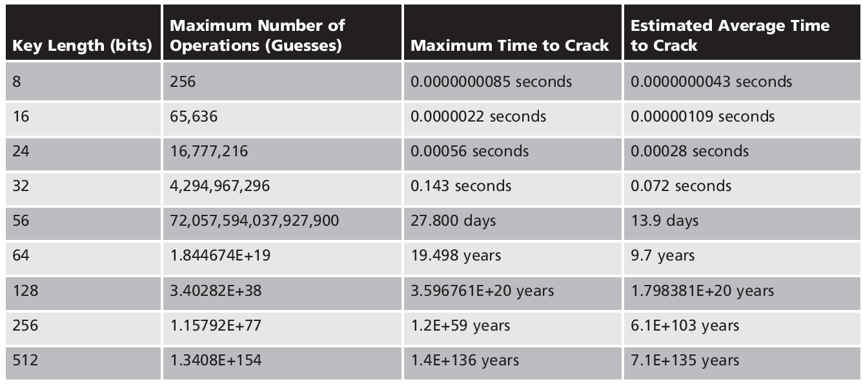
Encryption Key Size

Slide 51
Multiple Encryption Methods
Using same operation (XOR, substitution, transposition) multiple times
No additional benefit gained
Using different operations (XOR, substitution, transposition)
Dramatically scrambles plaintext

Slide 52
Cryptographic Hash Functions
Mathematical algorithms
Generate a message summary or digest
Used to confirm whether message content has changed
Confirms message identity and integrity
The same message always provides the same hash value
Hash cannot be used to determine message contents
Secure Hash Standard (SHS) issued by NIST

Slide 53
Cryptographic Hash Functions
Properties of hash functions
Efficient: should not take much computational power to produce the hash
One way: given H(M) it should be infeasible to determine M
Collision resistant: it should be infeasible to determine M₁ and M₂ such that H(M₁)=H(M₂)

Slide 54
Cryptographic Hash Functions
Attack methods
Rainbow cracking
Rainbow table
Database of precomputed hashes from sequentially calculated passwords
Protecting against rainbow cracking
Protect the file of hashed passwords
Limit login attempts
Hash salting

Slide 55
Cryptographic Hash Functions
Known weak functions
MD2, MD4, MD5, SHA-0, SHA-1
Theoretically weak functions
SHA-256/224, SHA-512/384
No known weaknesses
SHA-3 in 224/256/384/512 varieties

Slide 56
Securing Web Sites
Private keys can also be used for signing
Signing is about authenticity (you are who you say you are)
If I use my private key to sign your public key, then I am vouching for your identity.
How? People can get my public key, decrypt what I encrypted, and compare it against your original public key.
Thus, anyone who trusts me can trust you.

Slide 57
Securing Web Sites
X.509 certificates
Have the public key of the site wanting a valid HTTPS connection
Signed using the private key of a signing authority
HTTPS requires certificates that are signed by a signing authority recognized by the browser.

Slide 58
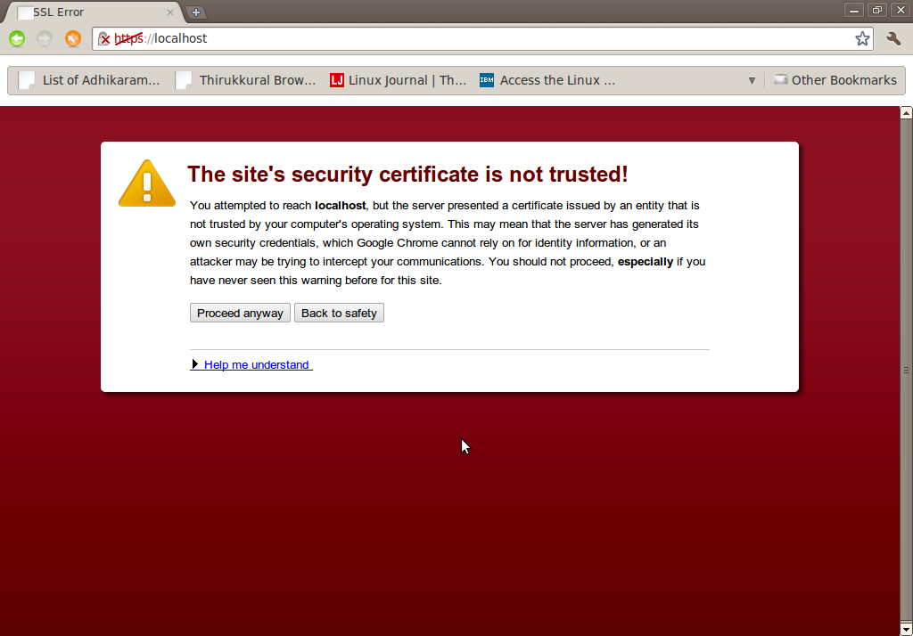
Securing Web Sites
X.509 certificates
Have the public key of the site wanting a valid HTTPS connection
Signed using the private key of a signing authority
HTTPS requires certificates that are signed by a signing authority recognized by the browser.
If the signing authority isn’t recognized, you get this!

Slide 59
Securing Web Sites
X.509 certificates
Have the public key of the site wanting a valid HTTPS connection
Signed using the private key of a signing authority
Certificate:
Data:
Version: 1 (0x0)
Serial Number: 7829 (0x1e95)
Signature Algorithm: md5WithRSAEncryption
Issuer: C=ZA, ST=Western Cape, L=Cape Town, O=Thawte Consulting cc,
OU=Certification Services Division,
CN=Thawte Server CA/emailAddress=server-certs@thawte.com
Validity
Not Before: Jul 9 16:04:02 1998 GMT
Not After : Jul 9 16:04:02 1999 GMT
Subject: C=US, ST=Maryland, L=Pasadena, O=Brent Baccala,
OU=FreeSoft, CN=www.freesoft.org/emailAddress=baccala@freesoft.org
Subject Public Key Info:
Public Key Algorithm: rsaEncryption
RSA Public Key: (1024 bit)
Modulus (1024 bit):
00:b4:31:98:0a:c4:bc:62:c1:88:aa:dc:b0:c8:bb:
33:35:19:d5:0c:64:b9:3d:41:b2:96:fc:f3:31:e1:
66:36:d0:8e:56:12:44:ba:75:eb:e8:1c:9c:5b:66:
70:33:52:14:c9:ec:4f:91:51:70:39:de:53:85:17:
16:94:6e:ee:f4:d5:6f:d5:ca:b3:47:5e:1b:0c:7b:
c5:cc:2b:6b:c1:90:c3:16:31:0d:bf:7a:c7:47:77:
8f:a0:21:c7:4c:d0:16:65:00:c1:0f:d7:b8:80:e3:
d2:75:6b:c1:ea:9e:5c:5c:ea:7d:c1:a1:10:bc:b8:
e8:35:1c:9e:27:52:7e:41:8f
Exponent: 65537 (0x10001)
Signature Algorithm: md5WithRSAEncryption
93:5f:8f:5f:c5:af:bf:0a:ab:a5:6d:fb:24:5f:b6:59:5d:9d:
92:2e:4a:1b:8b:ac:7d:99:17:5d:cd:19:f6:ad:ef:63:2f:92:
ab:2f:4b:cf:0a:13:90:ee:2c:0e:43:03:be:f6:ea:8e:9c:67:
d0:a2:40:03:f7:ef:6a:15:09:79:a9:46:ed:b7:16:1b:41:72:
0d:19:aa:ad:dd:9a:df:ab:97:50:65:f5:5e:85:a6:ef:19:d1:
5a:de:9d:ea:63:cd:cb:cc:6d:5d:01:85:b5:6d:c8:f3:d9:f7:
8f:0e:fc:ba:1f:34:e9:96:6e:6c:cf:f2:ef:9b:bf:de:b5:22:
68:9f
Public key of HTTPS site
Hash of the whole certificate by signing authority
Source http://en.wikipedia.org/wiki/X.509
59

Slide 60
Securing Web Sites
Problem
Public/private key encryption is expensive computationally whereas symmetric key encryption is relatively inexpensive.
But, we would need to securely exchange symmetric keys.
Solution: encrypt a symmetric key using a public key!
60

Slide 61
Securing Web Sites
HTTPS
Get and verify the site’s certificate
Use the public key in the certificate to encrypt a random secret key (generated by the browser) used for symmetric encryption.
Send the symmetric key (encrypted) to the server.
Use that key for the duration of the conversation.
61

Slide 62
Message Authentication
Remember HMACs?
HMAC (K,m) = H((K ⊕ opad) ∥ H((K ⊕ ipad) ∥ m))
Remember K was a secret key. A shared secret can be used to authenticate a message (no tampering or repudiation)

Slide 63
Message Authentication
Remember HMACs?
HMAC (K,m) = H((K ⊕ opad) ∥ H((K ⊕ ipad) ∥ m))
Issue clients or users keys, and all messages must include an HMAC of the message. Recompute the HMAC on your end, and if they match, the message is authentic (as long as the key is kept secret).
Remember K was a secret key. A shared secret can be used to authenticate a message (no tampering or repudiation)

Slide 64
Upcoming deadlines

Slide 65
Question & answer
Questions?
Comments?
Concerns?

