Slide 1
C# Continued
COMP 205 – Week 10
Chunbo Chu

Slide 2
Method

Slide 3
Local variables
The existence of a local variable is limited to the block in which it is created and the blocks nested within it.
It comes into existence at the point at which it is declared.
It goes out of existence when the block completes execution.
Local variables can be declared at any position in the method body.

Slide 4
Classes
Before the days of object-oriented analysis and design, programmers thought of a program as just a sequence of instructions.
A class is a data structure that can store data and execute code. It contains the following:
Data members
Function members
A running C# program is a group of interacting type objects, most of which are instances of classes.

Slide 5
using System; class OutputClass { string myString;
// Constructor public OutputClass(string inputString) { myString = inputString; } // Instance Method public void printString() { Console.WriteLine("{0}", myString); } // Destructor ~OutputClass() { // Some resource cleanup routines } }

Slide 6
// Program start class class ExampleClass {
public static void Main() { // Instance of OutputClass OutputClass outCl = new OutputClass("This is printed by the output class."); outCl.printString(); } }

Slide 7
To allocate memory for the actual data, you use the new operator.
new TypeName ( )

Slide 8
Classes
A class can have multiple constructors.
The specific constructor called depends on the number of parameters and the type of each parameter.
Two types of class members: instance and static.
public static void staticPrinter() { Console.WriteLine("There is only one of me."); }
//In Main()
OutputClass.staticPrinter();
When there is a function to be performed and no intermediate state is required, such as math calculations.

Slide 9
Classes
Destructors look just like constructors, except they have a tilde, "~", in front of them.
They don't take any parameters and do not return a value.
Destructors are places where you could put code to release any resources your class was holding during its lifetime.

Slide 10
Access Modifiers
From within a class, any function member can access any other member of the class simply by using that member’s name.
The access modifier is an optional part of a member declaration that specifies what other parts of the program have access to the member.
Private (default)
public
protected
internal
protected internal

Slide 11
class C1
{
int F1; // Implicit private field
private int F2; // Explicit private field
public int F3; // Public field
void DoCalc() // Implicit private method
{
...
}
public int GetVal() // Public method
{
...
}
}

Slide 15
Instance Fields vs. Local Variables
 | Instance Field | Local Variable
Lifetime | Starts when the instance is created. Ends when the instance is no longer accessible. | Starts at the point in the block where it is declared. Ends when the block completes execution.
Implicit Initialization | Initialized to a default value for the type. | No implicit initialization. The compiler produces an error message if the variable is not assigned to before use.
Storage Area | All the fields of a class are stored in the heap, regardless of whether they are value types or reference types. | Value type: Stored on the stack. Reference type: Reference stored on the stack, and data stored in the heap.

Slide 16
The var keyword
static void Main( )
{
var total = 15;
var mec = new MyExcellentClass();
...
}
Syntactic shorthand for whatever type can be inferred from the initialization on the right-hand side.

Slide 17
It can only be used with local variables—not with fields.
It can only be used when the variable declaration includes an initialization.
Once the compiler infers the type, it is fixed and unchangeable.
Note: The var keyword is not like the JavaScript var that can reference different types.

Slide 18
Local Variables Inside Nested Blocks
Method bodies can have other blocks nested inside them.
In C and C++ you can declare a local variable, and then within a nested block you can declare another local variable with the same name. The inner name masks the outer name while within the inner scope.
In C#, however, you cannot declare another local variable with the same name within the scope of the first name regardless of the level of nesting.

Slide 19
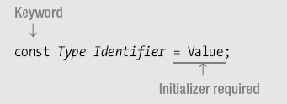
Local Constants
A constant must be initialized at its declaration.
A constant cannot be changed after its declaration.

Slide 20
Value Parameters
When you use value parameters, data is passed to the method by copying the value of the actual parameter to the formal parameter.
When a method is called, the system does the following:
Allocates space on the stack for the formal parameter
Copies the actual parameter to the formal parameter

Slide 21
Reference Parameters
When using a reference parameter, you must use the ref modifier in both the declaration and the invocation of the method.
The actual parameter must be a variable, which must be assigned to before being used as the actual parameter.
If it is a reference type variable, it can be assigned either a reference or the value null.
They do not allocate new memory on the stack for the formal parameters.
A formal parameter name acts as an alias for the actual parameter variable, referring to the same memory location.

Slide 22
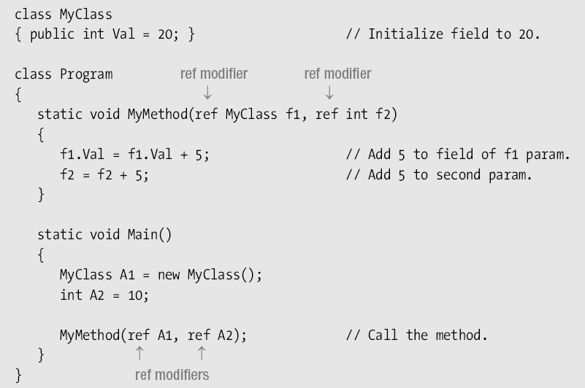

Slide 23
Output Parameters
Are used to pass data from inside the method back out to the calling code
You must use a modifier in both the method declaration and the invocation. With output parameters, the modifier is out, rather than ref.
The actual parameter must be a variable—it cannot be another type of expression.

Slide 24
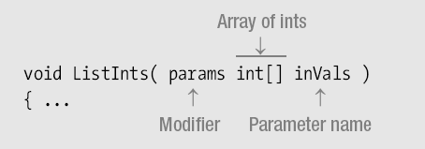
Parameter Arrays
Allow zero or more actual parameters for a particular formal parameter
There can be only one parameter array in a parameter list
If there is one, it must be the last parameter in the list.

Slide 25
Method Invocation
You can supply the actual parameters in two ways
ListInts( 10, 20, 30 ); // Three ints, called the expanded form.
//Or
int[] intArray = {1, 2, 3};
ListInts( intArray ); // An array variable
Unlike Reference or output parameters, parameter arrays
Require the modifier in the declaration
Do not allow it in the invocation

Slide 26
Method Overloading
A class can have more than one method with the same name. This is called method overloading.
Each method with the same name must have a different signature than the others.
The signature of a method consists of the following information from the method header of the method declaration:
The name of the method
The number of parameters
The data types and order of the parameters
The parameter modifiers
The return type is not part of the signature—although it is a common mistake to believe that it is.
The names of the formal parameters are also not part of the signature.

Slide 27
class A
{
long AddValues( int a, int b) { return a + b; }
long AddValues( int a, int b, int c) { return a + b + c; }
long AddValues( float a, float b) { return a + b; }
long AddValues( long a, long b) { return a + b; }
}

Slide 28
Activity
Create a C# program containing a countint class, which has:
a private data member: int[]numbers;
A default constructor that dynamically allocates and assigns five “0”s to numbers.
A constructor that takes an int array and initializes numbers with the actual parameters’ values
A public function listInt() that lists all values in numbers
In your Main(), instantilize a countint object, and test it.

Slide 29
Hint
numbers = new int[] { 0, 0, 0, 0, 0 };
numbers=new int[i]; //to generate an int array of i integers
Int[]val;
Val== null; //if it contains nothing

Slide 30
using System;
using System.Collections.Generic;
using System.Linq;
using System.Text;
namespace ConsoleApplication1
{
class countInt
{
int[]numbers;
public countInt()
{
numbers = new int[] { 0, 0, 0, 0, 0 };
}
public countInt(params int[] Val)
{
if (Val!=null)
{
numbers = new int[Val.Length];
for (int i = 0; i < Val.Length; i++)
numbers[i] = Val[i];
}
}
public void ListInt()
{
if (numbers!=null)
{
for (int i = 0; i < numbers.Length; i++)
Console.Write("{0} ", numbers[i] );
}
}
}

Slide 31
class Program
{
static void Main(string[] args)
{
var mylist=new countInt(1,2,3);
mylist.ListInt();
}
}
}

Slide 32
Class Inheritance
Inheritance is one of the primary concepts of object-oriented programming.
It allows you to reuse existing code.
Through effective employment of reuse, you can save time in your programming.
An existing class, called the base class, is the basis for a new class, called the derived class.
The members of the derived class consist of the following:
The members in its own declaration
The members of the base class

Slide 33
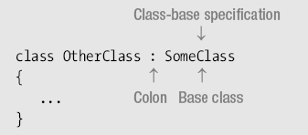
Class Inheritance
To declare a derived class, you add a class-base specification after the class name
A derived class is said to extend its base class, because it includes the members of the base class plus any additional functionality provided in its own declaration.
A derived class cannot delete any of the members it has inherited.

Slide 34
Base class and derived class

Slide 35
Accessing the Inherited Members
Inherited members are accessed just as if they had been declared in the derived class itself.

Slide 36
In C#
All classes, except special class object, are derived classes, even if they don’t have a class-base specification.
Class object is the only one that is not derived, since it is the base of the inheritance hierarchy.
A class declaration can have only a single class listed in its class-base specification. This is called single inheritance.
There is no limit to the level of derivation.

Slide 37
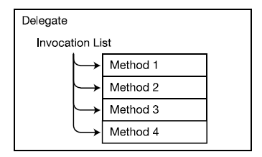
Delegate
A delegate can be thought of as an object that contains an ordered list of methods with the same signature and return type.
The list of methods is called the invocation list.
When a delegate is invoked, it calls each method in its invocation list.

Slide 38
Declaring the Delegate Type
delegate void MyDel ( int x );
The delegate type declaration does not have a method body

Slide 39
Creating the Delegate Object
MyDel delVar;

Slide 40
Combining Delegates
MyDel delA = myInstObj.MyM1;
MyDel delB = SClass.OtherM2;
MyDel delC = delA + delB; // Has combined invocation list

Slide 41
Invoking a Delegate
You invoke a delegate by calling it, as if it were simply a method.
The parameters used to invoke the delegate are used to invoke each of the methods on the invocation list
MyDel delVar = inst.MyM1;
delVar += SCl.m3;
delVar += X.Act;
...
delVar( 55 ); // Invoke the delegate.
...

Slide 42
Events
Traditional Console applications is inflexible in that everything is hard-wired and follows a rigid path of execution.
Modern GUI programs operate on an event-based model
With Windows Forms, there is not a polling mechanism taking up resources and you don't have to code a loop that sits waiting for input. It is all built into the system with events.

Slide 43
Events
A C# event is a class member that is activated whenever the event it was designed for occurs.
A common error is to think of an event as a type!
Anyone interested in the event can register and be notified as soon as the event fires.
At the time an event fires, registered methods will be invoked.
Events and delegates work hand-in-hand to provide a program's functionality.

Slide 44
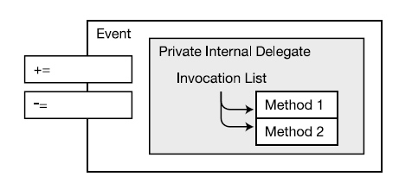
Events and delegates
An event gives structured access to its privately controlled delegate.
When an event is raised, it invokes the delegate, which sequentially calls the methods in the invocation list.

Slide 46
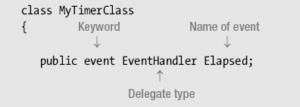
Declaring an Event
An event declaration requires the name of a delegate type. You can either declare one or use one that already exists.
A better idea is to use the predefined delegate type used by the .NET BCL and designated as the standard for use with events.
You are strongly encouraged to use it. It is the EventHandler delegate

Slide 47
public delegate void EventHandler(object sender, EventArgs e);
The first parameter is meant to hold a reference to the object that raised the event.
It is of type object and can, therefore, match any instance of any type.
The second parameter is meant to hold state information of whatever type is appropriate for the application.
The return type is void.

Slide 48
Using the EventArgs Class
The EventArgs class is designed to carry no data. It is used for event handlers that do not need to pass data—and is generally ignored by them.
If you want to pass data, you must declare a class derived from EventArgs, with the appropriate fields to hold the data you want to pass.

Slide 49
An Example
Create a new Windows Form Application
Open Program.cs

Slide 50
// custom delegate public delegate void Startdelegate(); class Eventdemo : Form { // custom event public event Startdelegate StartEvent; public Eventdemo() { Button clickMe = new Button(); clickMe.Parent = this; clickMe.Text = "Click Me"; // an EventHandler delegate is assigned // to the button's Click event clickMe.Click += new EventHandler(OnClickMeClicked);

Slide 51
// our custom "Startdelegate" delegate is assigned // to our custom "StartEvent" event. StartEvent += new Startdelegate(OnStartEvent); // fire our custom event StartEvent(); }
// this method is called when the "clickMe" button is pressed public void OnClickMeClicked(object sender, EventArgs ea) { MessageBox.Show("You Clicked My Button!"); } // this method is called when the "StartEvent" Event is fired public void OnStartEvent() { MessageBox.Show("I Just Started!"); } static void Main(string[] args) { Application.Run(new Eventdemo()); } }

