Slide 1
COMP 205 Introduction to Prolog
Dr. Chunbo Chu
Week 13
Slides Courtesy to: Peter LO

Slide 2
Outline
What is Prolog?
Prolog Programs
Data Types: constant (atoms, numbers), variables and compound terms
Facts and rules
Running Prolog
Queries – running program
Unification
Backtracking

Slide 3
What is Prolog?
Programming in Logic
Declarative language
Focus on describing the problem and desired solution
Use a subset of First Order Logic (Horn clauses)
Characteristics
Knowledge is represented by facts and rules
The system applies logical deduction to find answers for the problem
Depth-first search engine
Notes:
Prolog is a logical and a declarative programming language. The name itself, Prolog, is short for PROgramming in LOGic.
What is prolog ?
An AI Programming Language
Prolog – Logic programming (first order logic).
Philosophy of programming ››› Goal Oriented.
Declarative language (Execution is not in the step-by-step manner).
Characteristics of prolog?
Programming prolog is same as writing down anything you know that is true, in the form of rules and facts.
A.I. problems are usually `searching' problems, prolog is inherently a depth-first search engine.
Programming paradigm for programming paradigms in general
Imperative programming which in contrast concentrates on manipulating state
Procedural programming which in contrast concentrates on sequences of steps to follow
Procedural programming requires that the programmer tell the computer what to do. That is, how to get the output for the range of required inputs. The programmer must know an appropriate algorithm.
The declarative programming requires a more descriptive style. The programmer must know what relationships hold between various entities.

Slide 4
Prolog Programs
Terms
The data objects of the language
Either constant (atom or number), variable or compound term
Facts and Rules
Predicates: “Generalized functions”, allowing multiple return values, used in multiple directions
Facts: Predicates assumed to be true
Rules: P(..) :- P₁(..),P₂(..),…,P_{n}(..).
Notes:
The data objects of Prolog are terms. A term is either a constant, a variable, or a compound term.
Prolog does not employ data types in the way common programming languages usually do. We may rather speak about Prolog lexical elements instead of data types.

Slide 5
Prolog Terms
Constant
Denotes a known entity/object/thing
Includes numbers (integers, floats), atoms
Must begin with a lowercase letter
E.g. john (atom), 123 (integer), ‘hello world’ (atom), -0.05e10 (floating point), [] (atom)
Notes:
Numbers: Most Prolog do not distinguish integers from real numbers.
Atoms: An atom is a sequence consisting of letters, numbers and underscores, which begins with a lower-case letter.
Atoms: An atom is identified by its name, which is a sequence of up to 1023 characters.
Atoms are definite elementary objects, and correspond to proper nouns in natural language.
Starting with a lowercase letter. Note that an atom may not begin with an underscore.
Any sequence of characters delimited by single quotes, such as: ‘yes’, ‘%’
If a single quote character is included in the sequence it must be written twice, for example: ‘can’’t’, ‘’’’

Slide 6
Prolog Terms
Atom
An atom is identified by its name.
No special syntax. However,
Atoms containing spaces or certain other special characters must be surrounded by single quotes.
Atoms beginning with a capital letter must also be quoted, to distinguish them from variables.
Atoms can be constructed in 3 ways:
Strings of letters, digits & the underscore, starting with a lower-case letter: anna x_25 nil
String of special characters: <----> ::== .:.
Strings of characters enclosed in single quotes: ‘Tom’ ‘x_>:’ 'some atom’

Slide 7
Prolog Terms
The empty list, written [], is also an atom.
Atoms are definite elementary objects, and correspond to proper nouns in natural language.
The name of an atom has NO inherent meaning to the computer, but is just a symbol.
Numbers:
Reals: 3.14 -0.573
Integers: 23 5753 -42

Slide 8
Prolog Terms
Variable
Represents an unknown object
Corresponds to improper nouns
A string consisting of letters, numbers and underscore characters
Must begin with an uppercase letter or an underscore
E.g. Name, _type, X, Value, _3, _Result, _
‘_’ is the anonymous variable. It means ‘don’t care’.
Notes:
Variables
Variables are denoted by a string consisting of letters, numbers and underscore characters, and beginning with an upper-case letter or underscore. In the Prolog environment, a variable is not a container that can be assigned to (unlike imperative programming languages). Its behavior is closer to a pattern, which is increasingly specified by unification.
The so called anonymous variable (explained below), a wildcard which means 'any variable', is written as a single underscore (_).
If a variable is only referred to once in a clause, it does not need to be named and may be written as an anonymous variable, indicated by the underline character _.
A clause may contain several anonymous variables; they are all read and treated as distinct variables.

Slide 9
Prolog Terms
Variable
Scope restricted to one clause. i.e. variables with the same name in different clauses are unrelated
The anonymous variable _ is special
getsEaten(X) :- eats(_,X).
Multiple occurrences of _ within the SAME clause are UNRELATED
The variables in Prolog are VERY different from those in imperative languages (eg. C)
Variable are not assigned but instantiated
Notes:
Variables
Variables are denoted by a string consisting of letters, numbers and underscore characters, and beginning with an upper-case letter or underscore. In the Prolog environment, a variable is not a container that can be assigned to (unlike imperative programming languages). Its behaviour is closer to a pattern, which is increasingly specified by unification.
The so called anonymous variable (explained below), a wildcard which means 'any variable', is written as a single underscore (_).
If a variable is only referred to once in a clause, it does not need to be named and may be written as an anonymous variable, indicated by the underline character _.
A clause may contain several anonymous variables; they are all read and treated as distinct variables.

Slide 10
Prolog Terms
Compound Term
Consists of
A function symbol called functor
Term(s) in parentheses separated by commas
Can represent a structured data like tree, list
E.g. tree(tree(a,nil),tree(b,X))
Special cases of compound terms:
Lists are defined inductively:
The atom [] is a list.
A compound term with functor . (dot) and arity 2, whose second argument is a list, is itself a list.

Slide 11
Prolog Terms
Special syntax for denoting lists: .(A, B) is equivalent to [A|B].
.(a,.(b,.(c,[]))) same as [a|[b,c]] same as [a,b,c]
Strings: A sequence of characters surrounded by quotes is equivalent to a list of (numeric) character codes.
String is just a list of ASCII codes.
“Humpty” same as [72,117,109,112,116,121]

Slide 12
Prolog Programs
Programming in Prolog is very different from programming in a procedural language
Prolog programs describe relations, defined by means of clauses: facts and rules
In Prolog you supply a database of facts and rules; you can then perform queries on the database.
The basic unit of Prolog is the predicate entering into the database
Run the program by making some queries

Slide 13
The system try to deduce the query from the facts and rules
The answer is either true or false and the instantiated value of variables
Sometimes, it is the side effects that are wanted, e.g. Printing something on the screen.

Slide 14
Prolog Facts and Rules
Predicate
Defines a relation among elements or properties of elements
Consists of a predicate name (head), term(s) in parentheses separated by commas
e.g. mother(susan, ann), factorial(4,24)
A predicate is either true or false
No inherent meaning for the computer, just relations between objects

Slide 15
Prolog Facts and Rules
Predicate
Can be regarded as generalized function
E.g. append(X,[a,b],Z) may mean X appended to [a,b] gives Z.
Can treat X and [a,b] as input, Z as an output
Can also treat [a,b] and Z as input, X as output, which is asking what list appened to [a,b] gives Z
Can “return” multiple values easily, and the “function” can be used in different directions

Slide 16
Prolog Facts and Rules
Fact
Represents what is assumed to be true
Consists of a predicate ended with a full stop
E.g.
colour(red).
company(theIBM).
course(csc3230,’Fundamentals of AI’).
equal(X,X).
non_leaf(tree(_,_)).
Similar to what is stored in a relational database
Notes:
Programming in Prolog is very different from programming in a procedural language. In Prolog you supply a database of facts and rules; you can then perform queries on the database. The basic unit of Prolog is the predicate, which is defined to be true. A predicate consists of a head and a number of arguments. For example:
cat(tom).
This enters into the database the fact that 'tom' is a 'cat'. More formally, 'cat' is the head, and 'tom' is the single argument.
‘red’ is a colour, ‘colour’ is the head, and ‘red’ is the single argument.
‘TheIBM’ is a company, ‘company’ is the head, and ‘TheIBM’ is the single argument.
Similarly, ‘course’ is the head, and ‘csc3230’ and ‘Fund…’ are arguments.
The “:-” means “if”; this rule means light(on) is true if switch(on) is true.
Rules can also make use of variables; variables begin with capital letters while constants begin with lower case letters.
This means “if someone is a parent of someone and he’s male, he is a father”.
Conjunction (and) is written as ",", while disjunction (or) is written as ";".
Predicate
Defines a relationship among elements or properties of elements
E.g. mother(X, Y), larger(6,4)

Slide 17
Prolog Facts and Rules
Rule
Represents a conditional assertion
The head is a predicate, the body is one or more predicates – Horn clause
Tells how does the truth of a predicate depends on the truth of other predicates
Can be regarded as the body of a function
light(on) :- switch(on).
father(X,Y) :- parent(X,Y), male(X).
between(X,Y,Z) :- before(X,Y), before(Y,Z).
Notes:
Programming in Prolog is very different from programming in a procedural language. In Prolog you supply a database of facts and rules; you can then perform queries on the database. The basic unit of Prolog is the predicate, which is defined to be true. A predicate consists of a head and a number of arguments. For example:
cat(tom).
This enters into the database the fact that 'tom' is a 'cat'. More formally, 'cat' is the head, and 'tom' is the single argument.
‘red’ is a colour, ‘colour’ is the head, and ‘red’ is the single arugment.
‘TheIBM’ is a company, ‘company’ is the head, and ‘TheIBM’ is the single argument.
Similarly, ‘course’ is the head, and ‘csc3230’ and ‘Fund…’ are arguments.
The “:-” means “if”; this rule means light(on) is true if switch(on) is true.
Rules can also make use of variables; variables begin with capital letters while constants begin with lower case letters.
This means “if someone is a parent of someone and he’s male, he is a father”.
Conjunction (and) is written as ",", while disjunction (or) is written as ";".
Predicate
Defines a relationship among elements or properties of elements
E.g. mother(X, Y), larger(6,4)

Slide 18
Prolog Facts and Rules
Rule
Meaning : H(...) is true if B₁(...), B₂(...), ..., B_{n}(...) are all true.
Commas in the body can be read as the logical ‘AND'.
When there are more than 2 rules with the same head, they have the meaning of logical ‘OR’.
H(...) :- B₁(...), B₂(...), ..., B_{n}(...).
Head Goal (Conclusion)
Body Goals (Conditions)

Slide 19
Queries
Ask the program whether a predicate (or conjunction of predicates) is true based on the facts and rules
Similar to function calls in other languages
Similar to queries in database

Slide 20
Queries - Examples
?- father(tom,john).
Asking whether the atom tom is related to the atom john by the predicate father, either by a fact or through rules
May mean: is tom father of john?
?- tutor(csc3230,X).
Ask the system to find an X such that csc3230 is related to X by the predicate tutor
May mean: who are the tutors of csc3230?

Slide 21
Queries - Examples
?-tutor(csc3230,X),supervisor(Y,X).
Find X and Y such that both predicates are true
May mean: who is the supervisor of the tutor of csc3230?
?-append([a,b],[c],Z).
May mean: what is [a,b] appended to [c]?
?-takes(X,csc3230),age(X,A),A>20.
May mean: who takes csc3230 and is above 20?

Slide 22
What is SWI-Prolog?
SWI-Prolog offers a comprehensive Free Software Prolog environment.
Started in 1987 and has been driven by the needs for real-world applications.
These days SWI-Prolog is widely used in research and education as well as for commercial applications

Slide 23
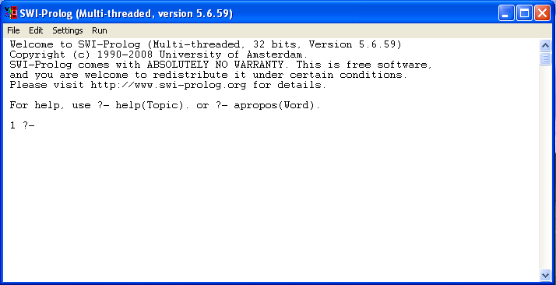
Launch SWI-Prolog

Slide 24
Queries - Examples
assert(before(a,b)).
assert(before(b,c)).
assert(before(a,d)).
assert(before(b,d)).
?- before(a,b).
true
?- before(b,a).
false
?- before(a,X).
X = b /* press ; */
X = d /* press ; */
Notes:
After loading a prolog program, we can submit query to interpreter.
When the interpreter is given a query, it tries to find facts that match the query.
If no outright facts are available, it attempts to satisfy all rules that have the fact as a conclusion.

Slide 25
Queries - Examples
before(a,b).
before(b,c).
before(a,d).
before(b,d).
Save as a .pl file
?- before(X,d).
X = a /* press ; */
X = b /* press ; */
?- before(a,c).
false /* !? */
Notes: If Prolog answers “no”, it doesn’t mean that answer is definitely
false. It means that the system cannot deduce that it is true
given its database – Closed World Assumption

Slide 26
Running Prolog
To load a prolog program
?- [filename]
Or simply double-click the file
Type “help” to get online help.

Slide 27
Activity
Write the following in Prolog
Facts:
Bear eats honey
Bear eats salmon
Rat eats salmon
Salmon eats worm
Queries:
Who eats salmon?
Who eats both honey and salmon?

Slide 28
Activity
eats(X,salmon) , eats(X,honey).
Rules:
For all X and Y, X is in Y’s food chain if Y eats X
food_chain(X,Y) :- eats(Y,X).
For all X and Y: X is in Y’s food chain if Y eats X, Or, Y eats some Z and X is in Z’s foodchain.
food_chain(X,Y) :- eats(Y,Z), food_chain(X,Z).
Queries:
What is in rat’s food chain?
Whose food chain contains worm?

Slide 29
Queries in Prolog
Can be regarded as
SLD-Resolution
DFS search of AND-OR tree
Two main parts
Unification
Match two predicates or terms
Backtracking
When some predicates “fails”, try alterative matchings

Slide 30
Matching
An operation on terms. Two terms match if:
they are identical, or
the variables in both terms can be instantiated to objects in such a way that after the substitution of variables by these objects the terms become identical.
course(N,S,95) matches course(X,fall,G)
course(N,S,95) doesn’t match course(Y,M,996)
course(X) doesn’t match semester(X)

Slide 31
Matching
If matching succeeds it always results in the most general instantiation possible.
course(N,M,85) = course(N1,fall,G).
N = N1
M=fall
G=85

Slide 32
General rules for matching two terms S and T
If S and T are constants then S and T match only if they are the same object.
If S is a variable and T is anything, then they match, and S is instantiated to T.
If S and T are structures then they match only if
S and T have the same principal functor and the same number of components, and
all their corresponding components match.
The resulting instantiation is determined by the matching of the components.

Slide 33
Queries - Unification
Try to match two predicates or terms by suitably instantiating variables
Rules
Term | Another term | Condition
Uninstantiated variable X | Any term | The term does not contain X
Atom or Number | Atom or Number | They are equal
Compound Term | Compound Term | Same functors, same arity, and the corresponding terms unify

Slide 34
Queries – Unification Examples
1st term | 2nd term | Unified? | Variable instantiation
abc | xyz | no
X | Y | yes | X→Y
Z | 123 | yes | Z→123
f(A) | f(234) | yes | A→234
f(A) | f(1,B) | no
f(g(A),A) | f(B,peter) | yes | A→peter, B→g(peter)
t(L,t(X,b)) | t(t(c,d),t([],b)) | yes | L→t(c,d), X→[]
[H|T] | [a,b,c,d] | yes | H→a, T→[b,c,d]

Slide 35
Geometric Example
Use structures to represent simple geometric shapes.
point - two numbers representing X and Y coordinates.
seg - a line defined by two points.
triangle - defined by three points.
point(1,1).
seg( point(1,1), point(2,3) ).
triangle( point(4,2), point(6,4), point(7,1) ).

Slide 36
In the same program we can also use three dimensional points:
point(1,3,5)
This will result in a different relation with the same name.
We want to match:
triangle(point(1,1), A, point(2,3)) with triangle(X, point(4,Y), point(2,Z)).

Slide 37
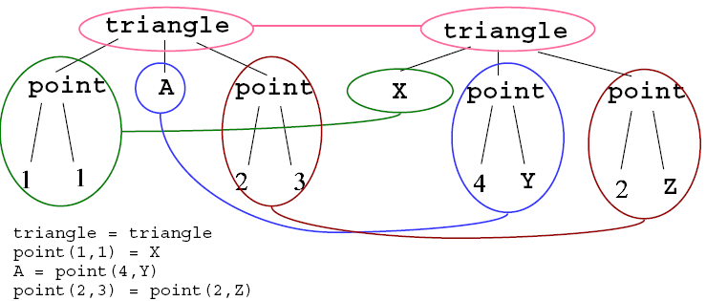
triangle(point(1,1), A, point(2,3)) = triangle(X, point(4,Y), point(2,Z)).

Slide 38
Activity
Define a Prolog program containing facts that define a vertical seg and a horizontal seg.
vertical( seg( point(X,Y), point(X, Y1) ) ).
horizontal( seg( point(X,Y), point(X1,Y) ) ).
To test, type the following:
vertical( seg( point(1,1), point(1,2) )).
horizontal( seg( point(1,1), point(2,Y) )).
vertical( seg( point(2,3), P)).

Slide 39
Arithmetics
Predefined operators for basic arithmetic:
+, -, *, /, mod
If not explicitly requested, the operators are just like any other relation
Example:
X = 1 + 2.
X=1+2

Slide 40
Arithmetics
The predefined operator ‘is’ forces evaluation.
?- X is 1 + 2.
X=3
A is B (A and B here can be anything) means
Evaluate B to a number and perform matching of the result with A
The comparison operators also force evaluation.
?- 145 * 34 > 100.
true

Slide 41
Comparison Operators
X > Y X is greater than Y.
X < Y X is less than Y.
X >= Y X is greater than or equal to Y.
X =< Y X is less than or equal to Y.
X =:= Y the values of X and Y are equal.
X =\= Y the values of X and Y are not equal.

Slide 42
= and =:=
X = Y causes the matching of X and Y and possibly instantiation of variables.
X =:= Y causes an arithmetic evaluation of X and Y, and cannot cause any instantiation of variables.
1 + 2 =:= 2 + 1.
true
1 + 2 = 2 + 1.
false

Slide 43
1 + A = B + 2.
A = 2
B = 1
1 + A =:= B + 2.
ERROR: =:=/2: Arguments are not sufficiently instantiated

Slide 44
Activity: The Greatest Common Devisor
Write a Prolog program that calculates the GCD of two integers.
Given X and Y, the gcd D can be found by:
If X and Y are equal then D is equal to X.
If X < Y then D is equal to the gcd of X and (Y-X).
If Y < X then do the same as in (2) with X and Y interchanged.

Slide 45
gcd(X,X,X).
gcd(X,Y,D) :-
X < Y,
Y1 is Y - X,
gcd(X,Y1,D).
gcd(X,Y,D) :-
Y < X,
gcd(Y,X,D).

Slide 46
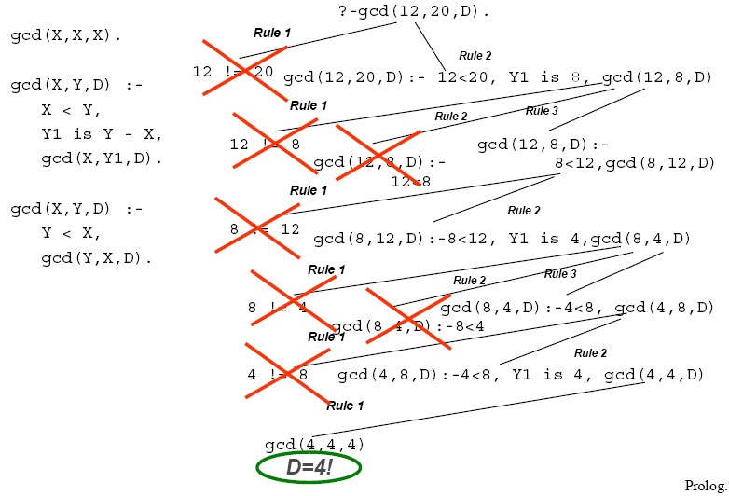
How does it work?

Slide 47
Queries - Backtracking
When asked P₁(..),P₂(..),…,P_{n}(..).
Most Prolog will attempt the following
Unify P₁ with a fact or rule, instantiate variables if needed
If P₁ unifies with more than one fact or rule, the first one is chosen
If succeed, do the same for P₂, and so on from left to right
If all predicates succeed, the whole goal succeeds
If anyone fails, say P_{i}, Prolog backtracks, and try an alternative of P_{i-1}
The predicates are tried in a Depth-First manner
After a successful query, if user presss ‘;’, backtrack and try alternatives

Slide 48
Queries – Backtracking Example
before(a,b).
before(b,c).
before(c,d).
before(A,C) :- before(A,B), before(B,C).
?- before(a,c).
<< Not match
<< Not match
<< Not match

Slide 49
Queries – Backtracking Example
before(a,b).
before(b,c).
before(c,d).
before(A,C) :- before(A,B), before(B,C).
?- before(a,c).
<< Unifed, with A→a,C→c
before(a,c) :- before(a,B), before(B,c).
Call : before(a,B).
<< Put B=b
yes
Exit : before(a,b).
<< Match Fact 1.

Slide 50
Queries – Backtracking Example
before(a,b).
before(b,c).
before(c,d).
before(A,C) :- before(A,B), before(B,C).
?- before(a,c).
<< Unifed, with A→a,C→c
before(a,c) :- before(a,B), before(B,c).
Call : before(b,c).
<< As B=b
yes
Exit : before(b,c).
<< Match Fact 2.

Slide 51
Queries – Backtracking Example
before(a,b).
before(b,c).
before(c,d).
before(A,C) :- before(A,B), before(B,C).
?- before(a,c).
See “AI through Prolog” ch 3 for a more elaborate explanation
<< succeeds, use the rule with A→a,B→b,C→c
before(a,c) :- before(a,b), before(b,c).
yes
yes
yes

Slide 52
References
Artificial Intelligence through Prolog by Neil C. Rowe
http://www.cs.nps.navy.mil/people/faculty/rowe/book/book.html
http://en.wikipedia.org/wiki/Prolog
SICStus Prolog (Summary) prepared by Dr. Jimmy Lee
http://appsrv.cse.cuhk.edu.hk/~csc3230/reference/prolog_primer.ps

