Slide 1
COMP 205 Introduction to Prolog
Dr. Chunbo Chu
Week 14

Slide 2
Student Evaluations
Course
Faculty
Student Services
Course ID: COMP 205
Section Number: V1FF
Instructor’s Name: Chunbo Chu

Slide 3
Review
What is Prolog?
Prolog Programs
Data Types: constant (atoms, numbers), variables and compound terms
Facts and rules
Running Prolog
Queries – running program
Unification
Backtracking

Slide 4
Prolog Programs
Terms
The data objects of the language
Either constant (atom or number), variable or compound term
Facts and Rules
Predicates: “Generalized functions”, allowing multiple return values, used in multiple directions
Facts: Predicates assumed to be true
Rules: P(..) :- P₁(..),P₂(..),…,P_{n}(..).
Notes:
The data objects of Prolog are terms. A term is either a constant, a variable, or a compound term.
Prolog does not employ data types in the way common programming languages usually do. We may rather speak about Prolog lexical elements instead of data types.

Slide 5
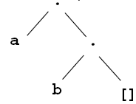
List
A sequence of any number of items.
Structure of lists: .( Head, Tail )
.(a, .(b,[ ])) eq.
Shorthand:
[tom, jerry] is the same as .(tom, .(jerry, [ ]))
[a | tail] is the same as .(a, tail)
[a,b,c] = [a | [b,c]] = [a,b | [c]] = [a,b,c |[ ]]
Elements can be lists and structures:
[a, [1, 2, 3], tom, 1995, date(1,may,1995) ]

Slide 6
Operations on Lists
Membership
member( X, L) if X is a member of the list L.
member(X, [X | Tail]).
member(X, [Head | Tail]) :- member(X, Tail).
Activity
How to get all members in a list [1, 2, 3]?
member(X,[1,2,3]).

Slide 7
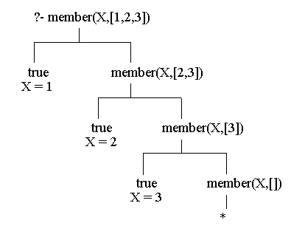
How?

Slide 8
member([3,Y], [[1,a],[2,m],[3,z],[4,v],[3,p]]).
Y = z ;
Y = p ;
Activity
Find all the numbers in [23,45,67,12,222,19,9,6] whose square is less than 100.
member(X,[23,45,67,12,222,19,9,6]), Y is X*X, Y < 100.

Slide 9
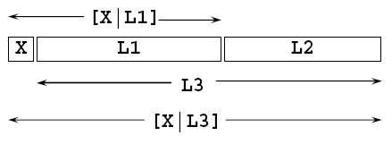
Concatenation
append(L1, L2, L3) if L3 is the concatenation of L1 and L2.
append([ ], L, L).
append([X|L1], L2, [X|L3]) :- append(L1, L2, L3).

Slide 10
?- append( [a,b,c], [1,2,3], L).
L = [a,b,c,1,2,3]
?- append( L1, L2, [a,b,c] ).
L1 = []
L2 = [a,b,c];
L1 = [a]
L2 = [b,c];
L1 = [a,b]
L2 = [c];
L1 = [a,b,c]
L2 = [];
false

Slide 11
Activity
Given [1,2,3,4,5,6,7], find the sublist before 4, and the sublist after 4.
?- append( Before, [4|After], [1,2,3,4,5,6,7]).
Before = [1,2,3]
After = [5,6,7]
Find the immediate predecessor and successor of 4.
append(_, [Pred, 4, Succ |_], [1,2,3,4,5,6,7]).
Pred = 3
Succ = 5

Slide 12
Redefining member using conc:
member1(X, L) :- append(_, [X|_], L).
Permutations
?-permutation( [a,b,c], P).
P = [a,b,c];
P = [a,c,b];
P = [b,a,c];

Slide 13
List Length
The length of a list can be calculated in the following way:
if the list is empty then its length is 0.
if the list is not empty then List = [Head | Tail]. In this case the length is equal to 1 plus the length of the tail Tail.
length is built in. If you want to try defining it, change the name...

Slide 14
length([], 0).
length([_|Tail],N) :- length(Tail, N1),
N is 1 + N1.
?-length([a,b,[c,d],e], N).
N = 4
?-length(L,4).
[_G337, _G340, _343, _346]

Slide 15
Database Query
Represent a database about families as a set of facts. Each family will be a clause.
The structure of a family:
each family has a husband, a wife and children.
children are represented as a list.
each person has a name, surname, date of birth and job.

Slide 16
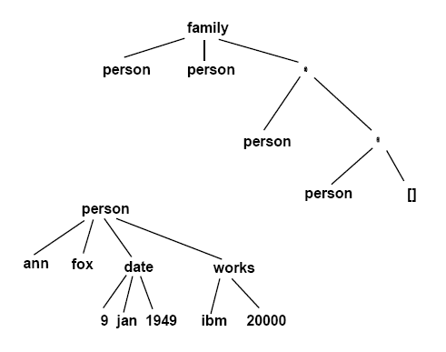

Slide 17
Example:
family(
person(tom, fox, date(7,may,1950), works(bbc,15200)),
person(ann, fox, date(9,jan,1949), works(ibm,20000)),
[ person(pat, fox, date(1,feb,1973), unemployed),
person(jim, fox, date(4,may,1976), unemployed)]).

Slide 18
Structure Queries
All armstrong families:
family( person(_,armstrong,_,_),_,_)
Are there families with 3 children?
family(_,_,[_,_,_])
Names of families with 3 children.
family(person(_,Name,_,_),_,[_,_,_])

Slide 19
All married women that have at least two children:
family(_,person(Name,Surname,_,_),[_,_|_]).

Slide 20
Structure Queries
Defining useful relations:
husband(X) :- family(X,_,_).
wife(X) :- family(_,X,_).
child(X) :- family(_,_,Children), member(X, Children).
exists( Person ) :- husband(Person); wife(Person); child(Person).
dateofbirth( person(_,_,Date,_),Date).
salary(person(_,_,_,works(_,S)), S).
salary(person(_,_,_,unemployed), 0).

Slide 21
Names of all people in the database:
exists( person(Name,Surname,_,_)).
All employed wives:
wife(person(Name,Surname,_,works(_,_))).
Unemployed people born before 1963:
exists(person(Name,Surname,date(_,_,Year), unemployed)), Year < 1963.

Slide 22
People born before 1950 whose salary is less than 8000:
exists(Person),dateofbirth(Person,date(_,_,Year)),Year < 1950,salary(Person, Salary), Salary < 8000.

Slide 23
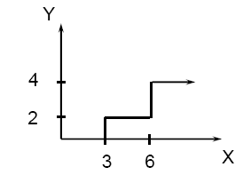
Controlling Backtracking
if X < 3 then Y = 0
if 3 <= X and X < 6 then Y = 2
if 6 <= X then Y = 4

Slide 24
The relation f(X,Y) in prolog:
f(X,0) :- X<3.
f(X,2) :- 3=<X, X<6.
f(X,4) :- 6=<X.

Slide 25
Controlling Backtracking
This procedure assumes that before f(X,Y) is executed X is already instantiated to a number.
The goal: “f(1,Y), 2<Y.” fails, but before prolog replies ‘false’, it tries all 3 rules.
The three rules are mutually exclusive so that one of them at most will succeed. If the goal matches the first rule and then fails, there is no point in trying the others.

Slide 26
Controlling Backtracking: Cut
Automatic backtracking can cause inefficiency.
A cut prevents backtracking from some point on.
Written as a ‘!’ sub-goal that always succeeds, but prevents backtracking through it.

Slide 27
Correcting the example:
f(X,0) :- X<3, !.
f(X,2) :- 3=<X, X<6, !.
f(X,4) :- 6=<X.
Whenever the goal f(X,Y) is encountered, only the first rule that matches will be tried.
If we now ask again “f(2,Y), 2<Y.” we will get the same answer, ‘false’, but only the first rule of ‘f’ will be tried.

Slide 28
Another problem:
If we ask:
?- f(7,Y).
Y=4
What happened:
7<3 --> fail
3=<7, 7<6 --> fail
6=<7 --> success.

Slide 29
Another improvement: The logical rule
if X<3 then Y=0,
otherwise if X<6 then Y=2,
otherwise Y=4.
is translated into:
f(X,0) :- X<3, !.
f(X,2) :- X<6, !.
f(X,4).

Slide 30
The last change improved efficiency. BUT, removing the cuts now will change the result !!!
?-f(1,Y).
Y = 0;
Y = 2;
Y = 4;
false
In this version the cuts do not only effect the
procedural meaning of the program, but also change the declarative meaning.

Slide 31
Red and Green cuts:
When a cut has no effect on the declarative meaning of the program it is called a ‘green cut’. When reading a program, green cuts can simply be ignored.
Cuts that do effect the declarative meaning are called ‘red cuts’. This type of cuts make programs hard to understand, and they should be used with special care.

Slide 32
Queries - Backtracking
When asked P₁(..),P₂(..),…,P_{n}(..).
Most Prolog will attempt the following
Unify P₁ with a fact or rule, instantiate variables if needed
If P₁ unifies with more than one fact or rule, the first one is chosen
If succeed, do the same for P₂, and so on from left to right
If all predicates succeed, the whole goal succeeds
If anyone fails, say P_{i}, Prolog backtracks, and try an alternative of P_{i-1}
The predicates are tried in a Depth-First manner
After a successful query, if user presss ‘;’, backtrack and try alternatives

Slide 33
Queries – Backtracking Example
before(a,b).
before(b,c).
before(c,d).
before(A,C) :- before(A,B), before(B,C).
?- before(a,c).
<< Not match
<< Not match
<< Not match

Slide 34
Queries – Backtracking Example
before(a,b).
before(b,c).
before(c,d).
before(A,C) :- before(A,B), before(B,C).
?- before(a,c).
<< Unifed, with A→a,C→c
before(a,c) :- before(a,B), before(B,c).
Call : before(a,B).
<< Put B=b
yes
Exit : before(a,b).
<< Match Fact 1.

Slide 35
Queries – Backtracking Example
before(a,b).
before(b,c).
before(c,d).
before(A,C) :- before(A,B), before(B,C).
?- before(a,c).
<< Unifed, with A→a,C→c
before(a,c) :- before(a,B), before(B,c).
Call : before(b,c).
<< As B=b
yes
Exit : before(b,c).
<< Match Fact 2.

Slide 36
Queries – Backtracking Example
before(a,b).
before(b,c).
before(c,d).
before(A,C) :- before(A,B), before(B,C).
?- before(a,c).
<< succeeds, use the rule with A→a,B→b,C→c
before(a,c) :- before(a,b), before(b,c).
yes
yes
yes

Slide 37
The Meaning of Cut
When the cut is encountered as a goal it succeeds immediately, but it commits the system to all choices made between the time the parent goal was invoked and the time the cut was encountered.
H :- B1, B2, ... , Bm, !, ... Bn.
when the ! is encountered:
The solution to B1..Bm is frozen, and all other possible solutions are discarded.
The parent goal cannot be matched to any other rule.

Slide 38
Consider the program
C :- P, Q, R, !, S, T, U.
C :- V.
A :- B, C, D.
And the goal: A
Backtracking is possible within P,Q,R.
When the cut is reached, the current solution of P,Q,R is chosen, and all other solutions are dumped.

Slide 39
The alternative clause “C :- V” is also dumped.
Backtracking IS possible in S,T,U.
The parent goal is “C” so the goal A is not effected.
The automatic backtracking in B,C,D is active.

Slide 40
Examples using CUT
holiday(friday,may1). weather(friday,fair). weather(saturday,fair). weather(sunday,fair). weekend(saturday).
weekend(sunday). % We go for picnics on good weekends and May 1st
picnic(Day) :- weather(Day,fair), weekend(Day).
picnic(Day) :- holiday(Day,may1).

Slide 41
?- picnic(When).
…
Now change the definition of picnic to the following:
picnic(Day) :- weather(Day,fair), !, weekend(Day).

Slide 42
Negation
The special goal fail always fails. ( like 1=0. )
The special goal true always succeeds. ( like 1=1. )
“Mary likes all animals but snakes”
likes( mary, X) :- snake(X), !, fail.
likes( mary, X) :- animal(X).

Slide 43
Define the relation “different” by the matching meaning - two terms are different iff they do not match.
different(X, X) :- !, fail.
different(X, Y).

Slide 44
Negation
Defining “not”:
if Goal succeeds then not(Goal) fails.
Otherwise not(Goal) succeeds.
not(P) :- P, !, fail.
not(P).
NOT is a built in prolog procedure, defined as a prefix operator:
not(snake(X)) ==> not snake(X)

Slide 45
Previous examples that use the combination “!, fail” can now be rewritten:
different(X, Y) :- not (X = Y).

