Slide 1
JavaScript: Introduction to Scripting
COMP 205 - Week 4
Dr. Chunbo Chu

Slide 2
Overview
JavaScript
  Syntax
  Functions
  Objects
Document Object Model
  Dynamic HTML

Slide 3
JavaScript
JavaScript is a scripting language
  A scripting language is a lightweight programming language
  Allows some control of a single or many software application(s).
Object-based language
  Object: Programming code and data that can be treated as an individual unit or component
  Statements: Individual lines in a programming language
  Methods: Groups of statements related to a particular object
An interpreted language

Slide 4
Java and JavaScript
NOT the same!
JavaScript’s real name is ECMAScript
Java and JavaScript are two completely different languages in both concept and design!
Java (developed by Sun Microsystems) is a powerful and much more complex programming language - in the same category as C and C++.

Slide 5
Behavioral Layer
Web pages have 3 layers…
Structural/Content Layer (XHTML)
  The meat and potatoes
Presentational Layer (CSS)
  How things look; garnishing the meat and potatoes on a pretty plate
Behavioral Layer (JavaScript and DOM)
  How websites behave; the meat can jump off the plate if you want it to.

Slide 6
Client-side Languages
User-agent (web browser) requests a web page
JavaScript is executed on PC
Can affect the Browser and the page itself
http request
http response
Web page (with JavaScript) is sent to PC

Slide 7
Client-side
What kind of things can you do with JavaScript?
Validating Form information,
  i.e., making sure all the fields are complete before submitting data back to the server
Modifying a web page based on Mouse Events.
  Can turn a web page into a user interface with interactive buttons and controls

Slide 8
Server-side Languages
User-agent (web browser) requests a web page
User never sees the PHP, only the output
Cannot affect the browser or client PC
http request
http response
Server detects PHP code in page, executes the code, and sends the output to the user
Web page (with PHP Output) sent to PC

Slide 9
JavaScript
What it is?
  It is NOT Java
  It is NOT Server-side programming
    Users can see code
  It is a client-side programming tool
  It is embedded within an HTML page
  JavaScript is case-sensitive
What it does?
  Allows interactive computing at the client level
  Supported by IE, Netscape, Firefox, etc.
  Dynamically changes HTML
  Reacts to events
  Read and write HTML elements
  Validates data

Slide 10
The First JavaScript Program
  <script> and </script>: notify the browser that JavaScript tatements are contained within
<html>
<body>
<script type="text/javascript">
document.writeln("<h1>Hello World! This is Me</h1>");
</script>
</body>
</html>
    type attribute: Specifies the type of file and the scripting language use
  Document Object: Represents the content of a browser’s window
    writeln method: Write a line in the document
  Semicolons are optional!

Slide 11
Where can you put JavaScript?
You can have more than one <script> element
Can be placed anywhere inside body or head of the html document.
Commands in JavaScript are case sensitive.

Slide 12
<html>
<head> <title> My first JavaScript </title>
<script type="text/javascript">
document.write("<h1 style=\"color:red\">");
document.write(" Hello World!"+ "This is Me</h1>");
</script>
</head>
<body></body>
</html>
    Escape character ( \ ): Indicates “special” character is used in the string

Slide 13
Some common escape sequences

Slide 14
alert
<html>
<body>
<script type="text/javascript">
alert("Hello World");
</script>
</body>
</html>
    alert method: Dialog box

Slide 15
confirm
<html>
<body>
<script type="text/javascript">
confirm("Do you want to copy the files?");
</script>
</body>
</html>

Slide 16
JavaScript Variables
Variables are used to store data.
A variable is a "container" for information you want to store.
Value can change during the script.
Refer to a variable by name to see its value or to change its value.
Rules for variable names:
  Variable names are case sensitive
  They must begin with a letter or the underscore character
    strname – STRNAME (not same)
Group definitions at the beginning.

Slide 17
Example: Dynamic Welcome Page
A script can adapt the content based on input from the user or other variables
  Example:
    A prompt box is often used if you want the user to input a value before entering a page.
    When a prompt box pops up, the user will have to click either "OK" or "Cancel" to proceed after entering an input value.
    If the user clicks "OK“, the box returns the input value. If the user clicks "Cancel“, the box returns null.

Slide 18
<html>
<body>
<script type="text/javascript">
var name;
name=prompt ("Please enter your name", "student");
document.write("<h1>Hello, " + name + ", Welcome to COMP 205!</h1>");
</script>
</body>
</html>

Slide 19
JavaScript Comments
Single line comments start with //
Multi line comments start with /* and end with */
<script type="text/javascript">
/*
The code below will write
one heading and two paragraphs
*/
document.write("<h1>This is a heading</h1>");
document.write("<p>This is a paragraph.</p>");
//document.write("<p>This is another paragraph.</p>");
</script>

Slide 20
JavaScript Comments
DO:
  Add comments to source code.
  Keep comments up to date.
  Use comments to explain sections of code.
Don't:
  Use comments for code that is self-explanatory.

Slide 21
JavaScript Operators
Arithmetic Operators
Arithmetic operators are used to perform arithmetic between variables and/or values.
Operator | Description | Example | Result
+ | Addition | x=2 | 4
 |  | y=2
 |  | x+y
- | Subtraction | x=5 | 3
 |  | y=2
 |  | x-y
* | Multiplication | x=5 | 20
 |  | y=4
 |  | x*y
/ | Division | 15/5 | 3
 |  | 5/2 | 2.5
% | Modulus (division remainder) | 5%2 | 1
 |  | 10%8 | 2
 |  | 10%2 | 0
++ | Increment | x=5 | x=6
 |  | x++
-- | Decrement | x=5 | x=4
 |  | x--

Slide 22
JavaScript Operators – 2
Assignment Operators
Assignment operators are used to assign values to JavaScript variables.
Operator | Example | Is The Same As
= | x=y | x=y
+= | x+=y | x=x+y
-= | x-=y | x=x-y
*= | x*=y | x=x*y
/= | x/=y | x=x/y
%= | x%=y | x=x%y

Slide 23
The + Operator Used on Strings
To add two or more string variables together, use the + operator.
  txt1="What a very";
  txt2="nice day";
  txt3=txt1 + txt2;
  After the execution of the statements above, the variable txt3 contains "What a verynice day".
To add a space between the two strings, insert a space into one of the strings:
  txt1="What a very ";
  txt2="nice day";
  txt3=txt1 + txt2;
or insert a space into the expression:
  txt1="What a very";
  txt2="nice day";
  txt3=txt1+" "+txt2;

Slide 24
Exercise:
Prompt user for two integers
Calculate the sum
Display the sum in the HTML page.

Slide 25
<html>
<body>
<script type="text/javascript">
var input1, input2,sum;
input1=prompt ("Please enter a number", "0");
input2=prompt ("Please enter a number", "0");
num1=parseInt(input1);
num2=parseInt(input2);
sum=num1+num2;
document.writeln("<h1>the sum is " + sum + "</h1>");
</script>
</body>
</html>
parseInt():Converts its string argument to an integer.

Slide 26
Error
If user types a non-integer value or clicks Cancel button, a runtime logic error will occur.
  NaN (not a number): “The sum is NaN”

Slide 27
Javascript Data Types
String
Integral
Floating
- default type
ordinal numbers
  Use parseInt()
real numbers
  Use parseFloat()

Slide 28
Display Floating Point Number
toFixed() function
Example:
var number = 2; document.writeln(“<h1>number.toFixed(2)</h1>”;
Result:
2.00

Slide 29
Memory Concepts
Variable names correspond to locations in the computer’s memory
Every variable has a name, a type, and a value
Read value from a memory location
  nondestructive

Slide 30
number1
45

Slide 31
number1
45
number2
72

Slide 32
number1
45
number2
72
sum
117

Slide 33
Decision Making:
Equality and Relational Operators
Decision based on the truth or falsity of a condition
  Equality operators
  Relational operators

Slide 34
JavaScript Operators - 3
Comparison Operators
Comparison operators are used in logical statements to determine equality or difference between variables or values.
Operator | Description | Example
== | is equal to | 5==8 returns false
=== | is exactly equal to (checks for both value and type) | x=5
 |  | y="5"
 |  | x==y returns true
 |  | x===y returns false
!= | is not equal | 5!=8 returns true
> | is greater than | 5>8 returns false
< | is less than | 5<8 returns true
>= | is greater than or equal to | 5>=8 returns false
<= | is less than or equal to | 5<=8 returns true

Slide 35
JavaScript Operators - 4
Logical Operators
Logical operators are used to determine the logic between variables or values.
Operator | Description | Example
&& | and | x=6
 |  | y=3
 |  | (x < 10 && y > 1) returns true
|| | or | x=6
 |  | y=3
 |  | (x==5 || y==5) returns false
! | not | x=6
 |  | y=3
 |  | !(x==y) returns true

Slide 36
Conditional Statements
In JavaScript we have the following conditional statements:
if statement - use this statement if you want to execute some code only if a specified condition is true
if...else statement - use this statement if you want to execute some code if the condition is true and another code if the condition is false
if...else if....else statement - use this statement if you want to select one of many blocks of code to be executed
switch statement - use this statement if you want to select one of many blocks of code to be executed

Slide 37
Conditional Statements - 2
if (condition)
{
code to be executed if condition is true
}
if (condition)
{
code to be executed if condition is true
}
else
{
code to be executed if condition is not true
}

Slide 38
Conditional Statements Examples
<script>
x=3
if(x<0)
{
alert ("negatif")
}
else
{
alert ("pozitif")
}
</script>

Slide 39
Conditional Statements Examples - 2
<script>
c=confirm("Are you sure you like COMP205?")
if(c)
{
alert ("Yay!")
}
else
{
alert (":(")
}
</script>

Slide 40
Conditional Statements Examples - 3
<script>
p=prompt("What’s the time?", " ")
if(p=="12")
{
alert("Time for Lunch!")
}
else
{
alert("Sorry..")
}
</script>

Slide 41
JavaScript Source File
JavaScript programs can be used in two ways:
  Incorporated directly into an HTML file
    Using <script> tag
  Placed in an external (source) file
    Has file extension .js
    Contains only JavaScript statements

Slide 42
JavaScript Source File
Advantages of JavaScript source files
  Makes HTML document neater (less confusing)
  JavaScript can be shared among multiple HTML files
  Hides JavaScript code from incompatible browsers
  Can use a combination of embedded and non–embedded code
    Allows finer granularity in coding functionality
    JavaScript sections executed in order of location within HTML document

Slide 43
JavaScript Source File
Use src attribute of <script> tag to denote source of JavaScript statements
  Browser will ignore any JavaScript statements inside <script> and </script> if src attribute is used
Cannot include HTML tags in source file
    <script language=“text/JavaScript” src=“c:\source.js”>
    </script>

Slide 44
Functions: why should we?
You don't have frequently used JavaScript code repeated all over your page (or web site).
You enter the code in one place and refer to it from anywhere in the document
Should the code need changing later, you only need to change it once.
When a browser reads a JavaScript function, the code is NOT executed until a call is made to run that function.

Slide 45
Functions in JavaScript
A Function is a group of methods (actions) joined together to undertake a complex task.
Executed by an event or by a call to the function.
In JavaScript functions must be defined.
EXAMPLE:
function display( ) {
alert(“Have a great day”)
}
Once defined functions can be called at need.
Can be defined both in the <head> and in the <body> section
It could be wise to put functions in the <head> section. Why?

Slide 46
Functions in JavaScript
Note:
  No type information in function signature
  Can declare a function with no arguments, then pass it some!
  and access with arguments array within function

Slide 47
HTML Forms
Forms allow us to have the user enter information into our webpage
  e.g.: username and password, etc
They are indicated with the <FORM> tag, combined with (typically) many <INPUT> tags

Slide 48
Creating an interactive page
Use of event programming.
An event is anything that happens to an object or element of an object.
  Click on a button: click event
  Select some text: select event
  Mouse hovering over: mouseover event
When an event happen, we need to have an event handler.

Slide 49
Let us create a simple button
<html>
<body>
<h1> Hey you are in luck. Do you need a date for valentine’s day? </h1>
<form>
<input type="button" name="button1"
value="Yes! I need a date"/>
</form>
</body>
</html>
Type of GUI
Button Identifier
The text that appear
on the button

Slide 50
Add event programming - body
<body>
<h1> Hey you are in luck.. Do you need a date for valentine’s day? </h1>
<form>
<input type="button" name="button1"
value="Yes! I need a date"
onclick="displayMyMessage() "/>
</form>
</BODY>
</HTML>

Slide 51
Add event programming - head
<HTML>
<HEAD>
<TITLE>Interactive Web Page</TITLE>
<script type="text/javascript">
function displayMyMessage(){
alert("Sorry! Can’t help you today!");
}
</script>
</HEAD>

Slide 52
Declaring functions in head
Most event programming handlers activate some form of JavaScript functions that is declared in the “head”
We’ll start to do that immediately.
Good Practice.
You declare the function, and you write a series of instructions of “what to do”
In this case, we are just “displaying” a message with a “alert” box.

Slide 53
Exercise:
<head>
<title>Interactive Web Page</title>
<script type="text/javascript">
function displayMyMessage1(){
}
function displayMyMessage2(){
}
</script>
</HEAD>
Make a page that have two buttons.
It also has two JavaScript functions declared.
If you press on one button, one of the functions will be called (activated). If you press the other button, the other function will be called instead.

Slide 54
Object Oriented Programming (OOP)
An object is a unique programming entity that has attributes to describe it and methods to retrieve/set attribute values.
We can create a blueprint of an object called a class.
We can create a usable instance of a class through instantiation.

Slide 55
Encapsulation
Data and the ways to get at that data are wrapped in a single package, a class.
The only way to access such data is through that package. This idea translates to information hiding.
Other OOP concepts:
  Inheritance
  Polymorphism

Slide 56
Is JavaScript “Object-Oriented?”
Some call it “Object-Based” instead …
JavaScript uses objects by way of supporting inheritance and encapsulation, but it doesn't really provide support for polymorphism.
We can create new, custom, re-usable objects in JavaScript that include their own methods, properties and events.

Slide 57
Key Objects in JavaScript
Key objects
  http://www.w3schools.com/jsref/default.asp
Exhaustive list
  http://www.devguru.com/Technologies/ecmascript/quickref/js_objects.html
String
Date

Slide 58
String Object
JavaScript’s string and character-processing capabilities
Appropriate for processing names, addresses, credit card information, etc.
Fundamentals of Characters and Strings
  Characters
    Fundamental building blocks of JavaScript programs
  String
    Series of characters treated as a single unit

Slide 59
Creating Strings
To create a string object, we use a constructor method:
var strMyName = new String(“”);

Slide 60
String Methods & Attributes
When we create a new string object, it inherits a number of useful methods and attributes from the String.
We can use these methods and attributes via our new object (encapsulation).

Slide 61
Attributes
We can use the String.length attribute to determine the number of characters a string object uses. When code calls the String.length attribute, it returns an integer value.
Syntax:
String.length
Example:
  var greeting = "Hello World";
  alert(greeting.length); //outputs 11

Slide 62
String Methods
match()
  Looks for the string in the argument and returns its value, or returns null if it’s not present
var greeting = "Hello World";
alert(greeting.match("World")); //outputs World
replace()
  Replaces some characters with other characters
var greeting = "Hello World";
alert(greeting.replace("Hello","Hi"));
//output is Hi World

Slide 63
Methods of the String Object

Slide 64
Exercise: JavaScript String Object
Ask the user to input his first name and last name;
Write a function which:
  Show the length of his full name;
  If the length is less than 4, pop up an alert message;
  Otherwise, show his full name in upper case.

Slide 65
DOM: Overview
The Document Object Model (DOM)
Element Access in JavaScript
Events and Event Handling
  Handling events from Body Elements
  Handling events from Button Elements
  Handling events from Text Box and Password Elements
Dynamic XHTML
  Element positioning and moving
  Changing Colours and Fonts
  Dynamic Content
  Reacting to a Mouse Click

Slide 66
Document Object Model (DOM)
What is model?
  Prototype or plan for the organization of objects on a page
Defined by the World Wide Web Consortium (W3C)
The HTML DOM defines a standard way for accessing and manipulating HTML documents.
The DOM presents an HTML document as a tree-structure.
DOM focuses primarily on the HTML document and the content nested inside it

Slide 67
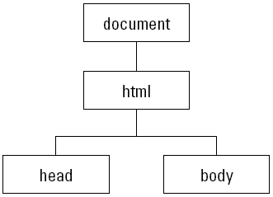
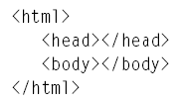
Element Hierarchy of an Empty HTML Document

Slide 68
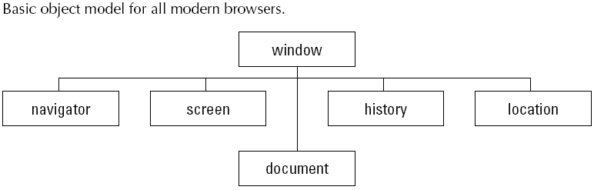
The DOM in a Browser Window

Slide 69
The DOM in a Browser Window
window object:
  Represents the content area of the browser window where HTML documents appear
  In a multiple-frame environment, each frame is also a window
  The outermost element of the object hierarchy
navigator object:
  read-only
  primarily to read the brand and version of browser

Slide 70
The DOM in a Browser Window
screen object:
  read-only
  about the physical environment
    the number of pixels high and wide available in the monitor
history object:
  this object assists a script in simulating a click of the Back or Forward button

Slide 71
The DOM in a Browser Window
location object:
  This object is the primary avenue to loading a different page into the current window or frame
document object:
  Each HTML document that gets loaded into a window becomes a document object
  Contains the content that you are likely to script
    Except for the html, head, and body element objects

Slide 72
The Document Object Model
DOM 0 is supported by all JavaScript-enabled browsers (no written specification)
DOM 1 was released in 1998
DOM 2 issued in 2000
  Nearly completely supported by NS7
  IE6’s support is lacking some important things
DOM 3 is the latest W3C specification
The DOM is an abstract model that defines the interface between HTML documents and application programs—an API

Slide 73
The Document Object Model
A language that supports the DOM must have a binding to the DOM constructs
In the JavaScript binding, XHTML elements are represented as objects and element attributes are represented as properties
e.g., <input type = "text" name = "address">
  would be represented as an object with two properties, type and name, with the values "text" and "address"

Slide 74
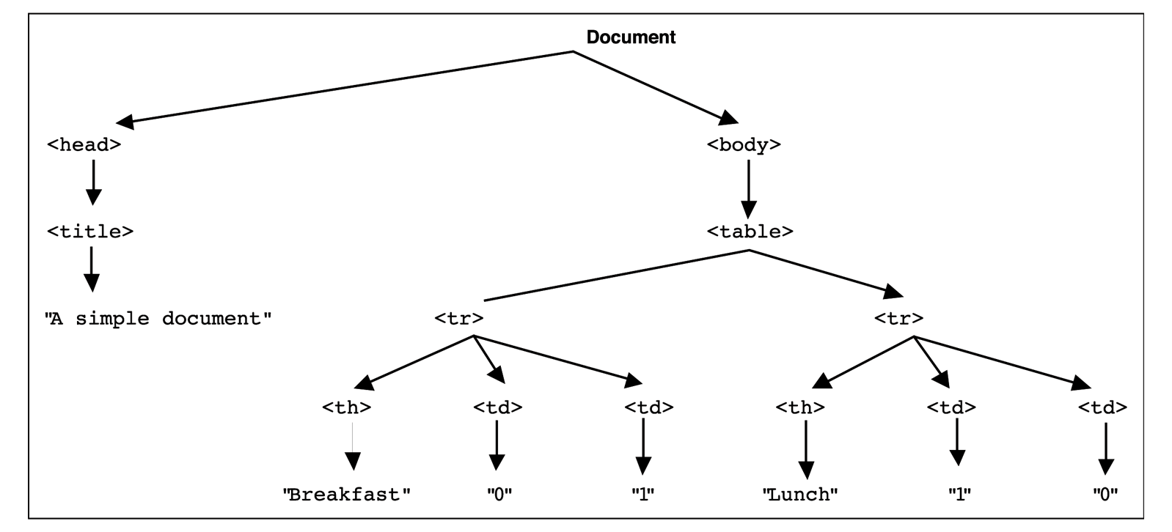
DOM Structure
<html xmlns = "http://www.w3.org/1999/xhtml">
<head> <title> A simple document </title>
</head>
<body>
<table>
<tr>
<th>Breakfast</th>
<td>0</td>
<td>1</td>
</tr>
<tr>
<th>Lunch</th>
<td>1</td>
<td>0</td>
</tr>
</table>
</body>
</html>

Slide 75
Element Access in JavaScript
There are several ways to do it
1. DOM address
  Example (a document with just one form and one widget):
  <form action = "">
  <input type = "button" name = "pushMe">
  </form>
  document.forms[0].elements[0]
  Problem: document changes

Slide 76
Element Access in JavaScript
2. Element names
  Requires the element and all of its ancestors (except body) to have name attributes
  Example:
<form name = "myForm" action = "">
<input type = "button" name = "pushMe">
</form>
  document.myForm.pushMe
  Problem: XHTML 1.1 spec doesn’t allow the name attribute in form elements
    Only validation problem, no difficulty for browsers

Slide 77
Element Access in JavaScript
3. getElementById Method (defined in DOM 1)
  Example:
<form action = "">
<input type = "button" id = "pushMe">
</form>
  document.getElementById("pushMe")
Form elements often have ids and names both set to the same value

Slide 78
Element Access in JavaScript
Checkboxes and radio button have an implicit array, which has their name
<form id = "toppingGroup">
<input type = "checkbox" name = "toppings"
value = "olives" />
...
<input type = "checkbox" name = "toppings"
value = "tomatoes" />
</form>
...
var numChecked = 0;
var dom = document.getElementById("toppingGroup");
for (index = 0; index < dom.toppings.length; index++)
if (dom.toppings[index].checked]
numChecked++;

Slide 79
Events and Event Handling
An event is a notification that something specific has occurred, either with the browser or an action of the browser user
An event handler is a script that is implicitly executed in response to the appearance of an event
The process of connecting an event handler to an event is called registration
Don’t use document.write in an event handler, because the output may go on top of the display

Slide 80
Events and their Tag Attributes
Event Tag Attribute
blur onblur
change onchange
click onclick
focus onfocus
load onload
mousedown onmousedown
mousemove onmousemove
mouseout onmouseout
mouseover onmouseover
mouseup onmouseup
select onselect
submit onsubmit
unload onunload

Slide 81
Events, Attributes and Tags
The same attribute can appear in several different tags
  e.g., The onclick attribute can be in <a> and <input>
A text element gets focus in three ways:
  When the user puts the mouse cursor over it and presses the left button
  When the user tabs to the element
  By executing the focus method

Slide 82
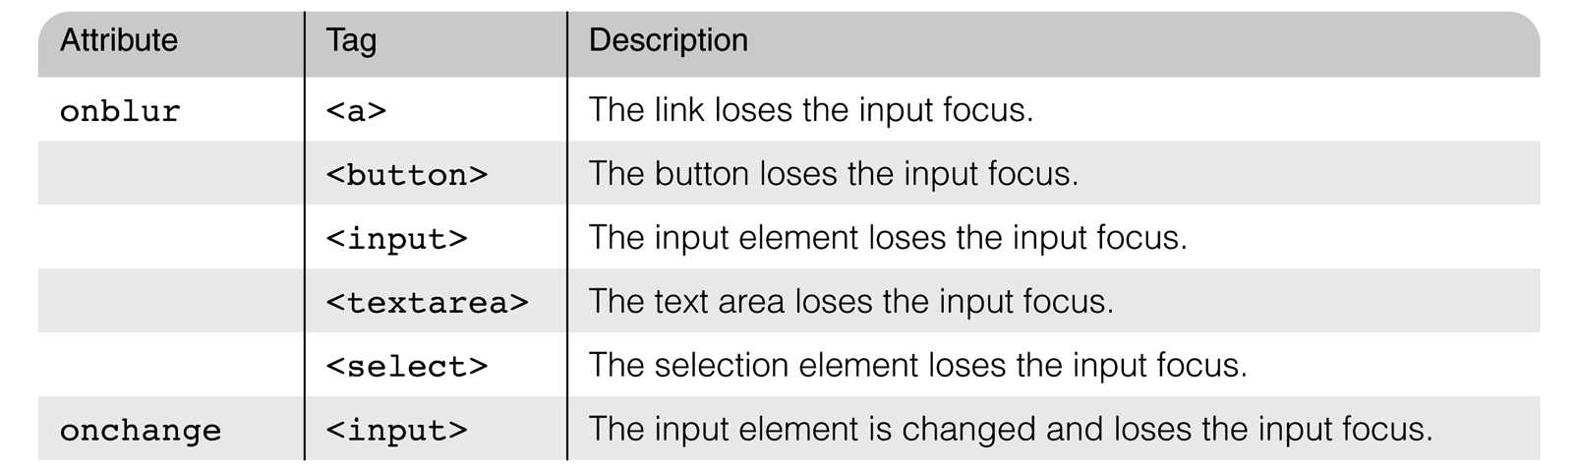
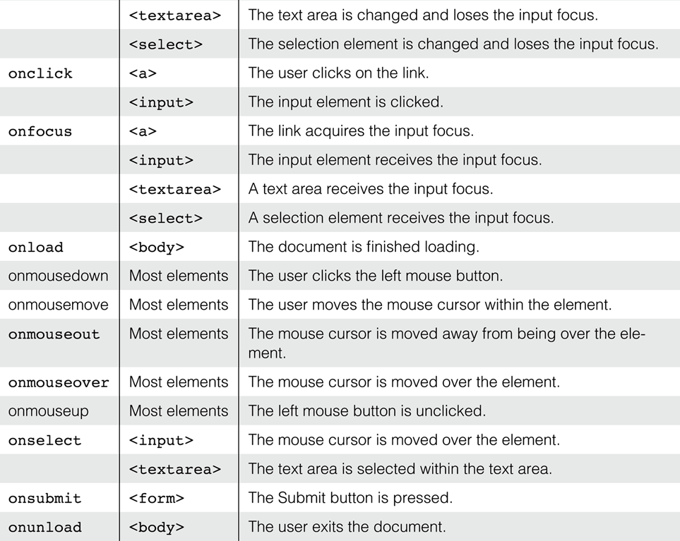

Slide 83
Registration of Event Handler
By assigning the event handler script to an event tag attribute
<input type “button” name = “myButton” onclick = "alert('Mouse click!');“ />
<input type “button” name = “myButton” onclick = "myHandler();" />

Slide 84
Handling Events from Body Elements
Events most often created by body elements are load and unload
Example:
  the load event - triggered when the loading of a document is completed

Slide 85
<html xmlns = "http://www.w3.org/1999/xhtml">
<head> <title> onLoad event handler </title>
<script type = "text/javascript">
// The onload event handler
function load_greeting () {
alert("You are visiting the home page of \n" +
“COMP205\n" +
"WELCOME!!!");
}
</script>
</head>
<body onload="load_greeting();">
<p />
</body>
</html>

Slide 86
Handling Events from Button
Elements
Plain Buttons – use the onclick property
Radio Buttons
  Example 1:
  http://www.cs.nott.ac.uk/~bnk/WPS/radio_click.html
    The handler is registered in the markup, so the particular button that was clicked can be sent to the handler as a parameter
  Exampe 2:
  http://www.cs.nott.ac.uk/~bnk/WPS/radio_click2.html
    The handler is registered by assigning it to a property of the JavaScript objects associated with the XHTML elements
    This registration must follow both the handler function and the XHTML form

Slide 87
Handling Events from Textbox and Password Elements
Checking Form Input
  A good use of JavaScript, because it finds errors in form input before it is sent to the server for processing
Things that must be done:
  Detect the error and produce an alert message
  Put the element in focus (the focus function) - puts the cursor in the element
  Select the element (the select function) - highlights the text in the element
To keep the form active after the event handler is finished, the handler must return false

Slide 88
Handling Events from Textbox and Password Elements
Example 1 – comparing passwords
  The form just has two password input boxes and Reset and Submit buttons
  The event handler is triggered by the Submit button
  http://www.cs.nott.ac.uk/~bnk/WPS/pswd_chk.html
Example 2 – checking the format of a name and phone number
  The event handler will be triggered by the change event of the text boxes for the name and phone number
  http://www.cs.nott.ac.uk/~bnk/WPS/validator.html

Slide 89
Dynamic XHTML
A XHTML document whose tag attributes, tag contents, or element style properties can be changed after the document has been and is still being displayed by a browser
Such changes are made with an embedded script (JavaScript) that accesses the elements of the document as objects in the associated DOM structure

Slide 90
Element Positioning
The position of any element is dictated by the three style properties: position, left, and top
  The three possible values of position are absolute, relative, and static
  <p style = "position: absolute; left: 50px;
  top: 100px;">
If position is set to either absolute or relative, the element can be moved after it is displayed
  Just change the top and left property values with a script
  http://www.cs.nott.ac.uk/~bnk/WPS/mover.html

Slide 91
Changing Colours and Fonts
Colour example:
http://www.cs.nott.ac.uk/~bnk/WPS/dynColors.html
  The actual parameter this.value works because at the time of the call, this is a reference to the text box (the element in which the call is made)
    So, this.value is the name of the new colour
Changing fonts example
http://www.cs.nott.ac.uk/~bnk/WPS/dynLink.html
  We can change the font properties of a link by using the mouseover and mouseout events to trigger a script that makes the changes

Slide 92
Dynamic Content
The content of an XHTML element is addressed with the value property of its associated JavaScript object
http://www.cs.nott.ac.uk/~bnk/WPS/dynValue.html

Slide 93
Reacting to a Mouse Click
A mouse click can be used to trigger an action, no matter where the mouse cursor is in the display
http://www.cs.nott.ac.uk/~bnk/WPS/anywhere.html
  Uses event handlers for onmousedown and onmouseup to change the visibility attribute of the message

Slide 94
Summary
The Document Object Model (DOM)
Element Access in JavaScript
Events and Event Handling
  Handling events from Body Elements
  Handling events from Button Elements
  Handling events from Text Box and Password Elements
Dynamic XHTML
  Element positioning and moving
  Changing Colours and Fonts
  Dynamic Content
  Reacting to a Mouse Click

