Slide 1
Chap 1
UML vs Thinking in Objects!
  Visual modeling
Learning UML
  Look at the book examples
  Alan Holub’s UML reference card
  Use library resources

Slide 2
Fig. 1.1

Slide 3
Object Design
Responsibilities
  Assigning responsibilities to objects!
Patterns

Slide 4
OOAD
OO Analysis – find and describe objects
  Concepts from the domain
OO Design
  Define software objects (classes)
Implementation
  Make design concrete in a programming langauge

Slide 5
Use Cases
Describe in text
Interaction of a user and the system
Be careful of implementation vs specification!

Slide 6
UML
UML as a sketch
UML as a blueprint
UML as a programming language

Slide 7
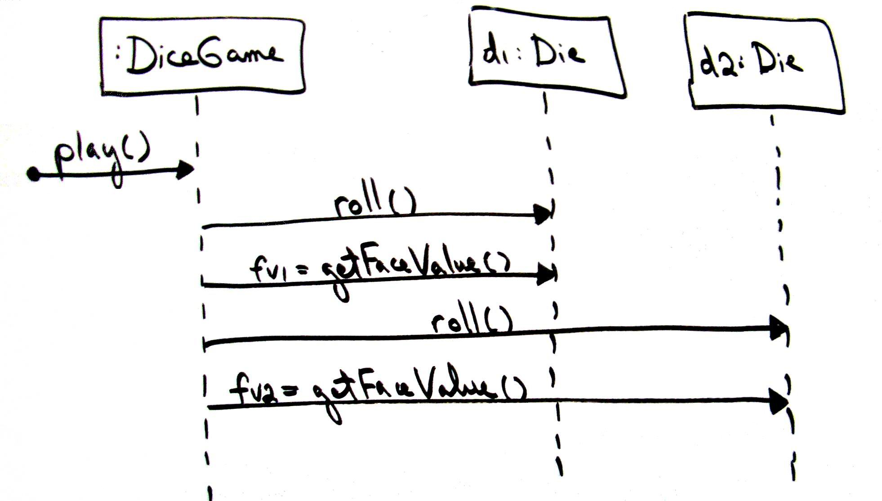
Fig. 1.4

Slide 8
UML Prespectives
Conceptual
  Real world concepts
  Domain model
Specification
Implementation
  Both of these deal with software

Slide 9
Fig. 1.5

Slide 10
Fig. 1.6

