Slide 1
Chapter 6
Use Case
  The interaction between an actor and the system

Slide 2
Why Use Cases
Understandable to a large audience
Focus on user goals and perspective
Primarily functional and behavioral
Warning - some requirements don’t fit in use cases!

Slide 3
Definitions
Actor
  Primary, supporter, offstage
  Scenario (a.k.a. use case instance)
Formats:
  Brief
  Causal
  Fully dressed

Slide 4
How to Find Use Cases
Choose system boundary
Identify primary actors
Identify goals of primary actors
Define use cases that satisfy the goals
Use case names should start with a verb!

Slide 5
Tests
Boss test - is the boss happy?
Elementary Business Process
  One person
  One place
  Measurable business value
  Leaves data in consistent state
Size test - fully dressed 3 - 10 pages

Slide 6
Fig. 6.1

Slide 7
Actors Change At System Boundaries

Slide 8
Fig. 6.3

Slide 9
Fig. 6.4

Slide 10
Fig. 6.5

Slide 11
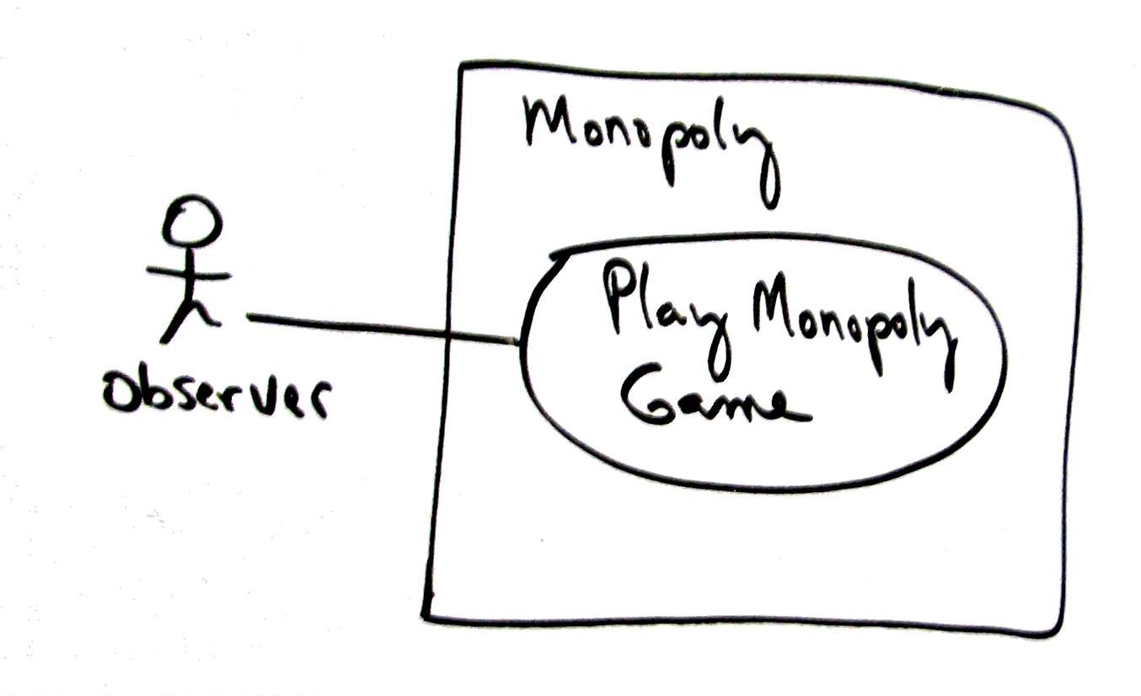
Fig. 6.6
Notes:
11

Slide 12
Fig. 6.6

Slide 13
Use cases in iterative methods
Initial use cases drive the first iteration
Near the end of an iteration:
  develop new requirements,
  elaborate existing use cases as needed
Next slide shows a requirements workshop

Slide 14
Fig. 6.7

Slide 15
Reliable Specifications
Agile advocates hold this as unrealistic
So
  Use the documents with care
  Control the amount of analysis
  Emphasize the acceptance by users

Slide 16
Artifacts
Supplementary Specifications
Glossary
Vision
Business Rules
These are not covered in the text

