Slide 1
Chapter 22 UML Tooks and UML as Blueprint
Model-Driven Architecture (MDA) Object-Constraint Language (OCL)

Slide 2
CASE TOOLS
Forward Engineering
code from diagrams
Reverse Engineering
diagrams from code
Round-Trip Engineering
either way – synchronize between code and diagrams
Static Diagrams are easy
Dynamic Modeling is hard

Slide 3
How to implement the process
Try the free tools first
Use the free tools to identify what you really need to do, and what is missing.
Give it to developers to use in real-life.
Make sure it supports your IDE.
Is the Reverse Engineering “good enough?”

Slide 4
Software as Abstraction
“The history of software development is a history of raising the level of abstraction.”
Mellor, Balcer, Executable UML.
Machine code => assembler => languages (C, Pascal) => object structure for data and behavior
Each step hides details, and required new tools for support

Slide 5
Executable UML
Eliminates programming and data design.
Execution derives from design diagrams.

Slide 6
Types of UML
Concept | Called | Modeled As | Expressed As
The world of things | Data | Classes Attributes Associations Constraints | UML class diagram
Things have lifecycles | Control | States Events Transition procedures | UML state-flow-chart diagram
Things do things at each stage | Algorithm | Actions | Action language State procedures Methods
From Mellor and Balcer, Executable UML

Slide 7
http://www.executableumlbook.com/
Download the Executable UML Models
The case study models in Executable UML are currently available for the BridgePoint Development Suite.
BridgePoint, available from Project Technology, provides a Model Builder for creating Executable UML models, a Model Verifier for executing these models, and a set of model compilers for generating complete system code from these models.
Step 1: Download the models
Download Zip File
Step 2: Download information on BridgePoint:
Using BridgePoint for Executable UML (PDF) Running the Case Study Models in BridgePoint (PDF) Note that this information is also contained within the Zip file above. Step 3: Request an evaluation copy of the BridgePoint Suite
Go to Request Form Note that this link takes you out of the Executable UML Book site.

Slide 8
Model Driven Architecture
Uses Model Compilers
Is built on
Platform Independent Model (PIM)
Executable UML
Still under definition

Slide 9
The MDA Process (1)
Separate the problem into multiple domains
“Semantically autonomous”
Build a model for the domain
Based on use cases
Find the classes
Understand the life-cycle (state machine)
etc.
Does this sound familiar?

Slide 10
The MDA Process (2)
“Compile your Executable UML models into an implementation.”
Choose a compiler, based on statistics and the desired end result.
Language, performance, repositories
Specialized “model compilers” for specific, well-structure domains (like telecom) have been around for more almost 20 years.

Slide 11
Object Constraint Language (OCL)
Formal language of logic to describe what a program should do (not how it does it).
Considered a subset of UML, to add details.
Similar to Operation Contracts, but done with a formal language
A type of pseudo-code as in the book.

Slide 12
Chapter 23
Iteration 2
What is different in the second iteration?
We have spent 8 weeks on iteration 1. In our fantasy project, what has been accomplished up to now?

Slide 13
Results of iteration 1
All software has been tested!
Unit
Acceptance
Load
Usability
Customer engagement
Integrated system
We have a partial solution that can be delivered.

Slide 14
Start of Iteration 2 - Not covered in text
Iteration planning meetings
Reverse engineering with UML tools
UI work
Databases
Requirements workshop at start of iteration 2

Slide 15
Risk and Business value
Tools to use in planning iterations!
Agile must always go back to business values.
Risk must be used to identify the most critical areas to implement first.

Slide 16
Iteration 2
Fix misses from iteration 1
Customer issues
Better understanding
Add some new requirements for iteration 2

Slide 17
Chapter 24
Quick Analysis Update on
the POS and
the MONOPOLY Game

Slide 18
NextGen POS
NEW requirements added in Iteration 2

Slide 19
NextGen POS
NEW INTERFACES added in Iteration 2
Access added to three new systems.

Slide 20
NextGen POS
NEW Domain Rules added in Iteration 2
New rules come from the Business Domain for implementation.

Slide 21
Next Gen POS
Uses cases ok
Original “fully dressed” use cases were extensive, covering all scenarios including errors and access.
SSD – needs some new external ops!
Support external actors!
Domain model is ok!
All this stuff was included

Slide 22
Fig. 23.1 SSD

Slide 23
Monopoly additional requirements
Add special square rules
Player gets $1500
Bank is unlimited
Passing go gives $200
Goto Jail : but get out next turn.
Income Tax - pay min($200, 10% of net)

Slide 24
Monopoly
Use cases ok
No new SSD ops
Domain model changes!

Slide 25
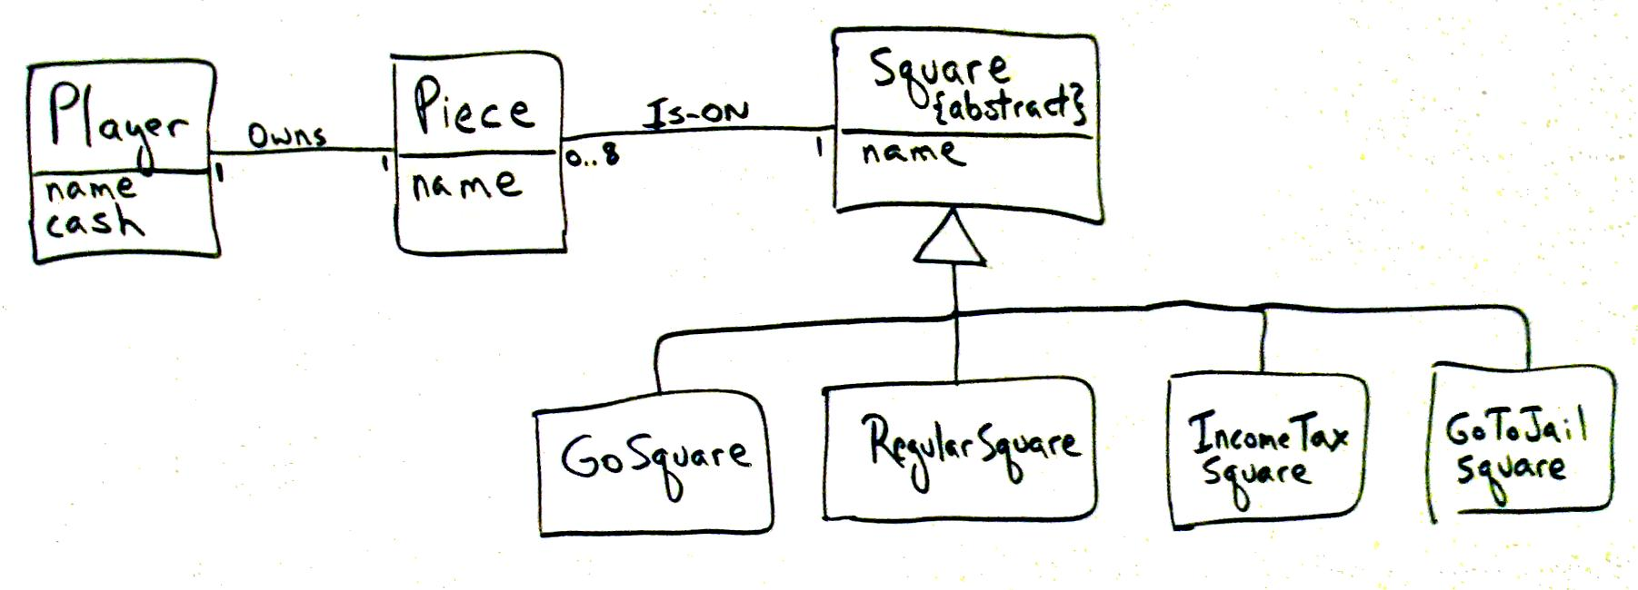
Fig. 23.2 New Domain Model

Slide 26
Summary
In both cases - add to functionality
Change the required artifacts
Go back to Domain Model, SSDs, Use Cases to see if updates are needed.
Use a Reverse-Engineering tool to create UML diagrams from code.
How does the R-E UML compare to the original?
Keep testing!

