Slide 1
Chapter 25
GRASP
The other four
What are the first five?
What is the goal/purpose of using patterns?

Slide 2
Why use patterns?
Decide how to divide responsibilities across objects.
Data structures
Methods
Common, shorthand terms to discuss design.
Get a feel for the underlying reasoning.
GRASP and GoF are similar (if not identical).

Slide 3
GRASP
Polymorphism
Indirection
Pure Fabrication
Protected Variations

Slide 4
Polymorphism
Handle alternatives based on type
Simplify methods by removing if-then-else and case statements
Easier extension to a new type, across multiple areas.
All methods can be put in one object.
aka Choosing Message or “Don’t ask ‘What Kind’”

Slide 5
Fig. 25.1

Slide 6
Implementation in Monopoly
Different types of squares require different behavior/actions/methods.
Switch on square.type
CASE GoSquare: player receives $200
Case IncomeTaxSquare: play pays tax
Etc.
What is the action that triggers this?

Slide 7
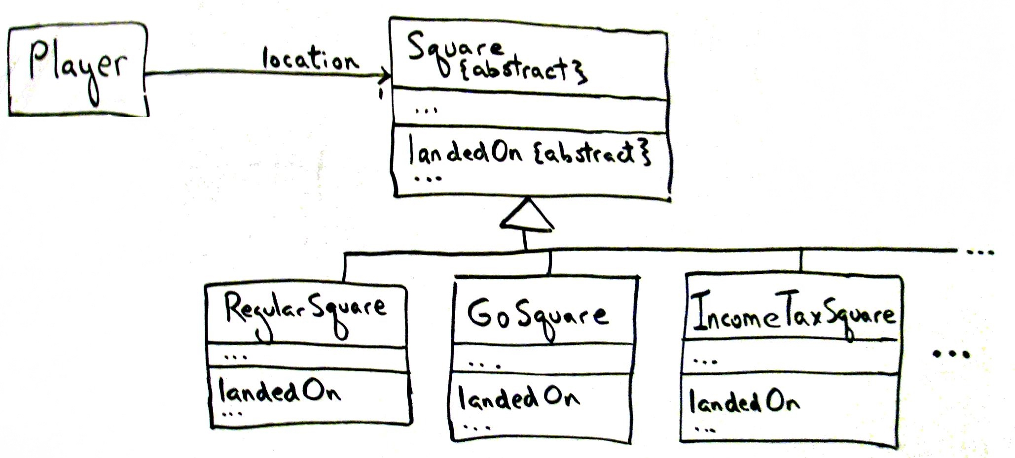
Fig. 25.2
Each square type has it’s own “landed-on” method.

Slide 8
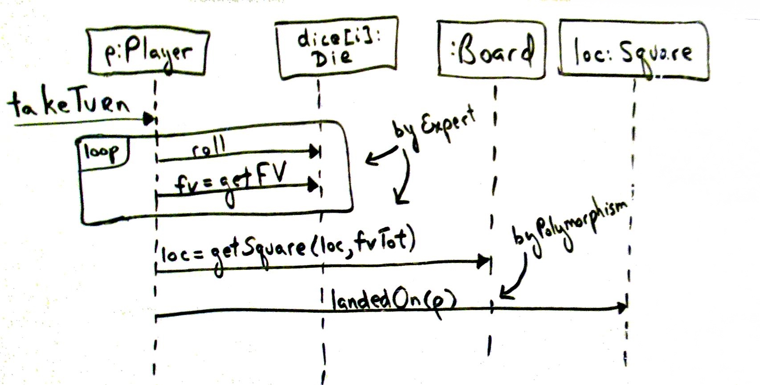
Fig. 25.3
i.e.
loc = square_12;
Square_12.landedOn(p);

Slide 9
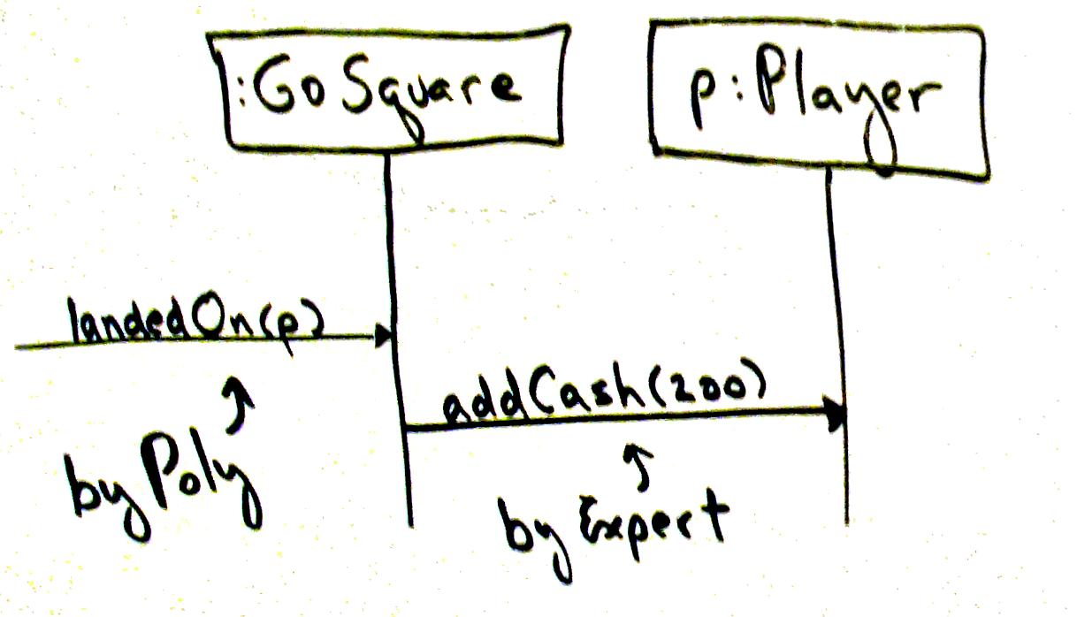
Fig. 25.4 Go Square
p.addCash(200);

Slide 10
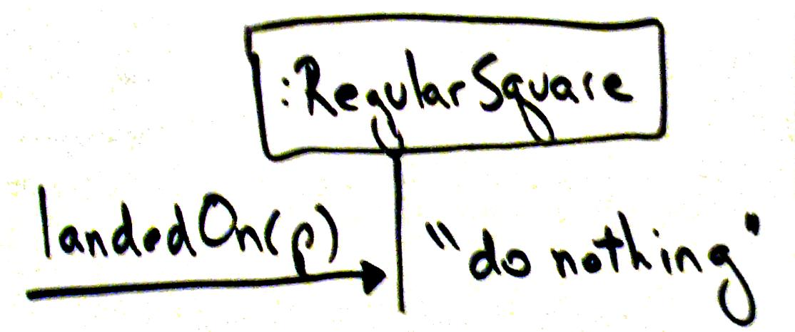
Fig. 25.5 Regular Square

Slide 11
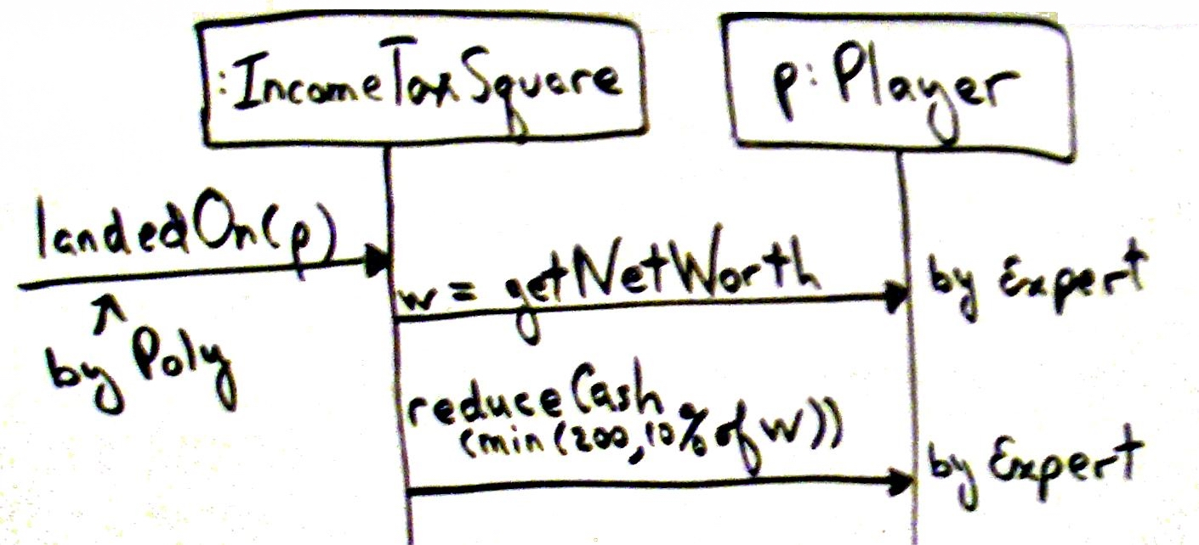
Fig. 25.6 Income Tax

Slide 12
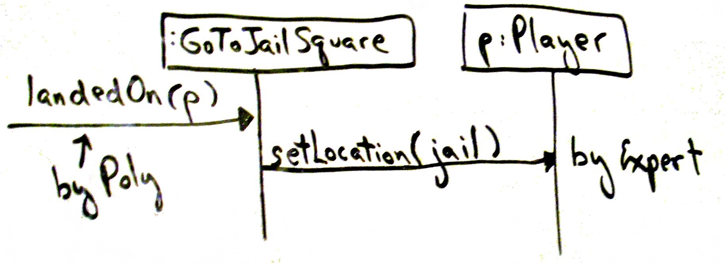
Fig. 25.7 Goto Jail

Slide 13
Improving coupling
Piece knows square, player does not
Therefore player needs to use piece too often
Refactor
In a simulation “piece” does not have a real purpose.

Slide 14
Interfaces
Choosing interfaces vs polymoprhism
An interface allows coupling without a specific class hierarchy.
With single-inheritance this can be too limiting.
Tradeoff near-term efforts with the possibility of future extensions.

Slide 15
Pure Fabrication
Assign a responsibility to avoid violations of High Cohesion and Low Coupling
Make up an object to assign a highly cohesive set of responsibilities

Slide 16
Example: Databases and Sale
Saving to database requires:
DB Task requires a large number of support operations, unrelated to main class
Sale Class has to be coupled to db connector
Saving in DB is a general task using many support classes
Fabricate DB persistence object
Database is NOT part of the Object Model
Persistent Storage
---------------------------
insert(Object)
Update(Object)

Slide 17
Dice in Monopoly
Dice can be more general that just in monopoly
Some games have a dice cup
Created with a number of dice
Created with dice having different number of sides (6, 12, 25, etc).

Slide 18
Fig. 25.8

Slide 19
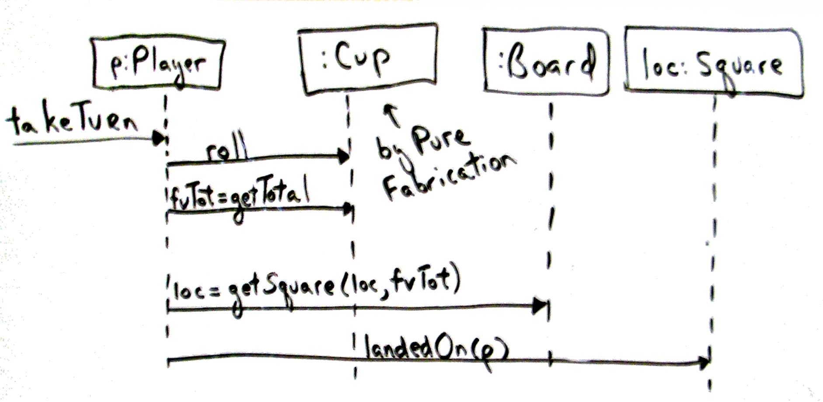
Fig. 25.9

Slide 20
Design of objects
Representaional decomposition
What the thing is in the domain
Behavioral decomposition
Algorithm in a “made up” object
Overuse turns into functional programming
An Object is ….
Pay attention to the data flows across objects.

Slide 21
Indirection
Avoid direct coupling by adding another object.
Supports re-use and future extensions.
Indirection and polymorphism can create an adapter object “to protect the inner design.”

Slide 22
Fig. 25.10
If TaxMaster is swapped out, or new Tax program added, the new code is isolated in the adapter.

Slide 23
Persistent Storage
Often a good use of indirection
Collect all the database operations together in one place.
Compare with GoF patterns coming up.

Slide 24
Protected Variations
Design object, subsystems or systems to reduce instability
Identify predicated points of variation and create a stable interface around them
Indirection, polymorphism, interfaces, adapter, encapsulation, information hiding, etc.
Hide structure and information in Data-driven design, Service lookups, uniform access, etc.
Replaces the pattern “Don’t Talk to Strangers.”
The farther the data, the more fragile the design.

Slide 25
Summary
Why use patterns?
What is the goal?
What is an object?
What are the 9 GRASP patterns? Where can you find the summary?

