Slide 1
How to insert equation symbols in Microsoft Word
By: Kristi Ryder

Slide 2
Purpose
There are many symbols that are used in Discrete Math that some students may not have used or seen before.
Examples of these symbols include but are not limited to: ∃(p→q)↔¬p≡∀(p ̅∨p). Finding these symbols in Microsoft Word can be frustrating, but this presentation should help alleviate some of that frustration.

Slide 3
Step One – Open Microsoft Word.
Step Two – Click on the insert tab.
The Insert Tab is located at the top of the window, where the blue arrow is pointing.

Slide 4
Step Three - Click on the equation Pi symbol or press the Alt and the = buttons at the same time. This will insert the space to write your equation and brings up several symbols you can use.
The equation symbol is located here. Where the blue arrow is pointing.

Slide 5
Step four – place your cursor inside the blue space on the page.

Slide 6
Step five -
Choose the symbol that you need by either clicking on one that you see at the top of the page, or if you do not see the symbol that you need click on the more symbol (in the symbols pane on the right side, it is the bottom button (it looks like a line above a down arrow)) This will bring up the basic math equation symbols.
(The screen shot is shown on the next slide.)
There are additional symbols, to obtain these continue on with these instructions.

Slide 7
Equation Symbols are here.
The more symbol is located here.

Slide 8
Step six - Click on the down arrow, a menu of different types of symbols will appear. Find the symbol you need and click on it.
Basic math down arrow is located here.

Slide 9
Additional Information
There will also be a need for a nested equation symbol. Begin by inserting an accent or fraction into an equation
Click the down arrow beneath the accent or fraction symbol. Choose the type that you need and it will be placed into the equation.
Then you may need to insert a symbol into the accent or fraction. Do this by simply placing your cursor inside the dotted square and inserting the symbol needed.
See the screen shot on the next page.

Slide 10
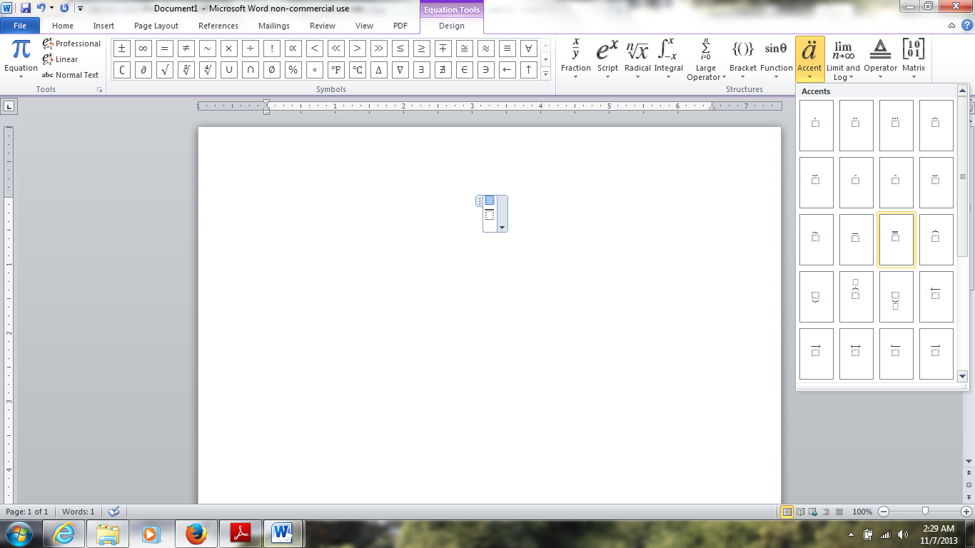
Accent symbols are found here.
When placing your cursor in the fraction it will become blue.

Slide 11
References
Gurak, L. J., & Hocks M. E. (2009). The
Technical Communication Handbook. Upper
Saddle River, NJ: Pearson Education Inc.

